Slide 1
Central Valley Transfer Project James Zimmerman Stan Carrizosa Sr. Craig Hayward Sr. Assoc VPDUE Tom Burke Assoc. VC, Analytics & innovation UC Merced CVHEC Coordinators Kern Community College District

Slide 2
UCM/CVHEC: Developing Transfer pathways to uc merced
Agenda
1. Welcome and Introductions
2. Phase I – UC Merced/BC/MC Progress from CELL Grant pilot
3. Onboarding process / CC preparation
4. Status Update: Implementation In-progress
5. Q and A

Slide 3
UCM + Merced College + Bakersfield College - Pilot
Convening BC/MC/UCM faculty and staff to work together on creating transfer pathways that connect Associate Degrees for Transfer (ADTs) to UC Merced majors. (COMPLETED)
Developing a two-semester Transfer experience course sequence at BC and MC that will encourage and prepare students to apply to UCM in the first semester and begin a cohort-model of integration into school culture (SNS, SSHA, SOE) in the second semester. (COMPLETED)
Developing Merced College program maps and gathering MC data and information pathways to prepare this data for loading in the program mapper interface. (In Progress)
Gathering data and information pathways on UC Merced undergraduate degree programs to prepare this data for loading in the program mapper interface. (COMPLETED)
Aligning Bakersfield College program maps, Merced College program maps, and Associate Degrees for Transfer (ADTs) to University of California-Merced undergraduate degree programs. (In Progress)

Slide 4
UCM + Merced C + Bakersfield C - Pilot
Convening BC/MC/UCM faculty and staff to work together on creating STEM transfer pathways that connect Associate Degrees for Transfer (ADTs) to UC Merced majors. (COMPLETED)
Developing a two-semester Transfer experience course sequence at BC and MC that will encourage and prepare students to apply to UCM in the first semester and begin a cohort-model of integration into school culture (SNS, SSHA, SOE) in the second semester. (COMPLETED)
Developing Merced College program maps and gathering MC data and information pathways to prepare this data for loading in the program mapper interface. (In Progress)
Gathering data and information pathways on UC Merced undergraduate degree programs to prepare this data for loading in the program mapper interface. (COMPLETED)
Aligning Bakersfield College program maps, Merced College program maps, and Associate Degrees for Transfer (ADTs) to University of California-Merced undergraduate degree programs. (In Progress)

Slide 5
UCM + Merced C + Bakersfield C - Pilot
Convening BC/MC/UCM faculty and staff to work together on creating STEM transfer pathways that connect Associate Degrees for Transfer (ADTs) to UC Merced majors. (COMPLETED)
Developing a two-semester Transfer experience course sequence at BC and MC that will encourage and prepare students to apply to UCM in the first semester and begin a cohort-model of integration into school culture (SNS, SSHA, SOE) in the second semester. (COMPLETED)
Developing Merced College program maps and gathering MC data and information pathways to prepare this data for loading in the program mapper interface. (COMPLETED)
Gathering data and information pathways on UC Merced undergraduate degree programs to prepare this data for loading in the program mapper interface. (COMPLETED)
Aligning Bakersfield College program maps, Merced College program maps, and Associate Degrees for Transfer (ADTs) to University of California-Merced undergraduate degree programs. (In Progress)

Slide 6
UCM + Merced C + Bakersfield C - Pilot
Convening BC/MC/UCM faculty and staff to work together on creating STEM transfer pathways that connect Associate Degrees for Transfer (ADTs) to UC Merced majors. (COMPLETED)
Developing a two-semester Transfer experience course sequence at BC and MC that will encourage and prepare students to apply to UCM in the first semester and begin a cohort-model of integration into school culture (SNS, SSHA, SOE) in the second semester. (COMPLETED)
Developing Merced College program maps and gathering MC data and information pathways to prepare this data for loading in the program mapper interface. (In Progress)
Gathering data and information pathways on UC Merced undergraduate degree programs to prepare this data for loading in the program mapper interface. (COMPLETED)
Aligning Bakersfield College program maps, Merced College program maps, and Associate Degrees for Transfer (ADTs) to University of California-Merced undergraduate degree programs. (In Progress)

Slide 7
UCM + Merced C + Bakersfield C - Pilot
Convening BC/MC/UCM faculty and staff to work together on creating STEM transfer pathways that connect Associate Degrees for Transfer (ADTs) to UC Merced majors. (COMPLETED)
Developing a two-semester Transfer experience course sequence at BC and MC that will encourage and prepare students to apply to UCM in the first semester and begin a cohort-model of integration into school culture (SNS, SSHA, SOE) in the second semester. (COMPLETED)
Developing Merced College program maps and gathering MC data and information pathways to prepare this data for loading in the program mapper interface. (In Progress)
Gathering data and information pathways on UC Merced undergraduate degree programs to prepare this data for loading in the program mapper interface. (COMPLETED)
Aligning Bakersfield College program maps, Merced College program maps, and Associate Degrees for Transfer (ADTs) to University of California-Merced undergraduate degree programs. (COMPLETED)

Slide 8
Two Primary Teams
(running in parallel)
----- Curriculum Pathway Team -----
Approval of discipline-based transfer pathways from CVCC to UC Merced
**Optional development of ½ CR transfer courses**
----- Program Mapper Team -----
Preparation of CVCC College, Program, and Course data for upload into Program Mapper

Slide 9
Curriculum Pathway team
1. Review ADT’s
BC/MC Program Maps
Align with CC Courses
Develop CC Pathway Template
2. Attend Convening(s)
CC faculty and counselors
UCM faculty and staff
Meet by discipline
Identify gaps, articulation issues, etc.
3. Build CC to UCM Maps
Create and edit maps
4. UCM / College Approval
Publish maps
Who’s responsible?
College
With Support from Concentric Sky
Who’s responsible?
College
With Support from UCM / CVHEC
Who’s responsible?
College and UCM
With Support from CVHEC
Who’s responsible?
College
With Support from UCM
Who’s responsible?
College & UCM

Slide 10
Program Mapper Team
Milestone: Data due to Concentric Sky
Milestone: Training
Milestone: Faculty Review
1. Gather Data
College Data
Interest Clusters/Meta Majors
Programs
Program Maps
Courses
Curriculum Area
2. Clean Data
Import data
Merge data from various sources
Identify duplicates
Fill in missing data
3. Build Maps
Create and edit maps
4. Launch Site
Publish maps
Who’s responsible?
College
With Support from Concentric Sky
Who’s responsible?
College
With Support from Program Mapper
Who’s responsible?
Program Mapper
With Support from College
Who’s responsible?
College
With Support from Program Mapper
Who’s responsible?
College
With Support from Program Mapper

Slide 11
Transfer Project Process
Grassroots Initiative/Transfer Project Approval
(CC appoints Transfer Project Teams)
Curriculum Pathway Team Convenings
(CC selects ADTs they wish to review/include in the lower division course sequencing. A joint convening of faculty reps from each discipline held to review ADTs for alignment to upper division major course requirements. This now only requires one scheduled in-person meeting w/ respective homework. Convenings are facilitated by CVHEC/UC Merced project leads)
Program Mapper Team Convenings
(Reviewed/approved ADTs are prepared for uploading into Program Mapper. A convening of reps from CC Transfer/Articulation, IT, join with Program Mapper staff to complete simple steps to prepare for curricular data uploading. This requires scheduled zoom meetings w/ respective homework.
Publish Two-year Maps and Transfer Maps
Program Mapper staff helps CCs complete final upload/publishing of all completed course sequence maps by discipline. Associate degree maps can now be linked to Upper Division maps at partner universities

Slide 12
Program Pathways Mapper – Community College Partner Status
CC Partner | Initial Meeting | Faculty Convening | CC Maps approved | UCM Maps approved | CC P. Mapper Onboarding | Maps completed | Project Chronology
Merced | ✅ | ✅ | ✅ | ✅ | ✅ | ✅ | Phase 1 – Pilot (2020-22)
Bakersfield | ✅ | ✅ | ✅ | ✅ | ✅ | ✅
Porterville | ✅ | ✅ | ✅ | ✅ | Fall 2022 | Fall 2022 | Phase 2 – UCM CVHEC (2022)
Clovis | ✅ | ✅ | ✅ | ✅ | Fall 2022 | Fall 2022
Reedley | ✅ | ✅ | ✅ | ✅ | Fall 2022 | Fall 2022
WH - Lemoore | ✅ | ✅ | ✅ | ✅ | Fall 2022 | Fall 2022
Madera | ✅ | ✅ |  |  |  |  | Phase 3 – Initial Central Valley Scale-up
Sequoias | ✅ | Fall 2022
Taft College | Fall 2022
WH -Coalinga | Fall 2022
Columbia | Spring 2023
SJ Delta | Spring 2023 |  |  |  | ✅
Modesto | Spring 2023 |  |  |  | ✅
Cerro Coso | Spring 2023
Fresno CC

Slide 13
Program Pathways Mapper – UC Merced degree Programs Status
Completed | Near Completion | Near Completion | On-deck
Applied Mathematical Sciences | Material Sciences and Engineering | Computer Science and Engineering | Bioengineering
Biological Sciences | Anthropology | Management and Business Economics | Civil Engineering
Chemical Sciences | History | Political Science | Critical Race and Ethnic Studies
Physics | Economics | Cognitive Science | Global Arts Studies Program
Psychology | English | Environmental Systems Science
Sociology | Philosophy | Public Health
Environmental Engineering | Spanish

Slide 14
PPM’s value proposition for students
What students are saying about PPM
[Program Mapper] puts you at ease as a college student, like, okay, this is what I need to do. This is what has to happen next. . . .[I like] just how simple it is and how organized it is. I think that's my favorite part.
The salary growth and career section helped me to get a stepping-stone into researching more specifics about what I wanted to start a career in.
It's really useful to figure out which [classes] can transfer over into your certain area to the certain [transfer destination] because you don't want to take a class that's not going to mean anything.
If you follow Program Mapper or the pathways, you probably could have gotten everything out of the way and then been done on time. . . So it helps you with efficiency and being clear about how to get out as quickly as possible.

Slide 15
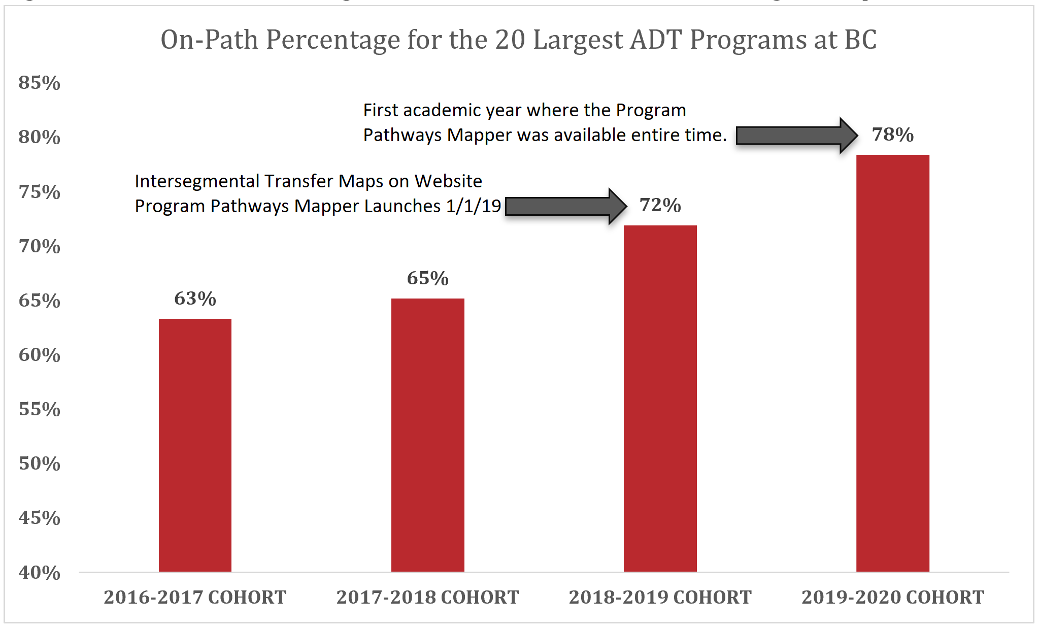
Evidence of PPM Effectiveness Student Course-Taking Becomes More Focused
Source: Bakersfield College
Notes:
Ultimately, increasing OPP will result in more students graduating and more students graduating more efficiently.

Slide 16
Evidence of PPM Impact on Equity The PPM has already advanced the equity agenda
Source: Bakersfield College
Notes:
Among students pursuing an ADT, White students increased their on-path percentage by 11 percentage points while Black students increased by 15 percentage points and Latinx students increase by 18 percentage points. PPM levels the playing field by elucidating the hidden curriculum in a radically transparent way. This promotes diversity, equity, and inclusion goals as well as completion goals

Slide 17
Reducing Units Earned at Degree Completion

Slide 18
Q and A
We are happy to answer any questions you might have.
jzimmerman6@ucmerced.edu
tburke5@att.net
craig.hayward@kccd.edu
scarrizosa44@gmail.com

