Slide 1
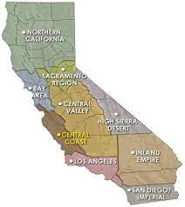
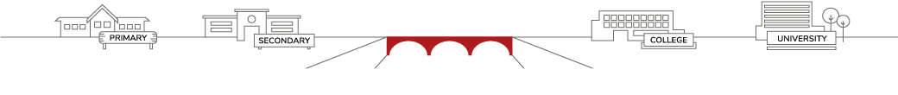

The State of
Mathematics in California
Presenter: Lynn Cevallos, Ed.D.
Founder & President, College Bridge
Notes:
owynn

Slide 2
01
20 Years of CA Math.
K12 – CCC – CSU – UC
Presentation
02
Where Are We Now?
The Looming Crisis.
Flow
03
The Path Forward.
Building Bridges.

Slide 3

How Many People Consider Themselves Bad at Math?
0 = none
1 = rare/few
2 = common/many

Slide 4
  Are We Bad At Math?
  The CSU Early Assessment Program (EAP), launched 2003
California Standards Test Outcomes for 11th Graders in 2010
Race | Juniors in Algebra II or Higher who took the EAP | College Math Readiness Rate (passing EAP score “Advanced”)
Asian | 78% (n = 34,193) | 35% (n = 11,968)
White | 54% (n = 77,306) | 17% (n = 13,142)
Hispanic | 39% (n = 88,677) | 6% (n = 5,321)
Black | 34% (n = 12,322) | 4% (n = 493)

Slide 5
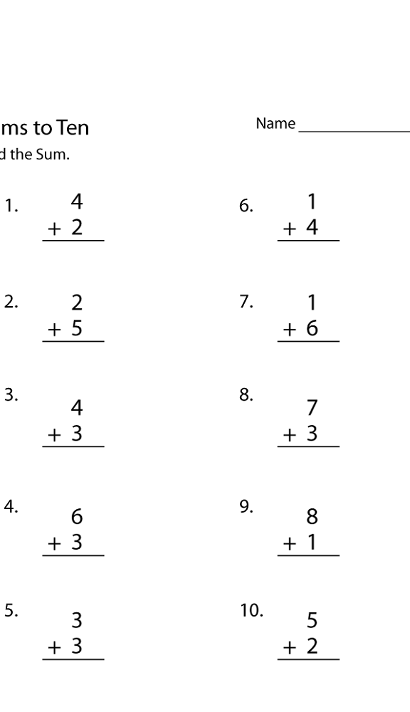
  What Was Happening 2003 - 2010?
  Focus on foundational knowledge and basic skills
New Courses
Algebra Readiness (9th grade)
Intervention
K-12
CCC
Basic Skills Initiative
New Developmental Math Classes
New Role
Developmental Math Coordinators
CSU

Slide 6
  Math Readiness and Completion in LA’s Community Colleges
72% Completed
First-time-freshmen Fall, 2009
40% Completed
Six-year completion rate

Slide 7
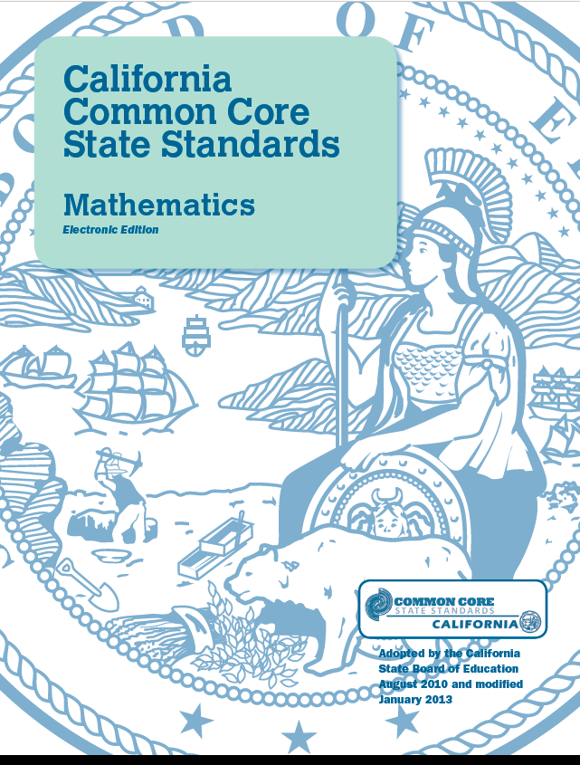
Common Core Math
Focus – Coherence - Rigor
Race to the Top announced June 2009 encouraging states to adopt by August 2010.
California eligible for $350M - $700M award.
“The Common Core
will fix all this.”
The culprit

Slide 8


  What Was Happening in Higher Ed in 2010?
Launched in
Summer 2010
Pilot Year with CCCs
2011-2012:
American River
Foothill
Mt. Sac
Pierce
San Diego City

Slide 9
  Academic Senate of the CSU, Sept. 2015
ESTABLISHING A TASK FORCE ON THE REQUIREMENTS OF CSU GENERAL EDUCATION (GE) MATHEMATICS / QUANTITATIVE REASONING (B4) CREDIT
RESOLVED: That the Academic Senate of the California State University (ASCSU) appoint a task force to address two fundamental questions.
Can the pre-requisite content for the CSU GE B4 course be met concurrently with achieving the CSU GE B4 standards?
b. What should be the pre- (potentially co-) requisite content for quantitative reasoning and mathematical competency (CSU GE B4)?¹
¹Executive Order 1100 specifies Intermediate Algebra; the math council statement advocates for ELM content; Statway includes a lesser amount of algebra.
AS-3230-15/APEP/AA September 3-4, 2015

Slide 10
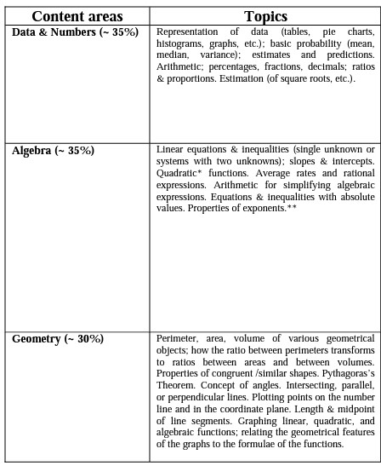
  Entry Level Math (ELM)
“ELM competency --- including sound evaluation of
graphs, statistics and numerical information ---
is vital to an informed citizenry.”
– CSU Academic Senate

Slide 11
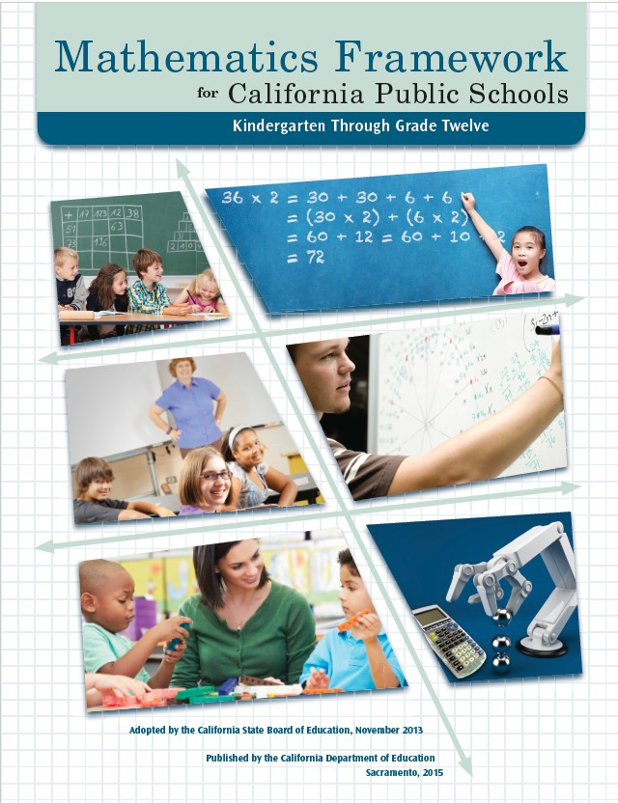
Between 2003 and 2009, 8th graders taking Algebra I increased from 32 percent to 54 percent.
01
The grade-eight standards in the CA CCSSM are significantly more rigorous than the previous Algebra I standards.
02
03
Acceleration begins as early as Grade 6.
Access all 900 pages here.
The culprit

Slide 12
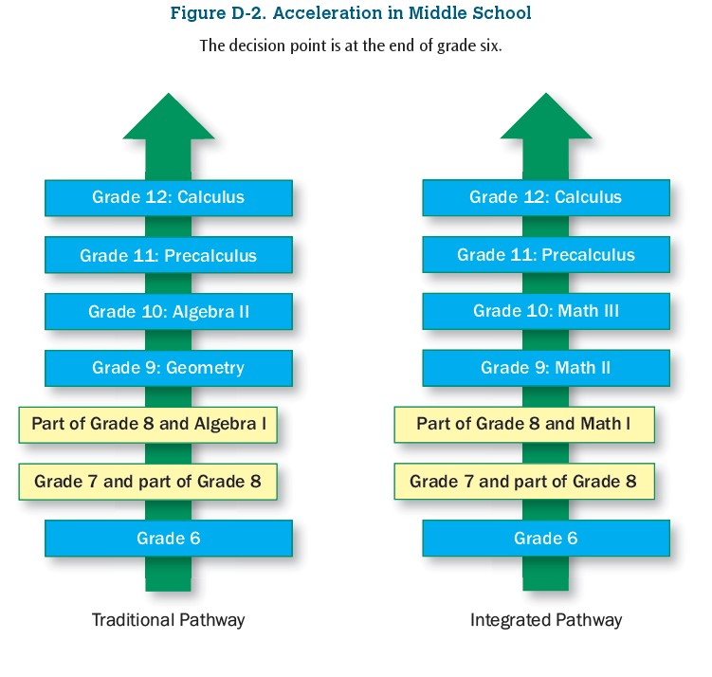
  Accelerated Math
  The Race to Calculus

Slide 13
  Framework’s Caution for Acceleration
Although the increase in grade-eight enrollment in Algebra I resulted in greater percentages of grade-eight students achieving either “Proficient” or “Advanced” on the Algebra I California Standards Test, it also led to larger numbers of grade-eight students achieving “Far Below Basic” or “Below Basic” on the test (Williams et al. 2011).
11th Grade CAASPP Performance Level | Pre-Calc-Calc (Accelerated) |  | Algebra 2/Math III (On-Track) |  | All Others (Repeaters) |  | Total Students
 | Schools A, B, D, E | Schools C, F, N | Schools A, B, D, E | Schools C, F, N | Schools A, B, D, E | Schools C, F, N | Schools A, B, D, E | Schools C, F, N
 | n = 289 | N/A | n = 776 | n = 420 | n = 259 | n = 212 | n = 1324 | n = 632
4 | 38% |  | 2% | 16% | 1% | 3% | 9% | 12%
3 | 42% |  | 14% | 32% | 9% | 7% | 19% | 24%
2 | 14% |  | 33% | 31% | 12% | 33% | 25% | 32%
1 | 7% |  | 51% | 20% | 79% | 57% | 47% | 32%
Districts of Schools A, B, D, E offer acceleration in math.

Slide 14
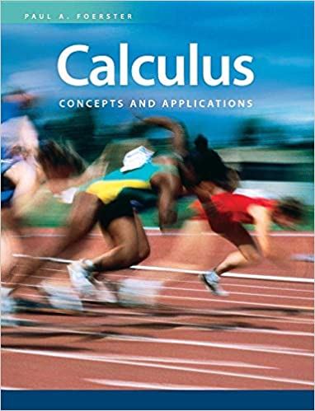

  Accelerated Math
  The Race to Calculus
  A Great School;
  A Cautionary Tale

Slide 15

California Math Placement Act of 2015
(Added by Stats. 2015, Ch. 508, Sec. 2. (SB 359) Effective January 1, 2016.)
SB 359
EC 51224.7
Adopt a fair, objective, and transparent mathematics placement policy for pupils entering grade 9…

Slide 16
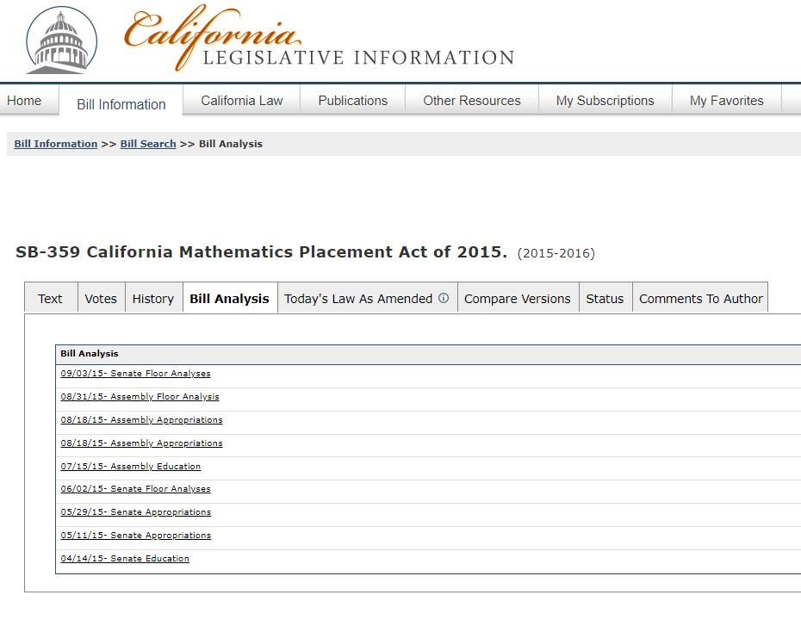
California Math Placement Act of 2015
SB-359 CA Legislative Information

Slide 17
California Math Placement Act of 2015
Need for the bill. According to the author’s office, “Math misplacement occurs when 9th grade students are held back to repeat their 8th grade math course…
Most universities, including the California State University and the University of California, require at least three years of math for college eligibility and prefer students who have taken high-level math courses such as Calculus or Advanced Placement Statistics.”
What causes math misplacement?
Lack of coordination between middle and high schools.
Wide variation in course names.
Concern in high schools about quality of 8th grade algebra courses.

Slide 18
Common Core Math
Coherence
How does the Common Core link the topic of exponents across grade levels?
Conversation with my son who just completed 5th grade. June 2017.
The culprit

Slide 19
Common Core Math
Coherence
5NBT2
Explain patterns in the number of zeros of the product when multiplying a number by powers of 10, and explain patterns in
the placement of the decimal point when a decimal is multiplied or divided by a power of 10. Use whole-number exponents
to denote powers of 10.
The culprit

Slide 20
  The Common Core Was Supposed to Fix All of This
College Math Readiness Rates via the EAP, by Race and Income (2018)
2018 EAP Data (Level 4 CAASPP) | Number of Juniors* | College Math Ready
All Students | 437,883 | 13% (56,443)
Race
Asian | 42,593 | 44% (18,741)
White | 104,873 | 19% (19,926)
Hispanic | 232,433 | 5% (11,622)
Black | 24,015 | 3% (720)
Economic Status
Low-Income | 252,960 | 6% (15,304)
NOT Low-income | 184,923 | 22% (41,164)
*Only juniors with test scores are included in the calculation.

Slide 21
  The Common Core Was Supposed to Fix All of This

Slide 22
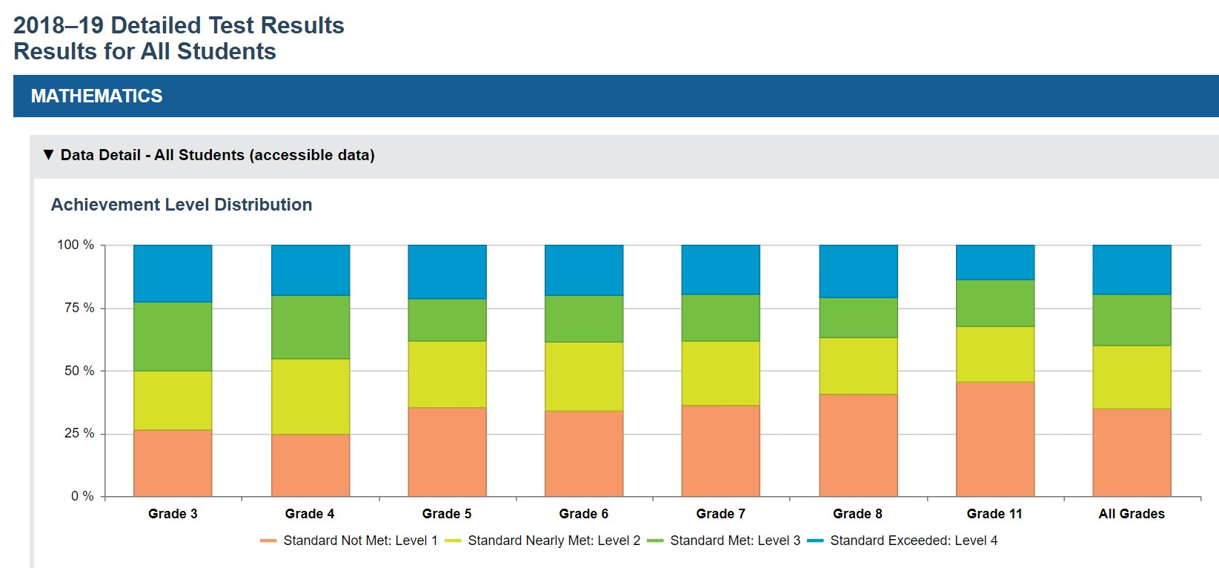
  The Common Core Was Supposed to Fix All of This
https://caaspp-elpac.ets.org/caaspp/

Slide 23
01
Retires ELM
Placement Test.
Requires multiple measures for placement.
CSU
02
Executive Order 1110 (EO 1110)
Issued August 2, 2017
Eliminates stand-alone developmental math pre-requisite courses.
03

Slide 24
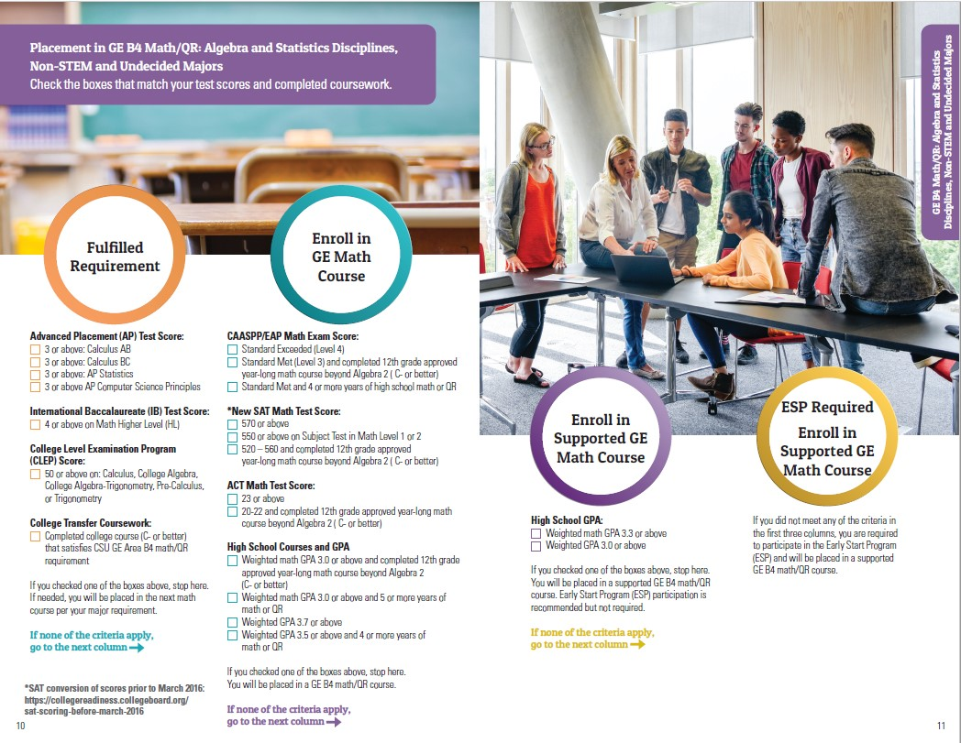
CSU
Math
Placement
(2017)

Slide 25
CCC Assembly Bill 705
[Approved by Governor October 13, 2017. Filed with Secretary of State October 13, 2017.]
Prohibits use of placement tests.
01
CCC
02
Requires multiple measures for placement.
Restricts requirement of remedial courses.
03
AB 705 CA Legislative Information

Slide 26
High School Performance Metric for Statistics/Liberal Arts Mathematics | Recommended AB 705 Placement for Statistics/Liberal Arts Mathematics
HSGPA ≥ 3.0 Success rate = 75% | Transfer-Level Statistics/Liberal Arts Mathematics No additional academic or concurrent support required for students
HSGPA from 2.3 to 2.9 Success rate = 50% | Transfer-Level Statistics/Liberal Arts Mathematics Additional academic and concurrent support recommended for students
HSGPA < 2.3 Success rate of 29% | Transfer-Level Statistics/Liberal Arts Mathematics Additional academic and concurrent support strongly recommended for students
AB 705
Math Placement

Slide 27
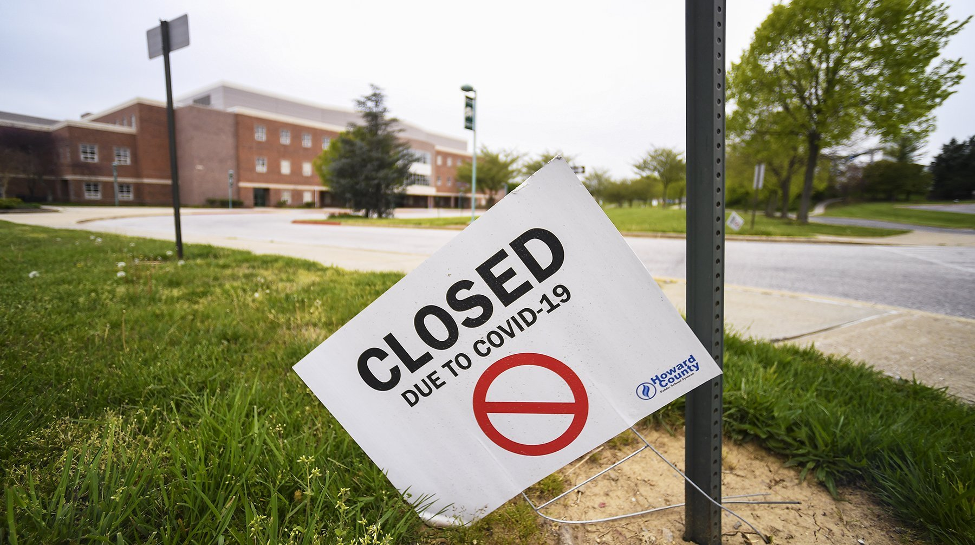
March 13, 2020

Slide 28


Slide 29
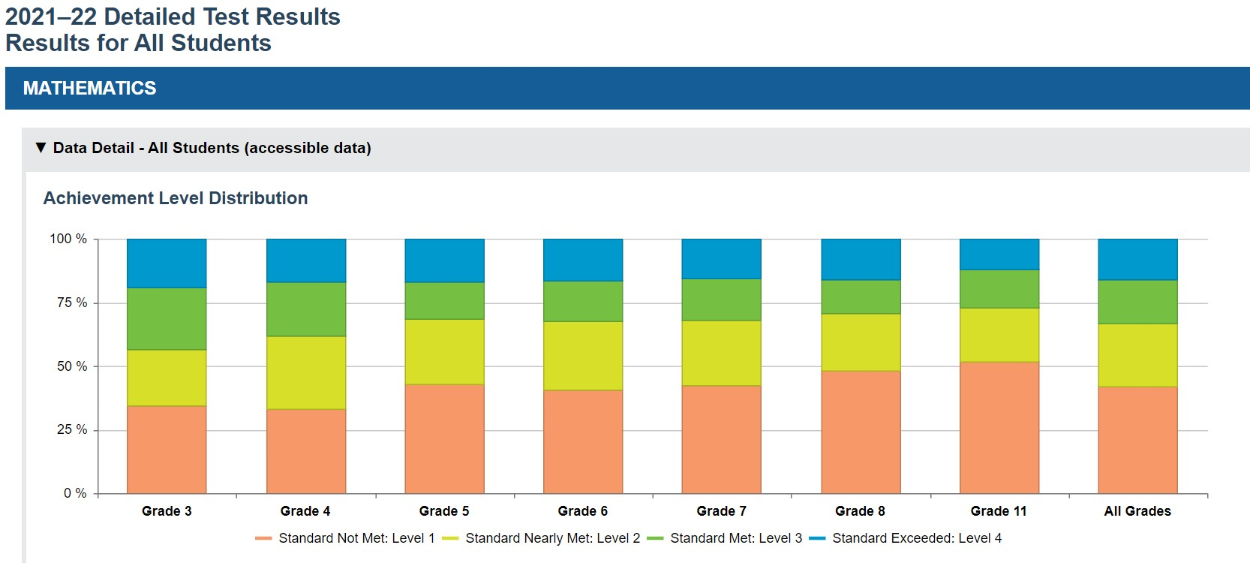
  CAASPP Outcomes, 2022

Slide 30
  The Learning Loss?
2019
2022

Slide 31
01
20 Years of CA Math.
K12 – CCC – CSU – UC
Presentation
02
Where Are We Now?
The Looming Crisis.
Flow
03
The Path Forward.
Building Bridges.

Slide 32
CCC Assembly Bill 1705
[Approved by Governor Sept 30, 2022. Filed with Secretary of State Sept 30, 2022.]
Stronger enforcement of AB 705.
01
CCC
02
Prohibits repetition of courses passed in high school.
03
Restricts time to Calculus.
AB 705 CA Legislative Information

Slide 33
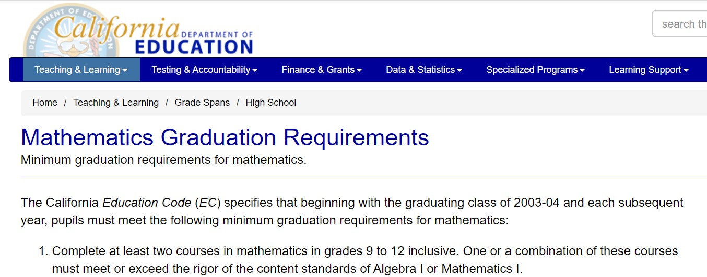
  High School Math Requirement
https://www.cde.ca.gov/ci/gs/hs/hsgrmath.asp
See also EC Section 51224.5

Slide 34
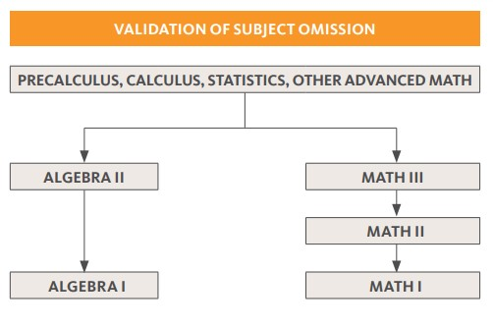
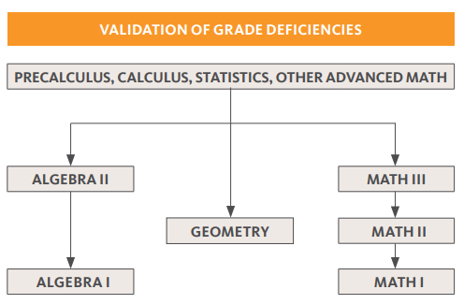
  UC Validation Policy
Quick Reference Guide to UC Admissions, August 2022
When a student has successfully completed advanced work (earning a grade of C or better) in an area of sequential knowledge, the students is presumed to have completed the lower-level coursework.

Slide 35
Mathematics Framework Revision Timeline
Timeline approved by the State Board of Education on May 8, 2019; revised on September 11, 2019, May 7, 2020, July 14, 2021, November 3, 2021, and July 13, 2022.
Proposed Framework and updates.
The culprit

Slide 36
01
20 Years of CA Math.
K12 – CCC – CSU – UC
Presentation
02
Where Are We Now?
The Looming Crisis.
Flow
03
The Path Forward.
Building Bridges.

Slide 37
Dual Enrollment Math Bridge
A Seamless Transition for Students
High School Math Program
Gateway College Math Course
11th or 12th grade

Slide 38
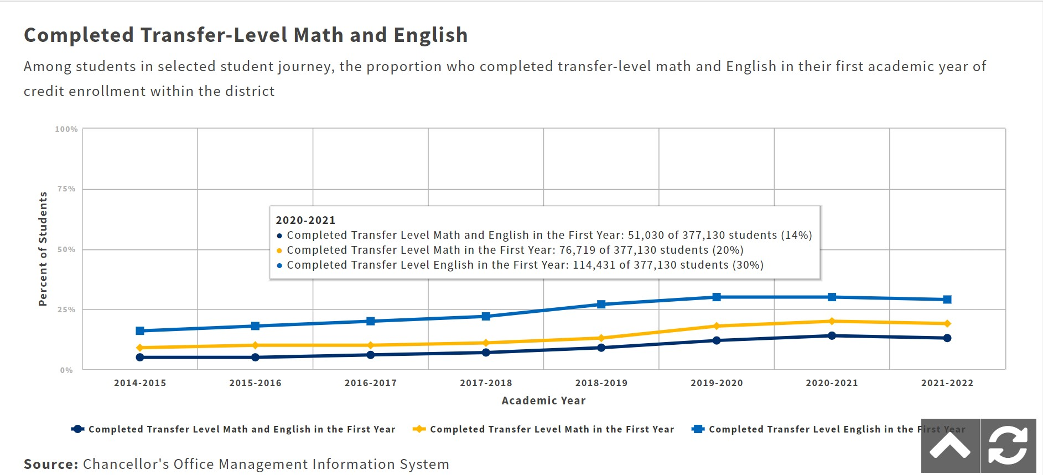
Target Population
Students Avoiding Math

Slide 39



Transfer-Level Math Pass Rates
Completion within One Year
84%
(N = 1,889)
Math Bridge High School Students
54%
(N = 137,529)
All Community College Students
(including Special Admits)

Slide 40
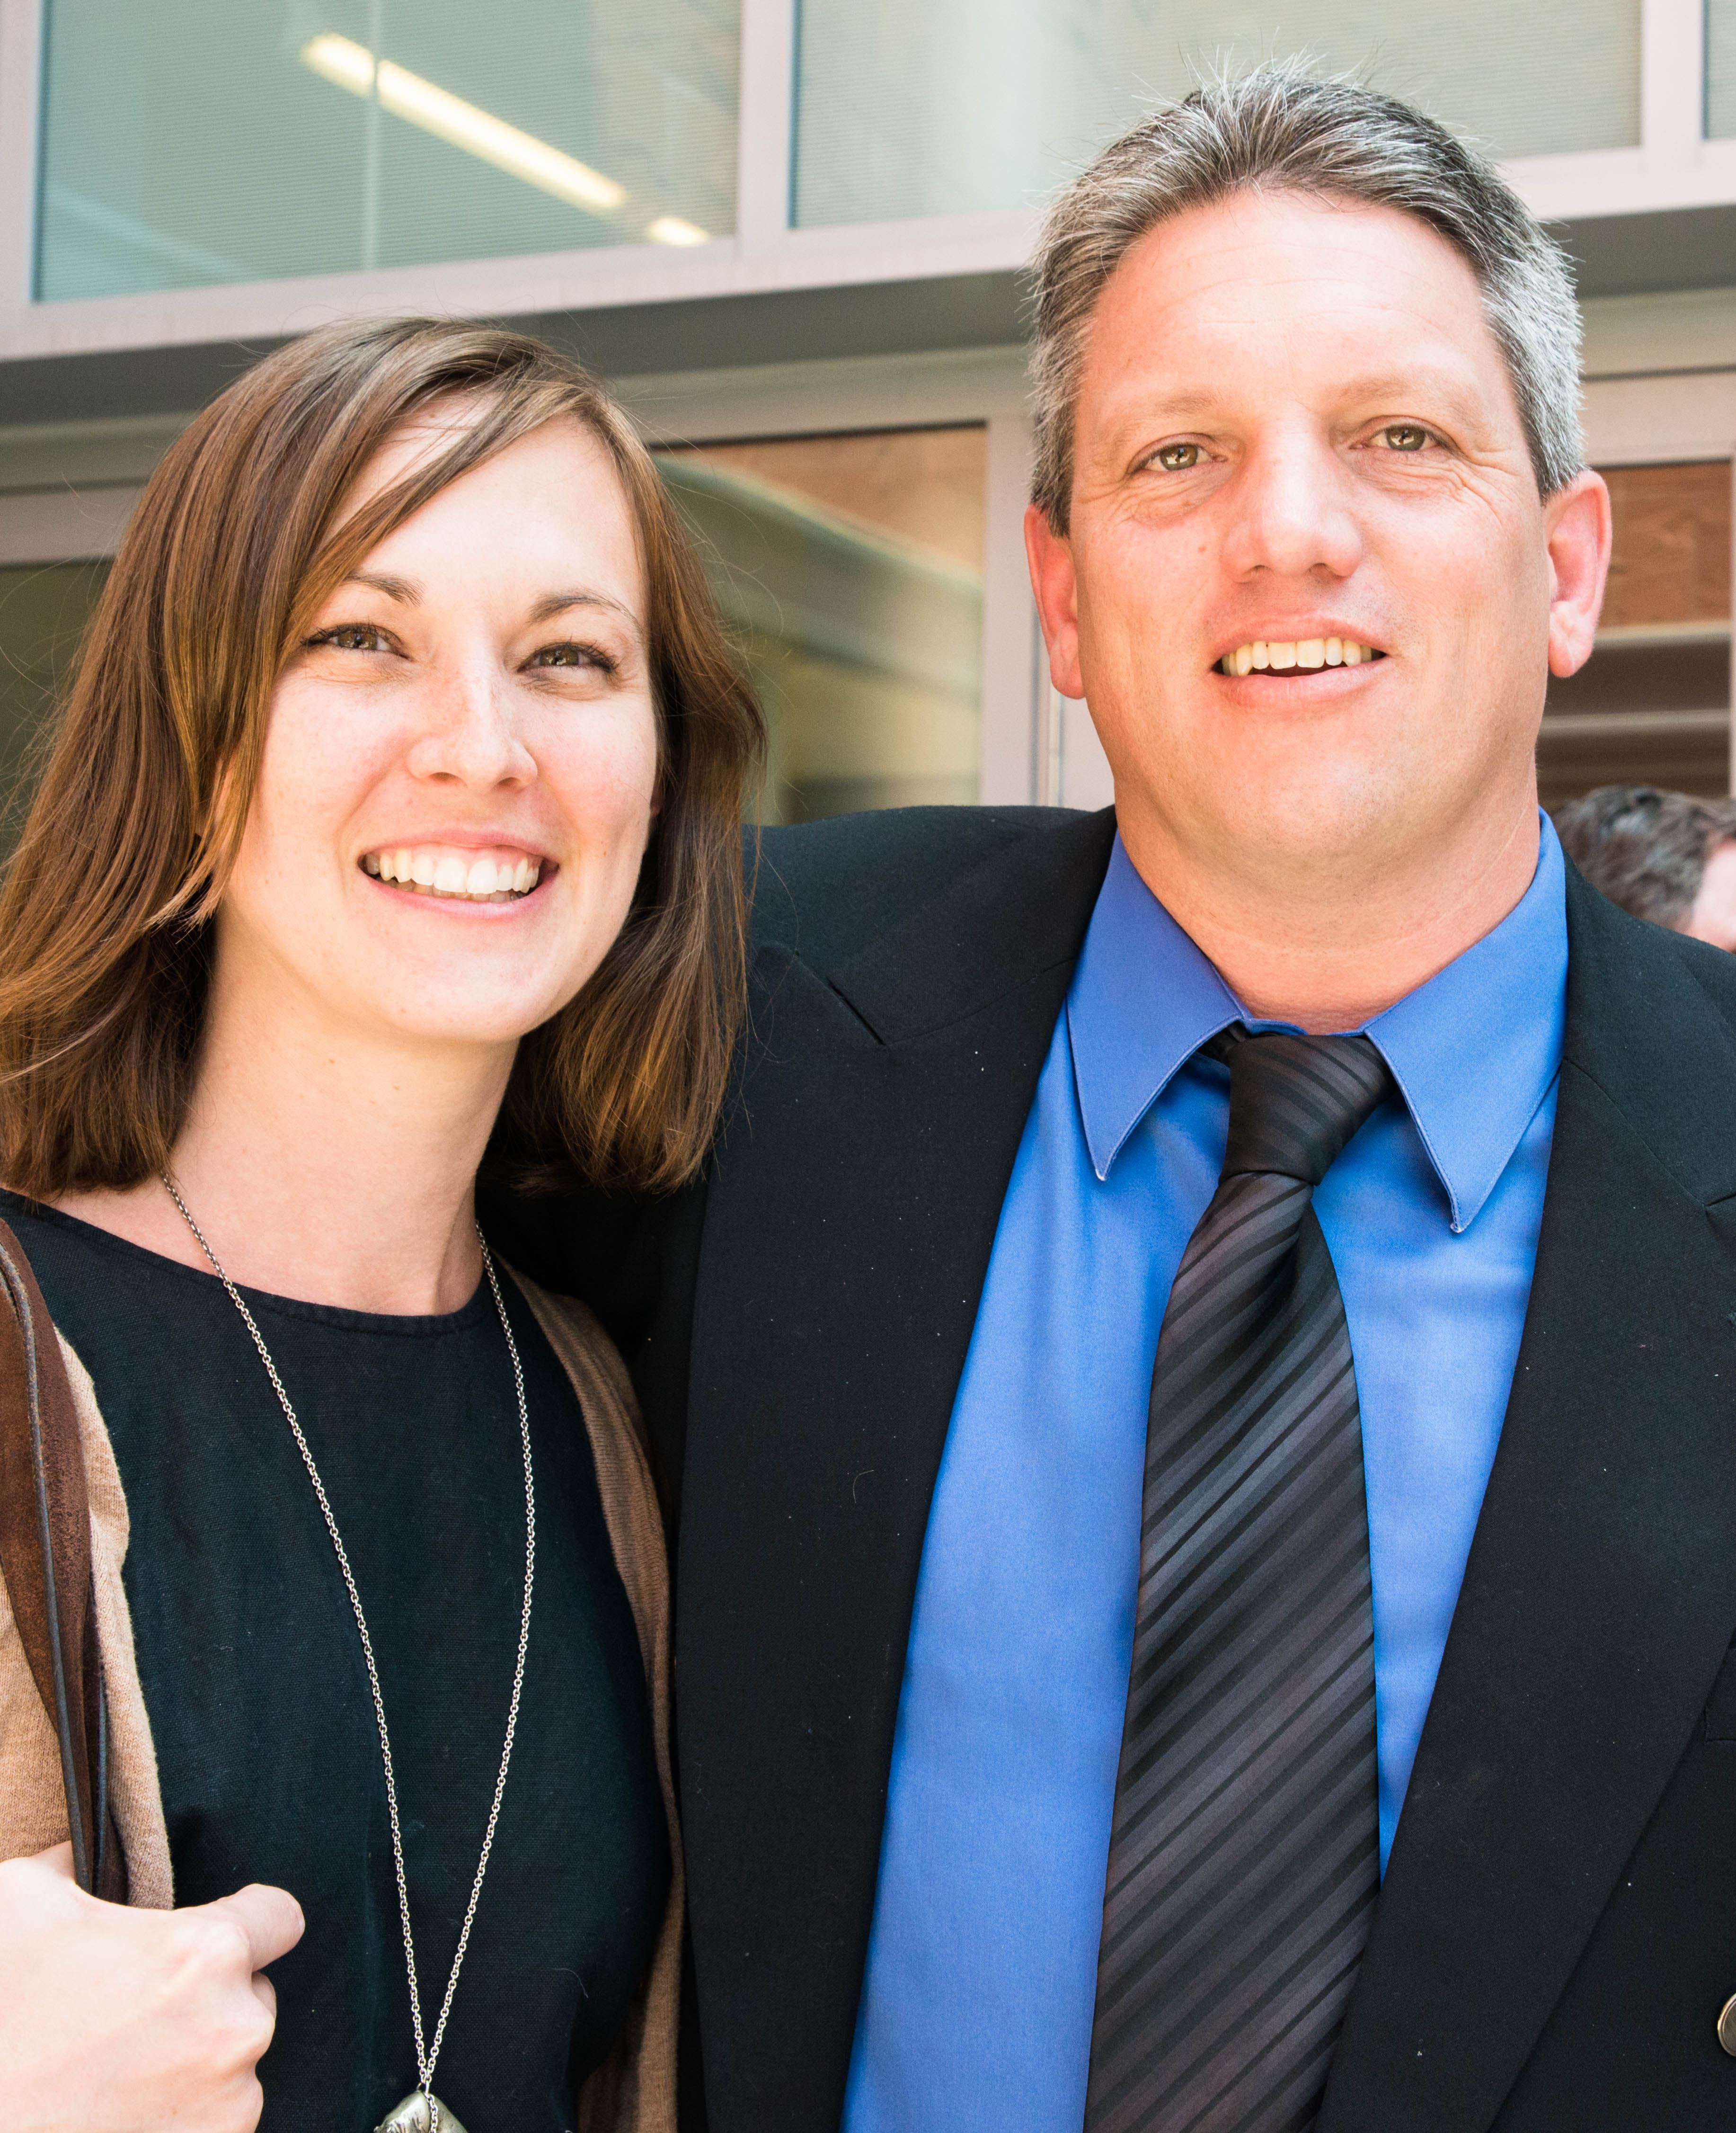
Strategic Planning Committee
Administrators
01.
Instructor Assignment
02.
Communication Plan
03.
Evaluation
04.
CCAP Agreements
The First DE Bridge Instructor Team

Slide 41



Curriculum & Assessment Committee
Instructors
Where?
Best location/modality for target population.
Student-Focused
Team Decisions
When?
Best time for target population.
What?
Which courses are the Best Fit?

Slide 42
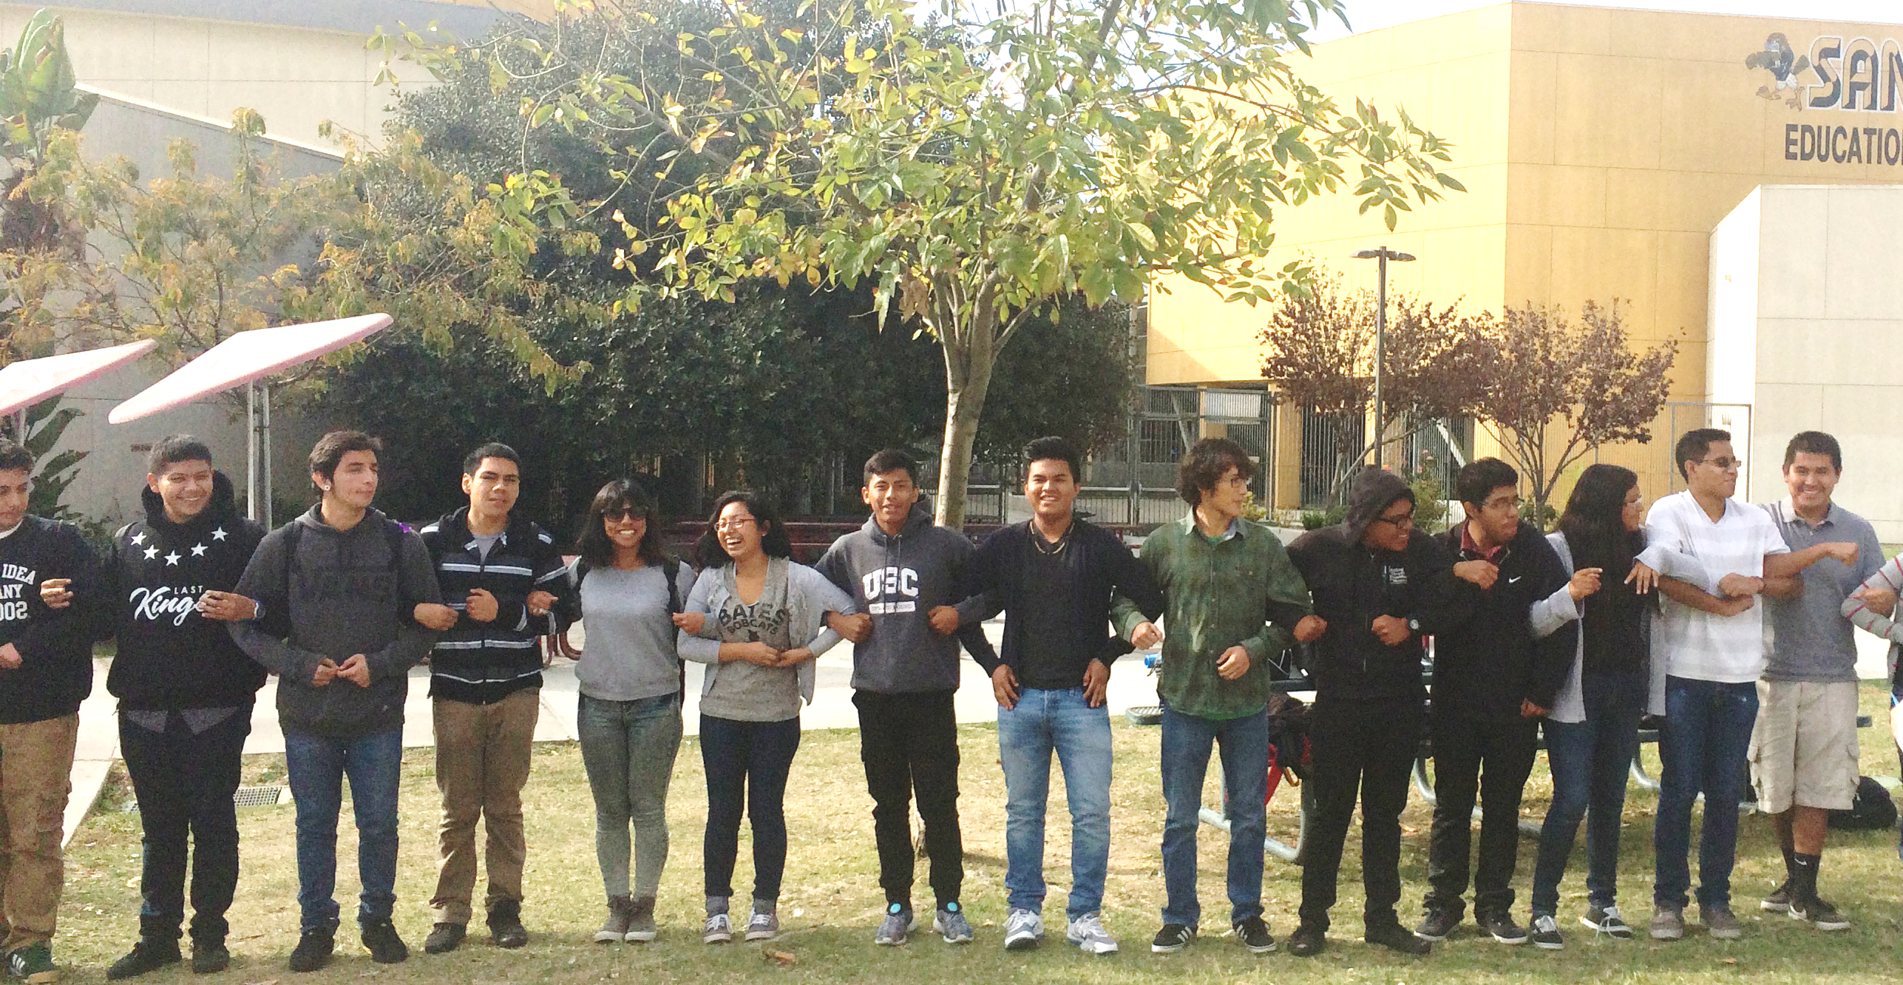
Student Recruitment
Committee
Counselors &
Dual Enrollment Staff
01.
DEI Plan.
02.
Student Recruitment Plan.
03.
Community Engagement Plan.

Slide 43
If you focus on students and that is your goal, then you can overcome what ordinarily would be insurmountable institutional barriers.
– HS Principal

