Slide 1
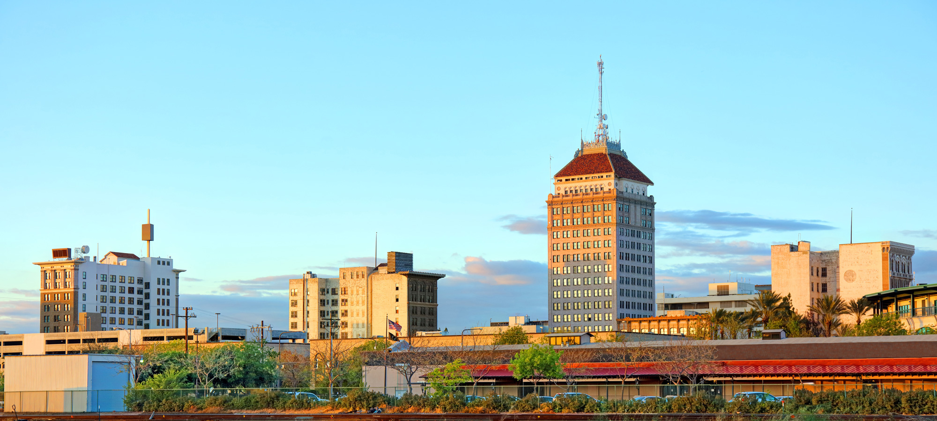
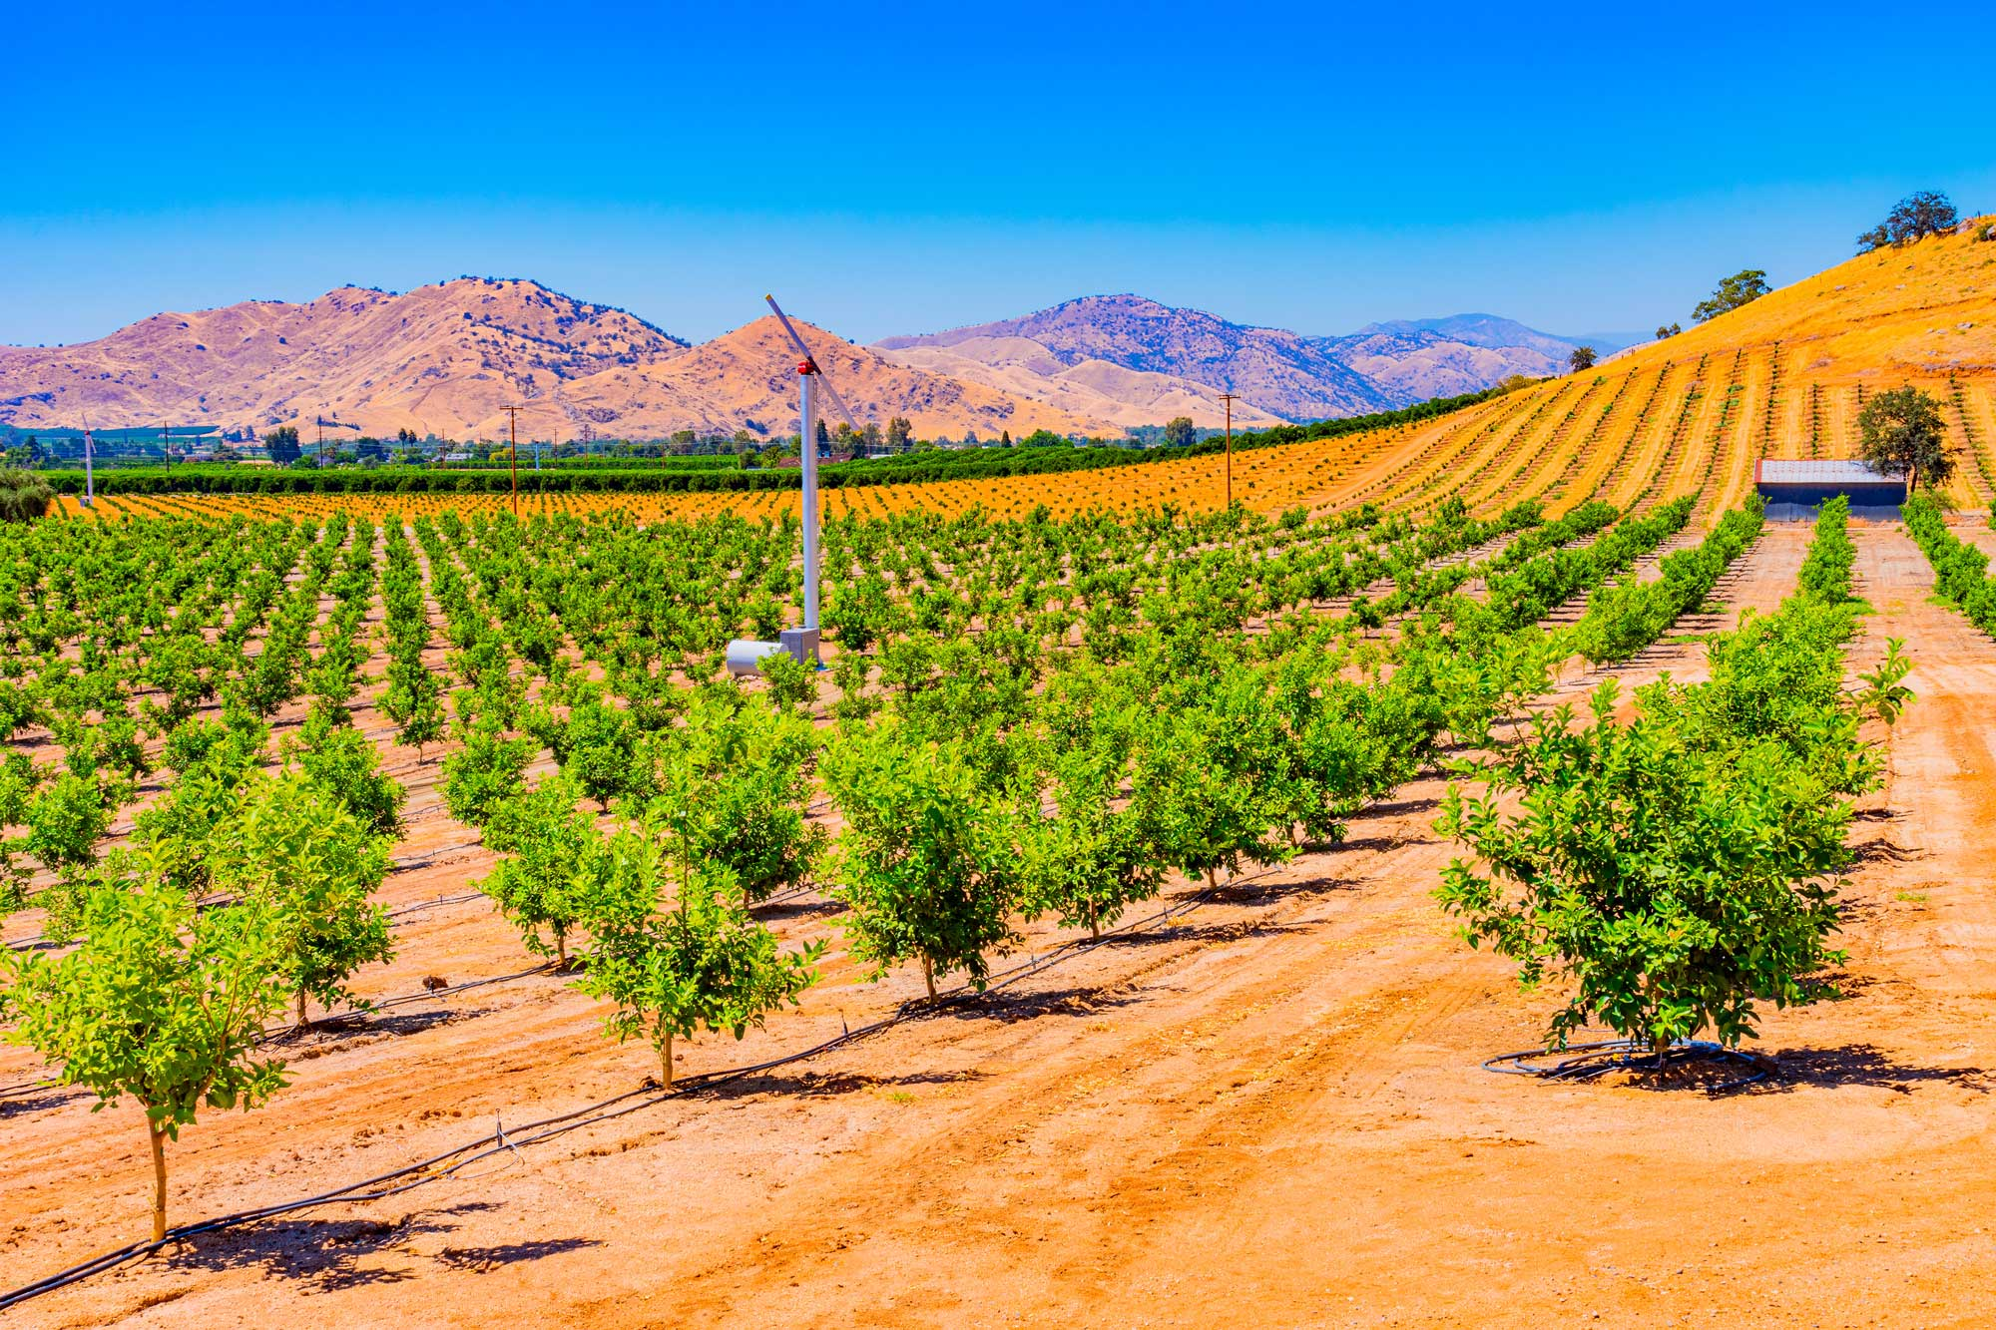
The Central Valley Landscape - Pathways to and through college in the San Joaquin Valley
October 2023 CVHEC
Hans Johnson, Olga Rodriguez, Cesar Perez

Slide 2
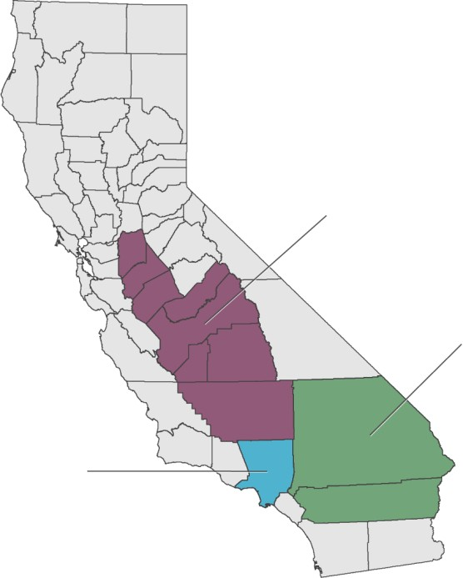
The San Joaquin Valley is one of the most populated regions of California
San Joaquin Valley
4.3 million (Oregon)
Inland Empire
4.6 million (Louisiana)
Bay Area
7.8 million
(Washington)
Los Angeles County
10.0 million
(Michigan)
Others:
San Diego metro 3.3 million
Orange County 3.2 million
Sacramento metro 2.4 million
2

Slide 3
California’s regions are growing apart economically
Per capita income relative to state, 1969-2020 (state=100)

Slide 4
State economic equivalents of California regions:
From Alabama to richer than Connecticut

Slide 5
The San Joaquin Valley has relatively few college graduates in core working ages

Slide 6
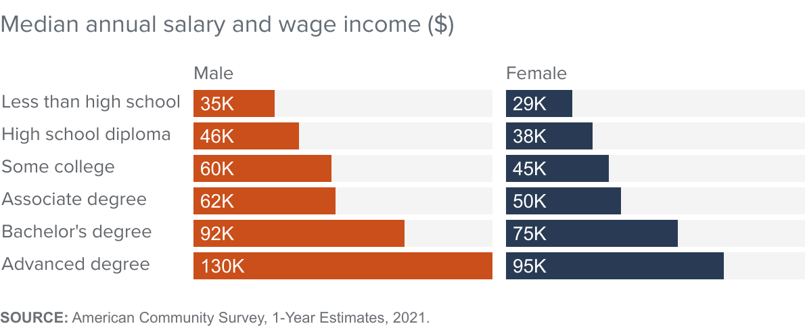
Is college worth it? YES!
6

Slide 7
Pathway to a bachelor’s degree
High school graduation rates
College-going rates of recent high school grads
Transfer rates from community colleges to four-year colleges
Completion rates of students in four-year colleges
Examine variation within the SJV and across race/ethnic and economic groups

Slide 8
High school graduation rates are similar to the rest of the state

Slide 9
High school graduation rates vary by race/ethnicity

Slide 10
College-going rates are low in the San Joaquin Valley

Slide 11
San Joaquin Valley high school grads are have low rates of enrolling in 4-year colleges

Slide 12
San Joaquin Valley high school grads are much more likely to go to a community college than a 4-year college

Slide 13
One reason: Completion of UC and CSU college prep courses is low in the San Joaquin Valley

Slide 14
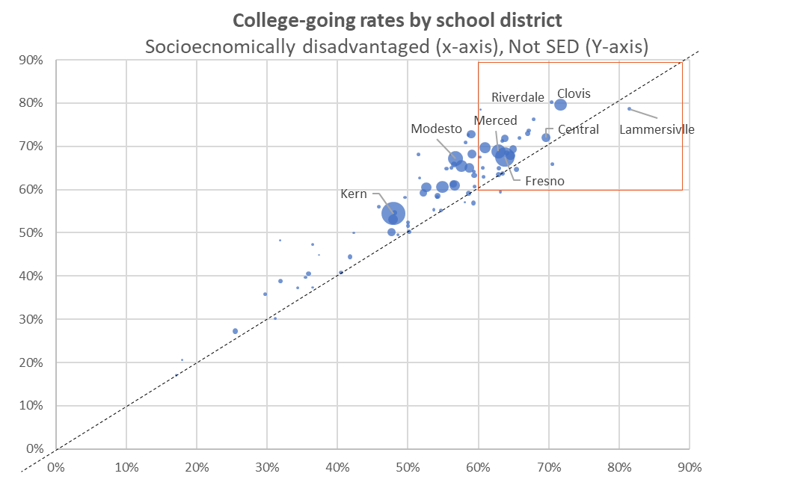
Districts vary widely in college-going rates of recent high school graduates

Slide 15
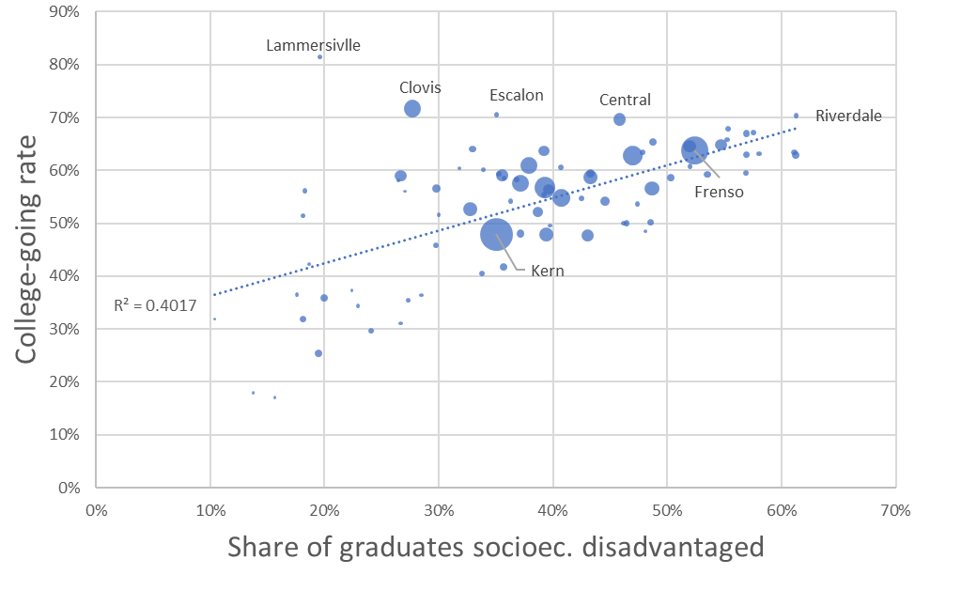
Districts with high shares of SED students tend to have higher college-going rates for those students

Slide 16
Transfer rates are lower in the SJV than in the rest of the state
Source: CCCCO student success metrics, restricted to students who earned at least 12 units, 2019-20

Slide 17
Graduation rates at UC and CSU campuses in the
San Joaquin Valley are lower than in the rest of the state

Slide 18
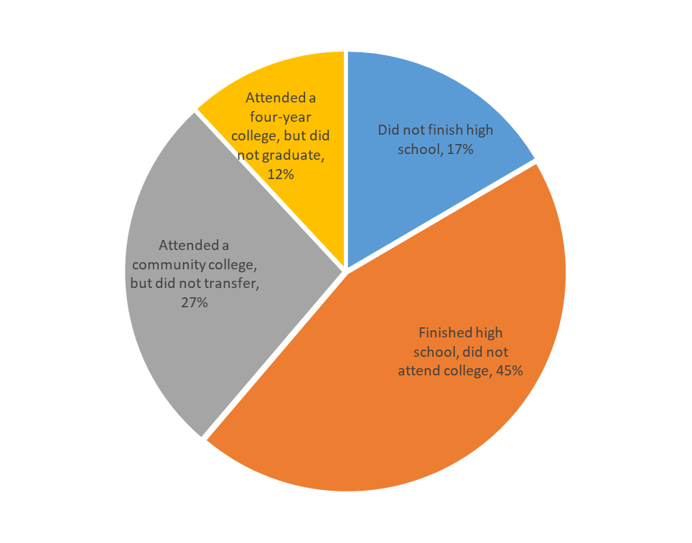
Where do students in the San Joaquin Valley fall off the path to a bachelor’s degree?

Slide 19
The San Joaquin Valley has abundant opportunities
Youthful, diverse, and growing population
Expanding economy
Strong regional networks and efforts

Slide 20
Setting goals:
Key transition points determine outcomes
Start in 9th grade
  Develop a-g pathways
  College prep should be the default
Transition to college
  Create a college-going culture
  Give students and families the information they need
  Encourage four-year college enrollment
College completion
  Persistence in first years is key
  Transfer rates should be higher
DATA, EVALUATION, FLEXIBILITY

Slide 21
Policy recommendations
Ensure capacity at four-year universities
  Continue efforts to boost four-year graduation rates
  Use satellite campuses to help serve local demand
Improve the transfer pathway
  Focus on regional coordination and program alignment
  Expand Associate Degrees for Transfer

Slide 22
Policy recommendations (cont.)
Develop regional (not local) college promise programs
  Grant priority enrollment to four-year colleges
  Create regional referral pools for CSU
Support regional data sharing and evaluation
  State should play a role in coordinating such efforts

Slide 23
Notes on the use of these slides
These slides were created to accompany a presentation. They do not include full documentation of sources, data samples, methods, and interpretations. To avoid misinterpretations, please contact:
Hans Johnson johnson@ppic.org
Thank you for your interest in this work.

