Slide 1

Math Bridge
Using Dual Enrollment as an Intervention and Equity Tool
Nicole Korgie, Vice President of Operations, College Bridge
Kristi Rieg, Math Faculty, Merced College

Slide 2
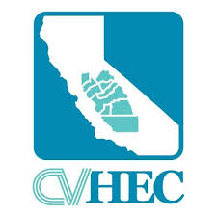

Which students takes dual enrollment classes at your high school?
Student Recruitment & Selection
Who coordinates everything?
Making the Logistics a Reality
Dual Enrollment –
The Central Valley Way

Slide 3

“We are thrilled to be part of this historic moment for our students. Assembly Bill (AB) 1705 moves the California Community Colleges one step closer to closing equity gaps by ensuring students are enrolled by default in transfer-level courses – and provided the tools they need to succeed.”
-Interim Chancellor Daisy Gonzales, PhD

Slide 4
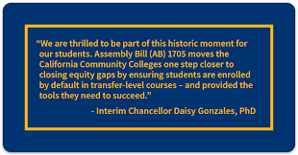
Remedial Math
No Longer Available at
California Community Colleges
Non-STEM Major = directly into college level Statistics or a Stats like course
STEM Major = directly into Calculus
High School Diploma Requirement =
2 yrs of math which includes Algebra 1

Slide 5
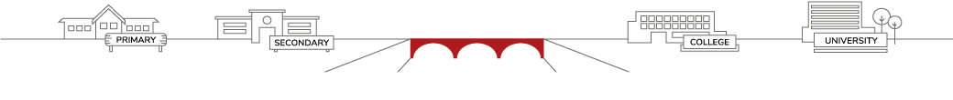
What is Math Bridge?
Student Centered Math Intervention
Targets students who:
  Have struggled or have disengaged with math
  GPA between 2.3 & 3.4
  Likely college bound
Students take transfer level math dual enrollment course during regular school day, with extensive support.
Intersegmental Instructor Collaboration
  High School Teacher and College Faculty Collaborate to provide support services to struggling students

Slide 6


Central Valley Math Bridge
High School Math Support
College Math Course

Slide 7
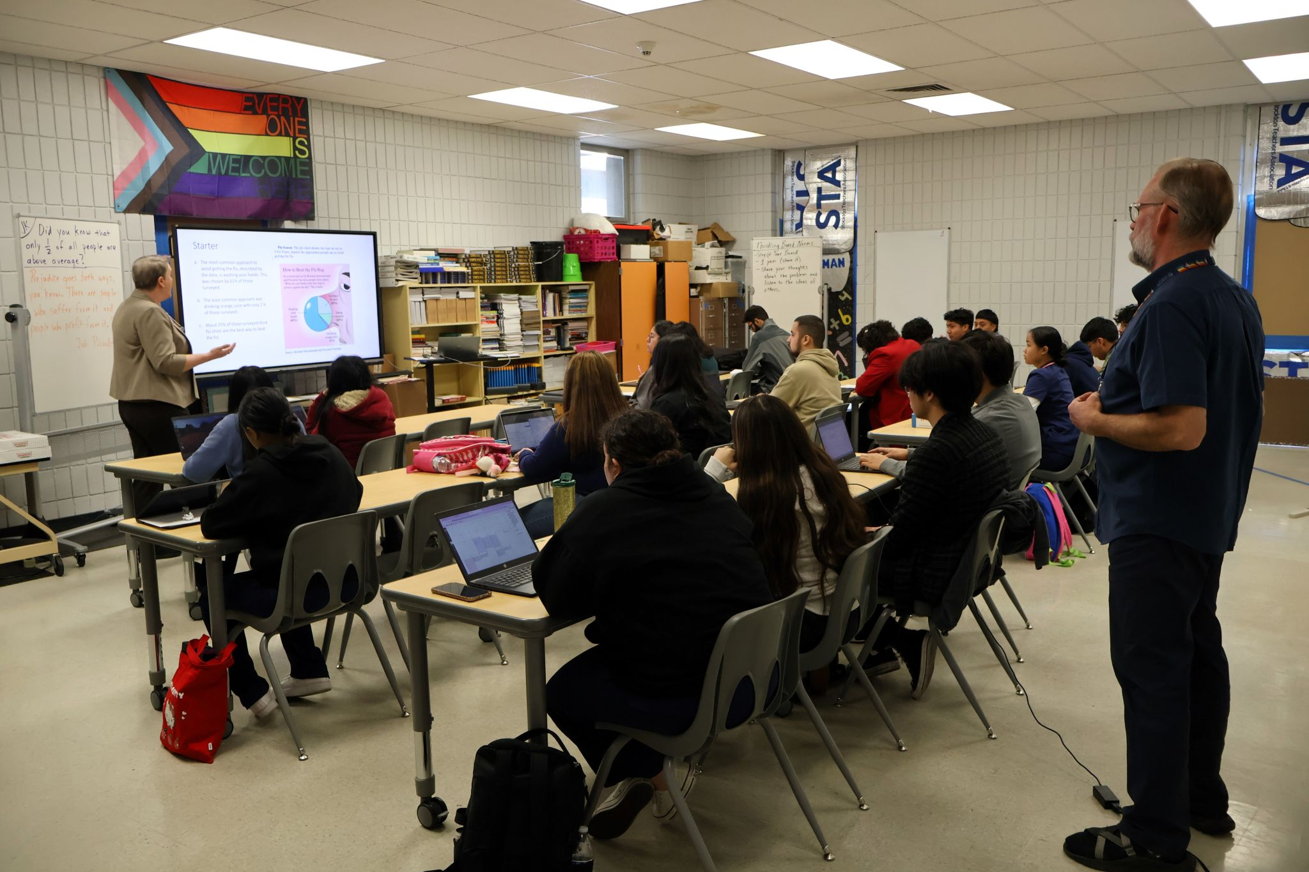


Instructor Community of Practice
High School Math Support
College Math Course

Slide 8
We Want to Hear From You
What do you think?
Are you already doing something like this?
Would this work at your school?
Would your students want to do this?
Nicole Korgie - nicole.korgie@college-bridge.org

Slide 9
“Students do not want to take more math.”
“They take their 2 years and say I’m done!”
“Students who are bad at math can’t pass a college math class.”
“Students won’t even try to do this.”
# of students attended information session | # completed interest forms | Student Interest
129 | 93 | 72%
55 | 25 | 45%
40 | 29 | 73%
126 | 38 | 30%
30 | 7 | 23%
60 | 43 | 72%
77 | 49 | 64%
51 | 42 | 82%
50 | 23 | 46%

Slide 10
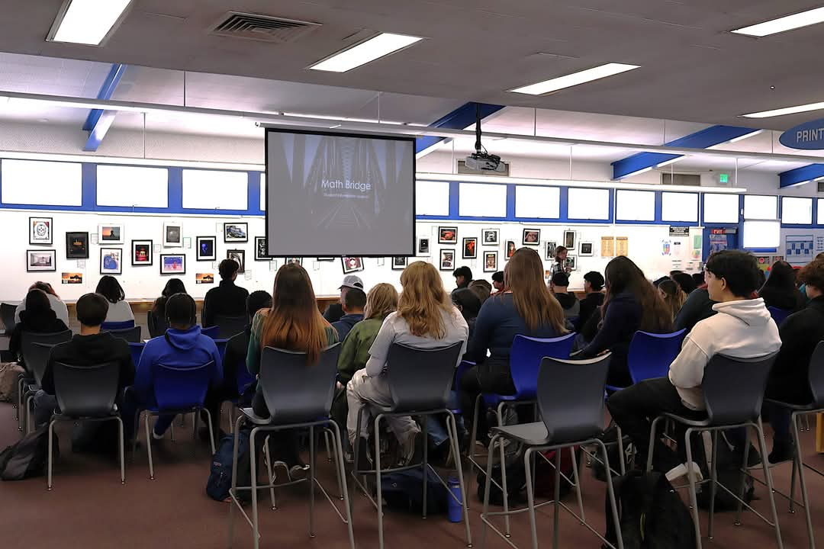
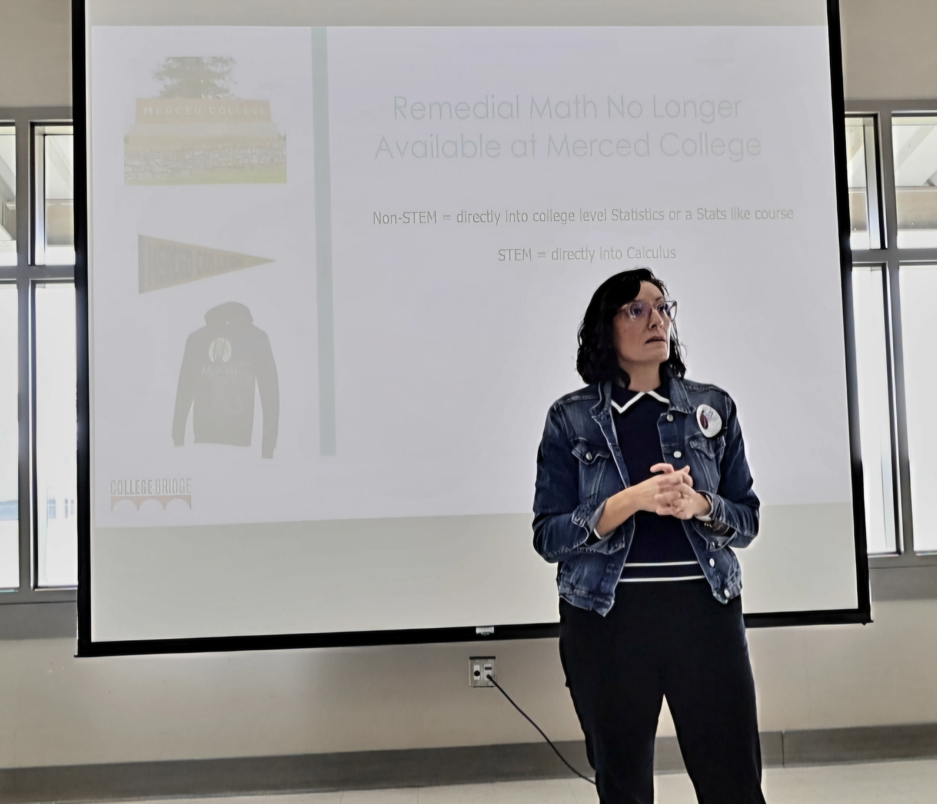
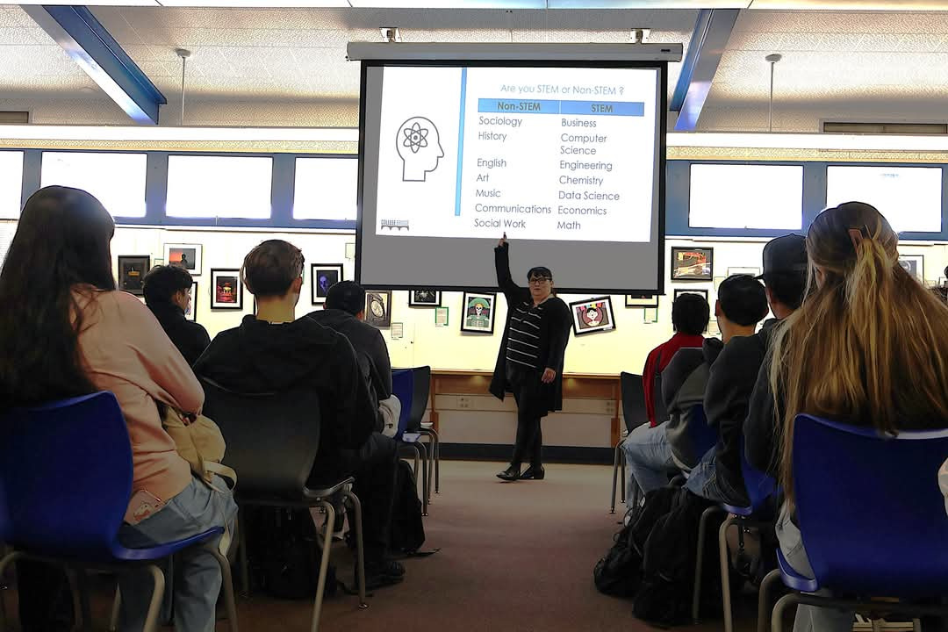
Who is planning on going to college?
Explain AB 1705 and current math situation at community colleges.
Talk about specific math course they will need in college.
Do it now or do it later.
# of students attended information session | # completed interest forms | Student interest
129 | 93 | 72%
55 | 25 | 45%
40 | 29 | 73%
126 | 38 | 30%
30 | 7 | 23%
60 | 43 | 72%
77 | 49 | 64%
51 | 42 | 82%
50 | 23 | 46%

Slide 11

Student Selection –
Checks & Balances
Student Criteria
Student Information Session
Student Interest Form
Math Teacher Feedback
Counselor Advising for Final Placement in Course

Slide 12
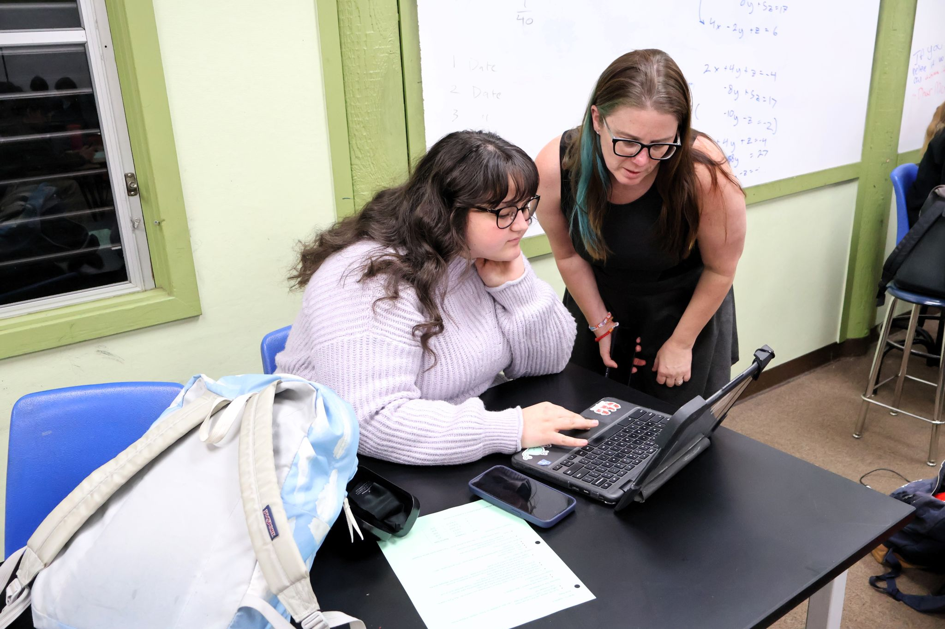
Student Feedback:
“Math Bridge changed my perception on myself as a math student because I saw my strengths and weaknesses that I didn't before.”
“I was able to see that I can take a rigorous course and be successful with my hard work and determination.”
“It showed me that I was capable of doing so much more than what I thought. I had to focus and just analyze.”
“Thank you so much for providing this course to high school students. It was a challenging course, but overall it really prepared us for future classes and get a feel of the difference between college courses and high school classes.“

Slide 13



Transfer-Level Math Pass Rates
84%
Math Bridge High School Students
(students who were underprepared in math and/or planned on not taking math senior year)
54%
All Community College Students
(including Special Admits)

Slide 14
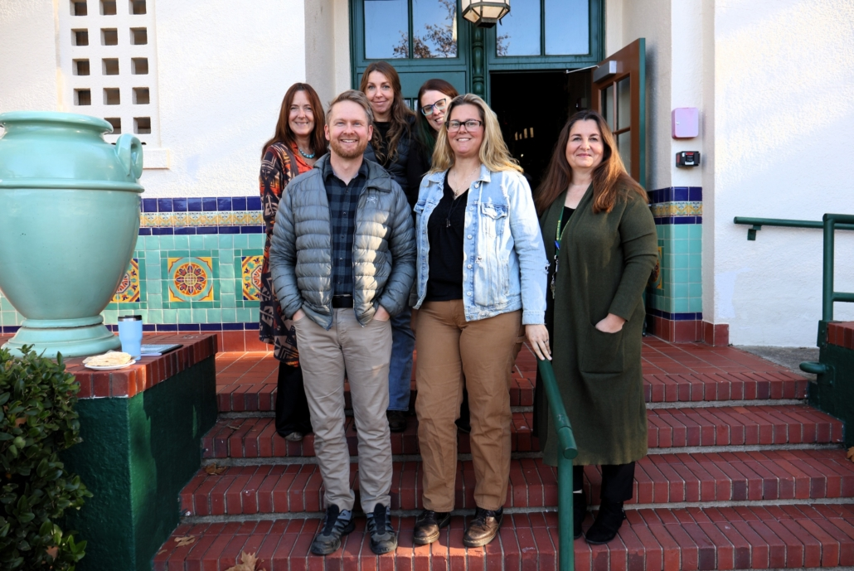
What Makes Math Bridge Successful?
Coordinating Lead
Selected College Math Faculty
Selected High School Math Teacher
High School Counselors
Student Recruitment & Selection Process

Slide 15
Central Valley Math Bridge Partners
Delta College | Taft College
Stagg, Weber Institute | Taft
Lemoore College | Reedley College
Riverdale | Dinuba, Orosi, Sanger, Sanger West
Merced College
Merced, El Capitan, Buhach, Livingston, Atwater, Golden Valley, Mariposa, Le Grand, Gustine, Dos Palos
5 Community Colleges
18 High Schools

Slide 16
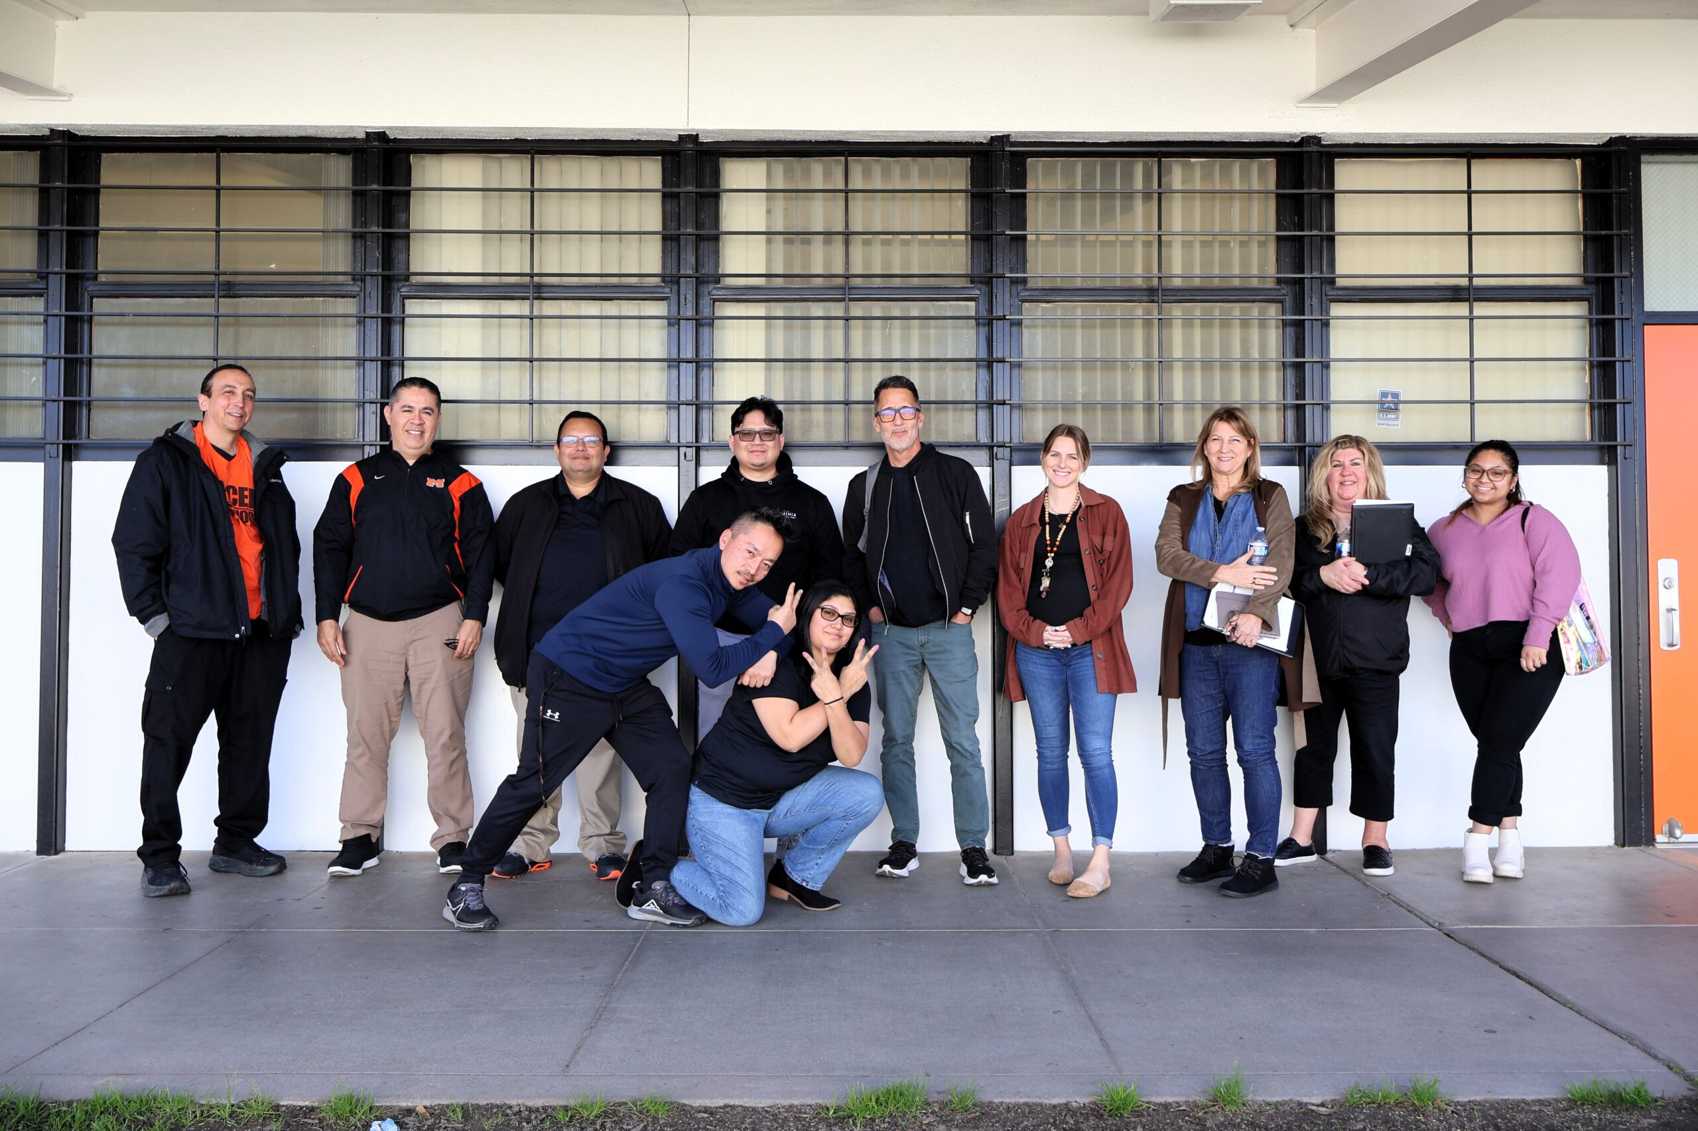
Join Central Valley Math Bridge
Nicole Korgie - nicole.korgie@college-bridge.org
Kristi Rieg - kristen.rieg@mccd.edu
www.college-bridge.org

