Slide 1
Expanding College and Career Access Pathways

Slide 2
Educational Attainment
Central Valley
HS diploma
AA/AS/ADT
BA/BS
22%
9%
14%
KEY FACTS
Most districts within Fresno County serve student populations where nearly 80% of students are designated as Socioeconomically Disadvantaged
Half of graduating seniors meet a-g requirements for college admissions
Individuals without "some college" are earning less than $25,000/year
State Center Community College District is 3rd Statewide in serving DE students and will continue to build opportunities

Slide 3
building the right team
Communication
shared ownership
Instructor-Facilitator
Dean-Instructor
champions in the work
Learning Outcomes
alignment
College outcomes-DE
Curriculum
System level alignment happens when there are collegial partners in the work who support a cycle of continuous improvement.
College & K12 partnership

Slide 4
Looking inward
setting intentional goals
impact
Data
DE Consideration
Current a-g rates
CCI index
Graduation rates
Post secondary data
Census data
Course access data
Student support data
Alignment of courses to a-g list
Ensuring & measuring equity
Promoting options for EL students
Identifying the purpose for each course
Gatekeeper courses
Improves a-g
Strengthens CCI
Promotes equity
Builds a college going culture
Promotes access to post secondary opportunites
Builds college knowledge

Slide 5
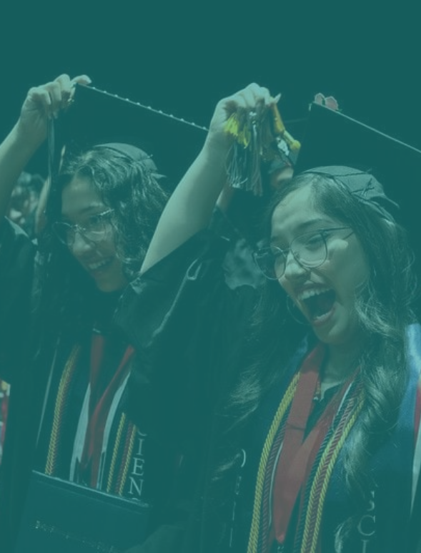
Master Scheduling
Pathway Alignment
Planning courses well in advanced to optimize access for students. Things to consider: athletics, EL designation, transportation, learning modality, and school site data.
Creating course alignment with current a-g pathways, CTE pathways and other advanced coursework offerings. No random acts of dual enrollment.
Creating intentional Access
Power of place
Summer options
Creating opportunities for students to take courses on a college campus, introducing the power of place.
Creating partnerships with colleges which promote access to summer experiences for students, aligned to goals.

Slide 6
Leveraging Dual Enrollment
Leadership is acutely aware of the envirnoment in which all entities navigate.
Governor's Master Plan for Career Education
Chancellor's Vision 2030
Regional K-16 Collaborative
Regional Efforts
Leadership supports one another publicly
Accreditation, Strategic Planning WASC
Collaborative Meetings
Board Presentations
Celebrating the WINS

Slide 7
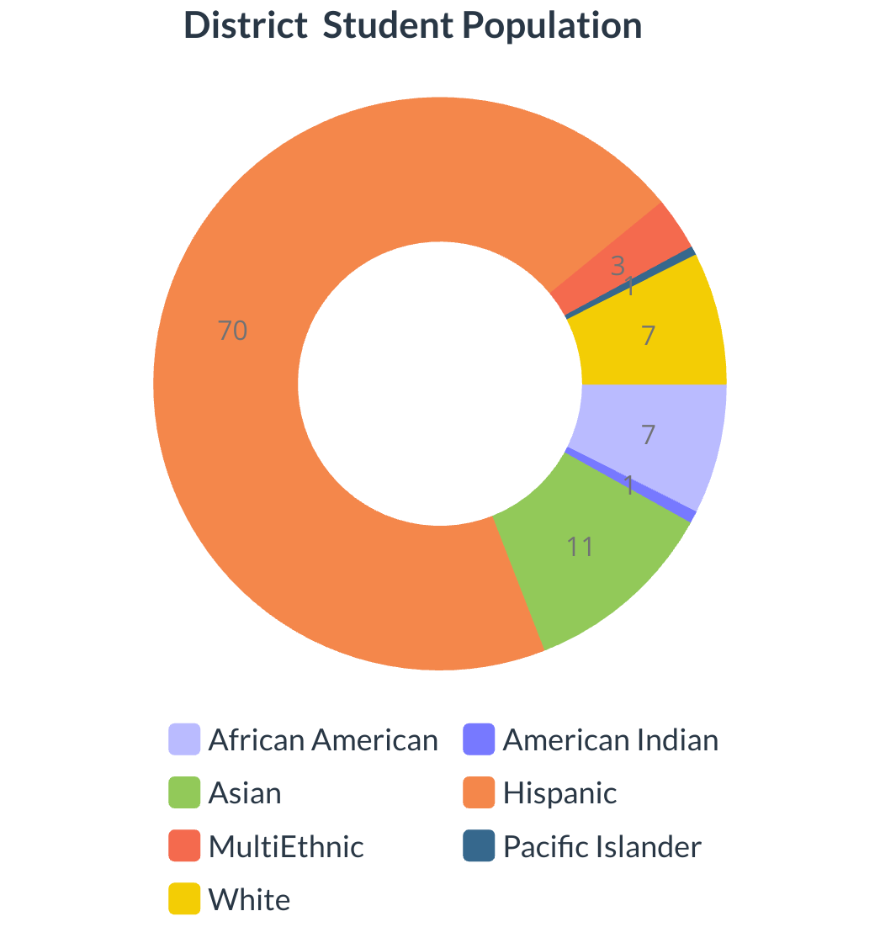
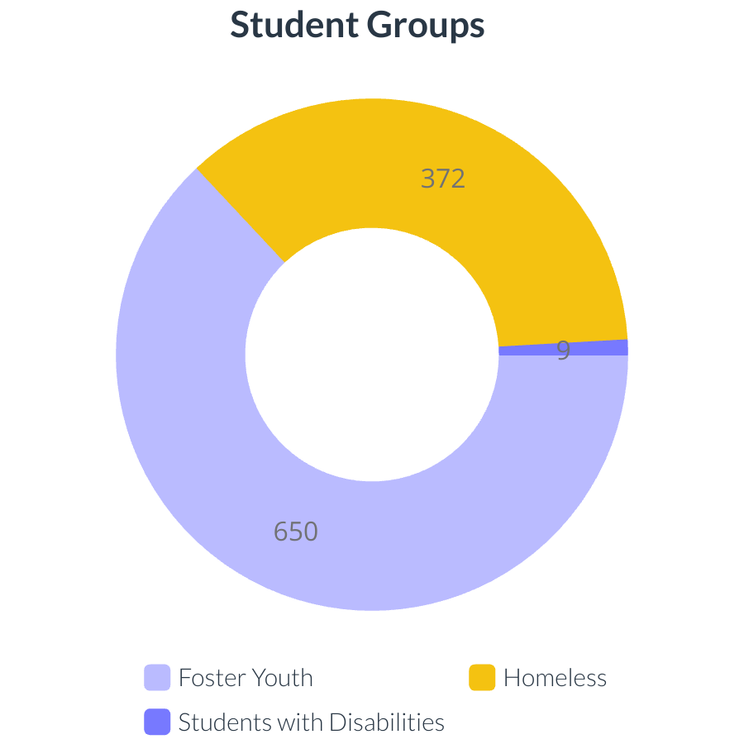
Equity data reporting
DE Data should reflect district data
Establish census benchmarks
Share your data across 3 yrs

Slide 8
Joint Board Resolution: Every students will have access to earning 12 units prior to graduation from high school. (FUSD-FCC 2022)
Intentional Design 9-14
bell schedules
Expand rigorous courses
Align Student supports
fall/spring offerings should align with HS academic planning & a-g
Consider where an early college pathway makes the most sense
Courses outside of the school day
SUmmer offerings

Slide 9
Pathway Options
Consider opportunities to embed college credit
CTE Pathway Alignment
Industry Certification
Work with your college partner to create 9-14 pathway alignment
Removing silos and promoting 9-14 career pathways.
Student Focus
Course support
Clear pathway to high wage options

Slide 10
K-14 System Challenges
Qualified Dual Enrollment Instructors
Course Scheduling
Processes and Protcols
Up-Skilling HS Teachers
Labor Partners-MOUs
Capacity of College Partner
The Vetting & Equivalency Process
Bell Schedules
Academic Calendars
Misalignment of course planning timeline
Impact to Enrollment & Registratin Process
Data Sharing MOU
Transcription Plan

Slide 11
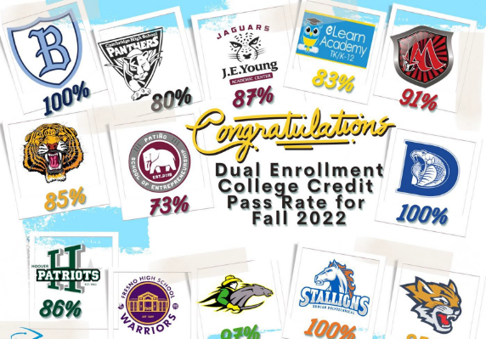
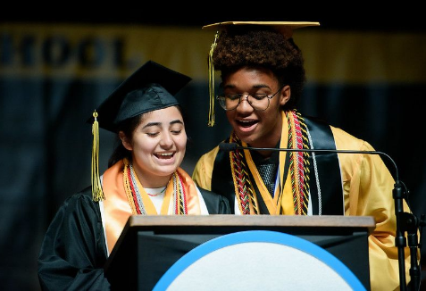
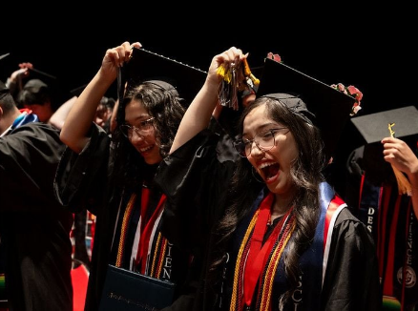
Celebrating Progress

Slide 12
THANK
YOU
If you are here with us, you are champion!
Early College Champions
Clovis Community College: Justin.Garcia@cloviscollege.edu
Fresno City College: Emily.Berg@fresnocitycollege.edu
Madera Community College:Darin.Soukup@maderacollege.edu
Reedley Community College: Sandra.Fuentes@reedleycollege.edu
State Center Community College: Tressa.Overstreet@scccd.edu

