Slide 1
COLLEGE AND CAREER INDICATORS- DUAL ENROLLMENT, CTE & ROP PROGRAMS
Central Valley Dual Enrollment Convening
February 3, 2025
Dustin Green-Director of Educational Services
Kern High School District

Slide 2
PROFESSIONAL EXPERIENCE
Kern High School District
Previous positions
Social Studies & Business teacher (7 years)
Administrative positions
Dean of Students, 2 school sites (3 years)
Assistant Principal of Administration (2 years)
Assistant Principal of Instruction (6 years)
Current role
Director of Educational Services
Oversee district CTE funding and support coordination of programs
19 comprehensive schools, 5 continuations schools, 2 special education satellite campuses, 2 ROP sites
Coordinate dual enrollment, concurrent enrollment, and Early College pathways with Kern Community College District and California State University Bakersfield
Collaborate with Kern County Superintendent of Schools on K16 initiatives including CTE and dual enrollment projects

Slide 3
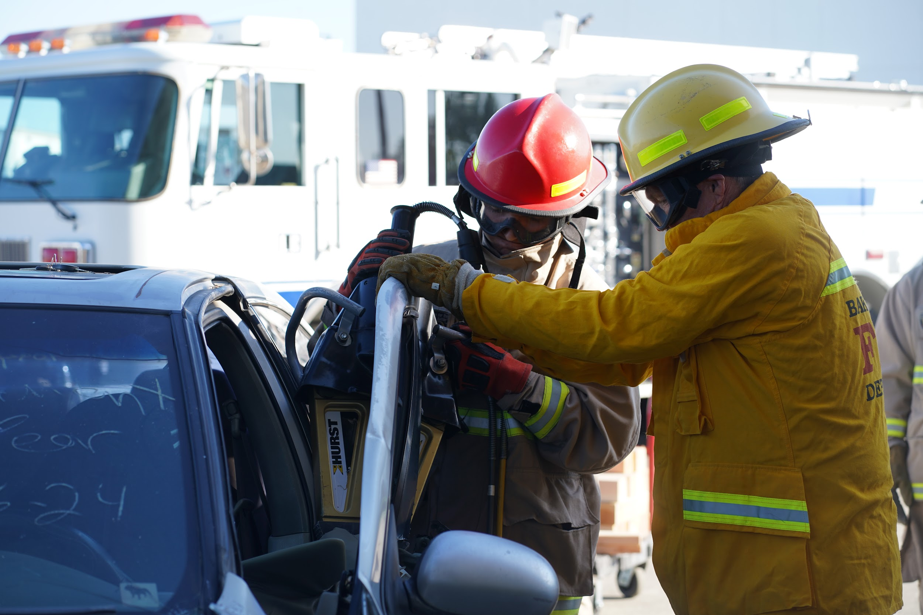
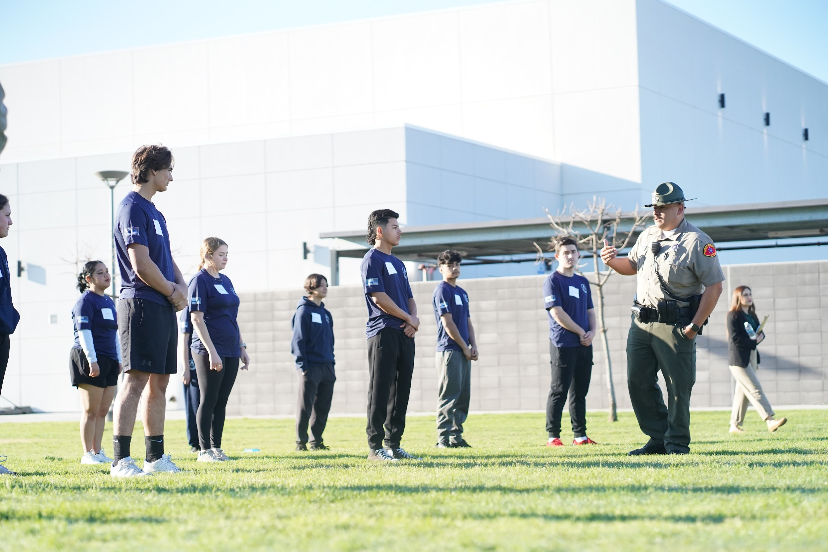
KHSD MISSION STATEMENT
The mission of the Kern High School District is to provide programs and services to allow ALL students to graduate from high school prepared to succeed in the workplace and at the post-secondary level.

Slide 4
DISTRICT GOALS FOR CAREER AND TECHNICAL EDUCATION
The goal of the Kern High School District’s CTE expansion effort is to create more opportunities for students to access career and technical programs, while pursuing their high school diplomas.
The Kern High School District can achieve its goal of creating more CTE opportunities for students by:
Supporting both college AND career readiness programs, including the expansion of dual enrollment opportunities
Continuing to support CTE program development, operation, and improvement efforts at each school site
Securing local, state, and federal funds to support CTE programs
Working with our community, education, and business industry partners to identify and develop appropriate career and technical preparation programs
Adding CTE facilities to offer more CTE programs

Slide 5
KEY RELATIONSHIPS
Kern Community College District (KCCD)-weekly meetings w/ Director of Outreach and other support coordinators
California State University Bakersfield (CSUB)-regular meetings w/ Faculty Director of Academic Systems
Kern County Superintendent of Schools (KCSOS)-regular meetings Chief Leadership Support Officer, Director II and Coordinator I of College and Career Readiness
Kern High School District ROC & CTEC Principal and administrators
Kern High School District Teachers on Special Assignment (TOSA)
Work Based Learning Resource Teacher
District Farm and Ag Coordinator

Slide 6
COLLEGE AND CAREER PREPAREDNESS
Supporting both college AND career readiness programs

Slide 7
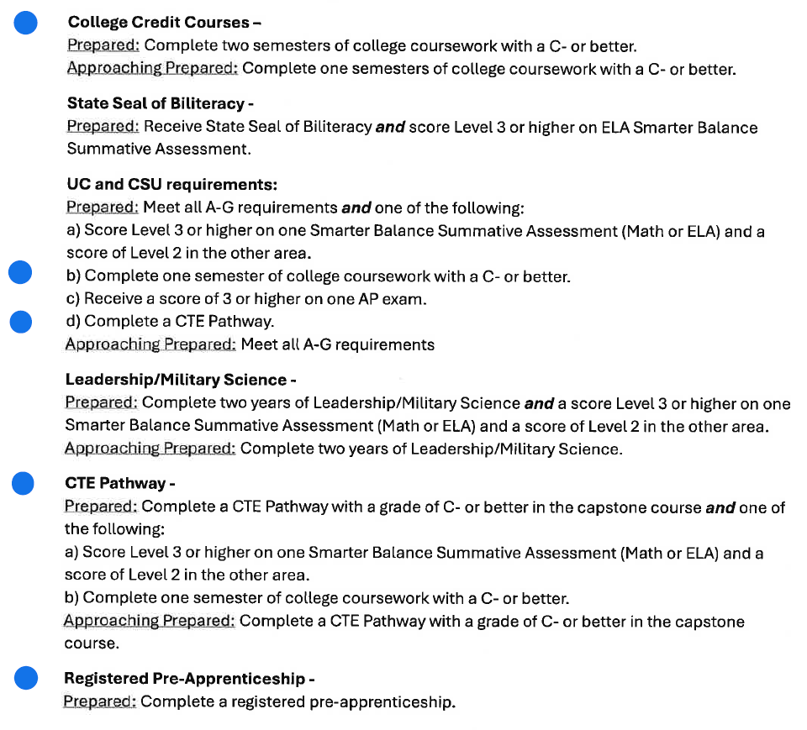
COLLEGE & CAREER INDICATORS
Students are considered “college ready” by completing rigorous coursework, passing challenging exams, or receiving a state seal
Students must meet at least one of the criteria listed to be considered prepared
Of the six measures listed, two measures incorporate the completion of CTE courses and/or pathways
CTE pathway completion occurs when a student completes at least 300 hours of instruction in a high-quality CTE pathway

Slide 8
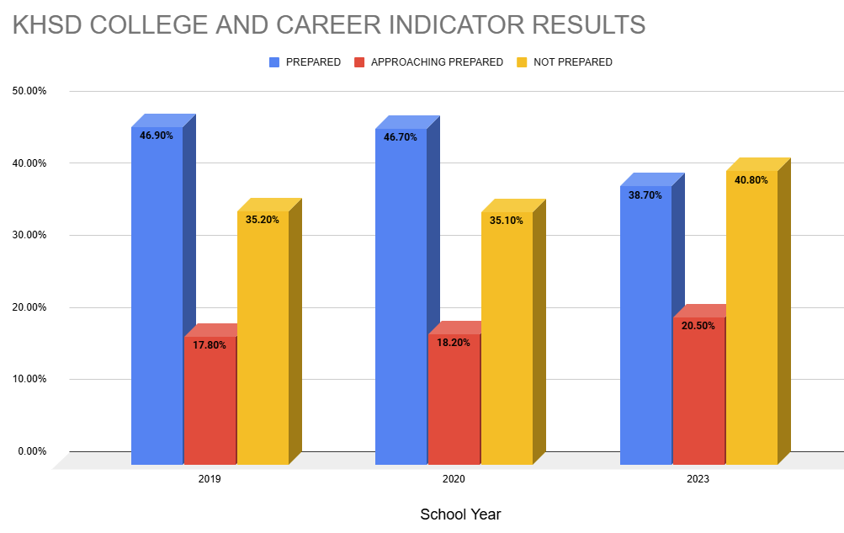
COLLEGE/CAREER INDICATOR DATA
*Data taken from www.caschooldashboard.org
Due to the COVID-19 pandemic, there will be no state indicators published on the California School Dashboard for 2021 & 2022 for CCI

Slide 9
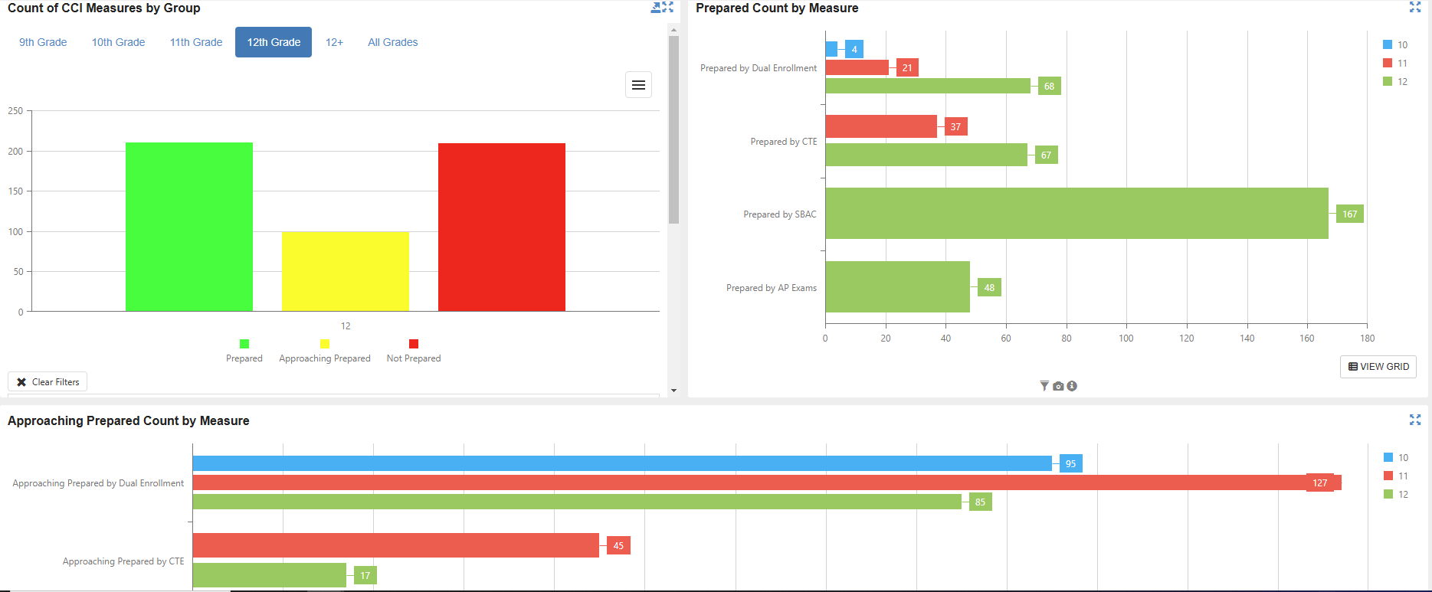
COLLEGE/CAREER INDICATOR DATA
**INFORMATION FROM KHSD SYNERGY ANALYTICS DASHBOARD

Slide 10
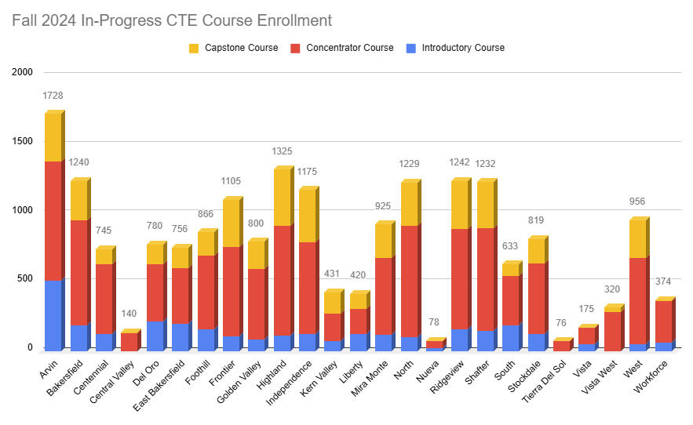
CTE PARTICIPATION DATA

Slide 11
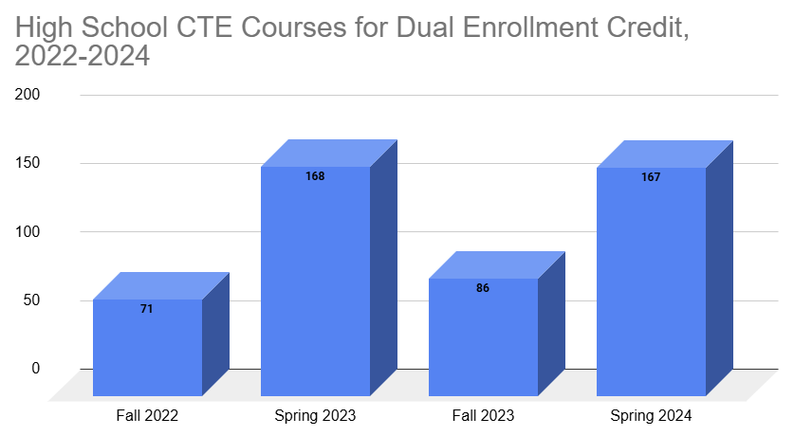
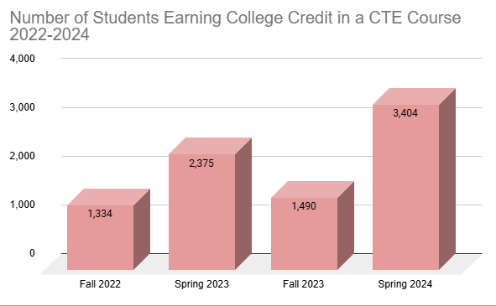
CTE DUAL ENROLLMENT

Slide 12
KHSD DUAL ENROLLMENT TOTALS 2015-2024
KCCD
44,611 students
136,098 credits earned
CSUB
5,902 students
18,444 credits earned

Slide 13
CTE DUAL ENROLLMENT, A-G APPROVAL, & ARTICULATION
44 CTE courses that are dual enrolled
192 CTE courses are formally approved as an A-G qualifying course through UC Doorways
51 CTE courses receive articulated credit through Bakersfield College (does not meet CCI)

Slide 14
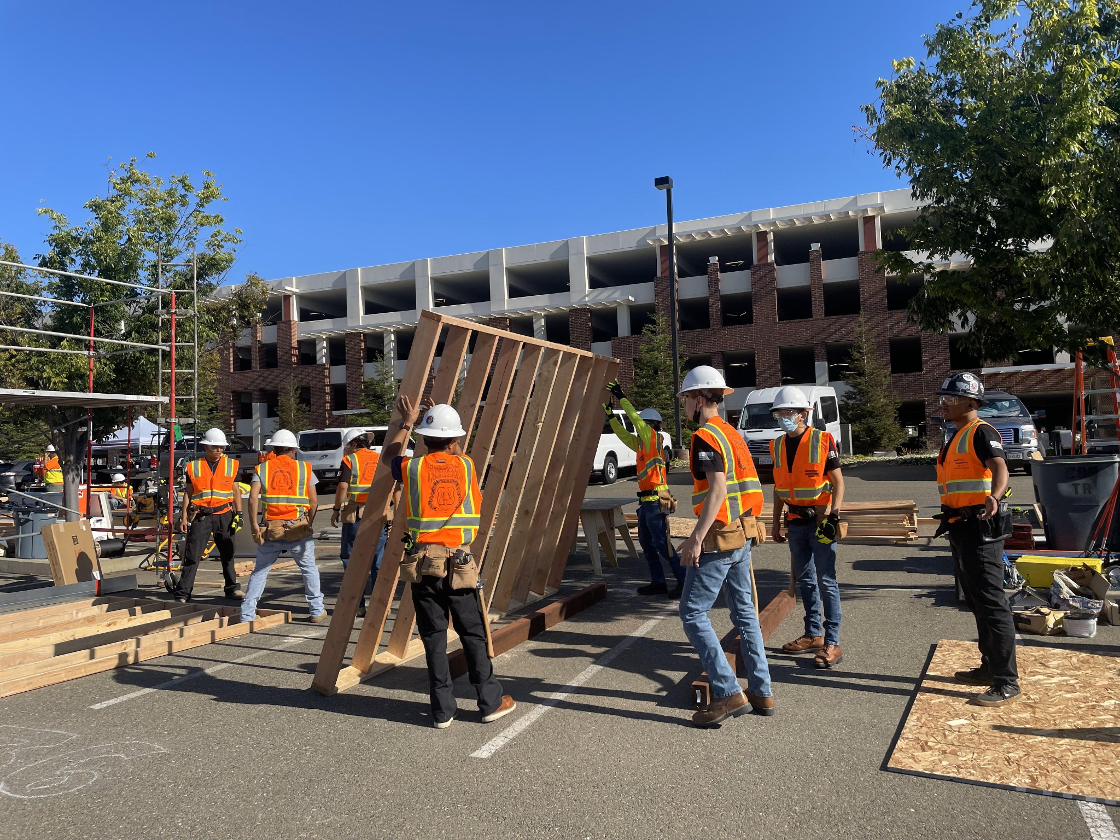
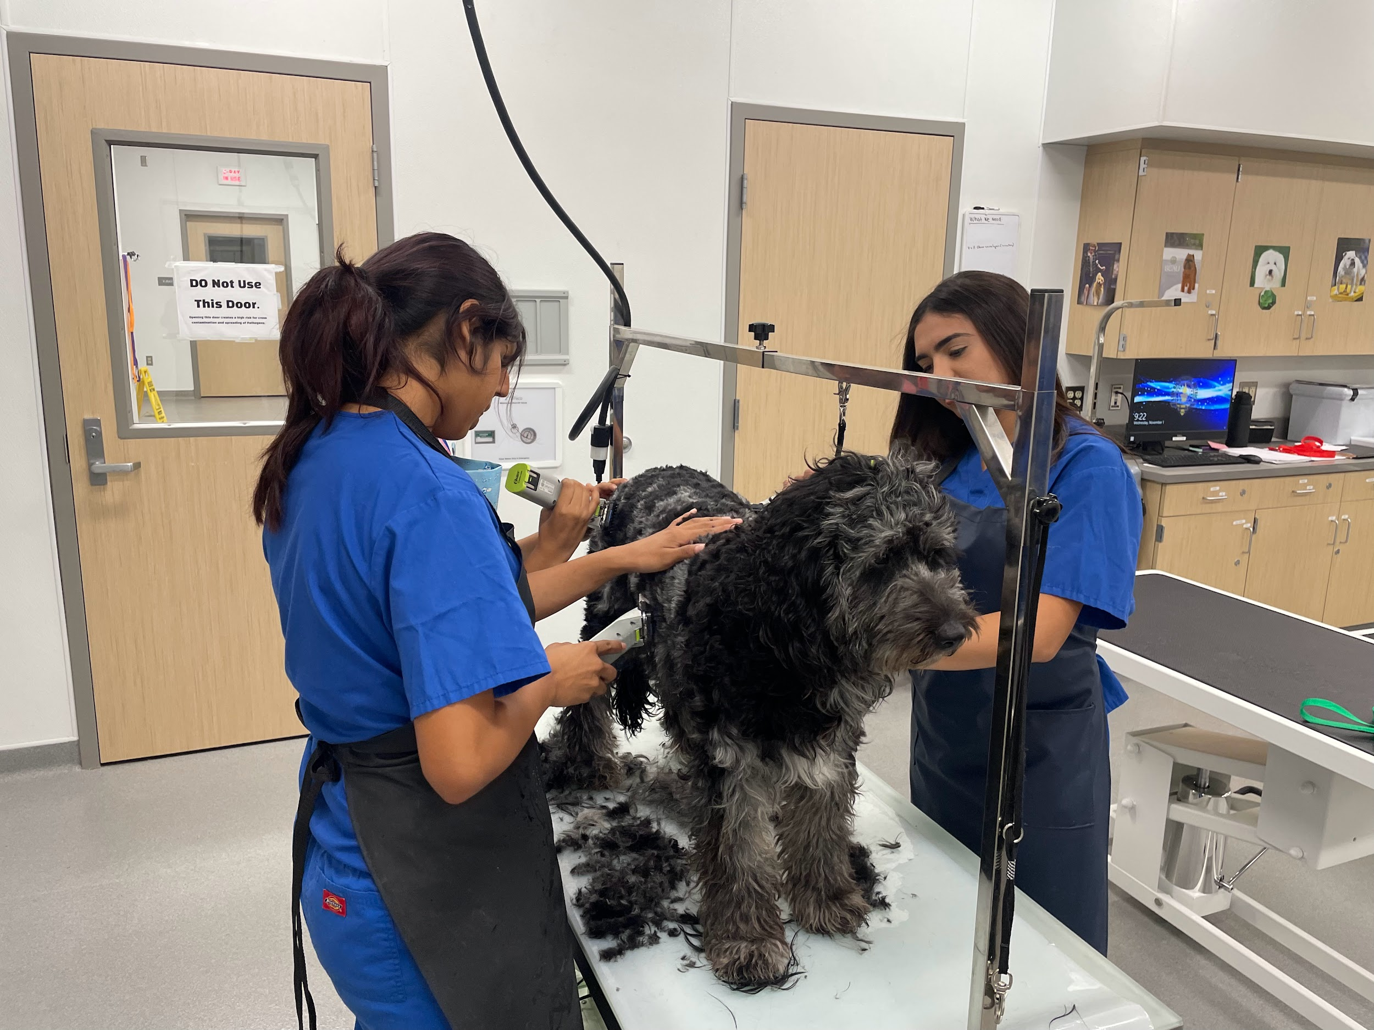
CAREER TECHNICAL EDUCATION PARTICIPATION Continuing to support CTE program development, operation, and improvement efforts at each school site

Slide 15
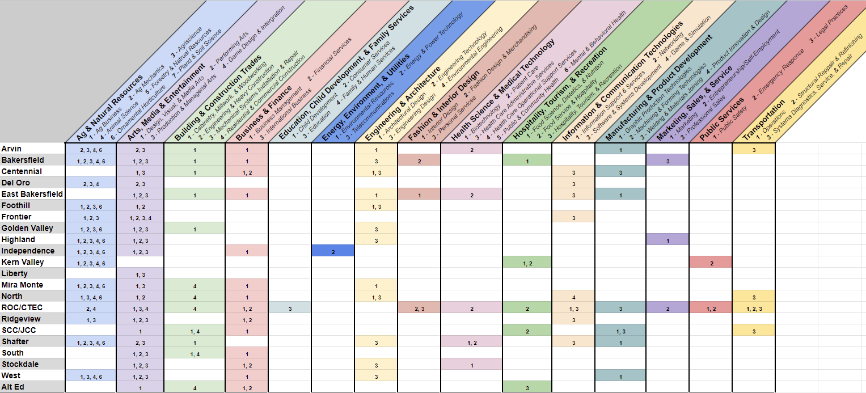
2024-2025 PATHWAYS OFFERED BY SCHOOL SITE AND INDUSTRY SECTOR

Slide 16
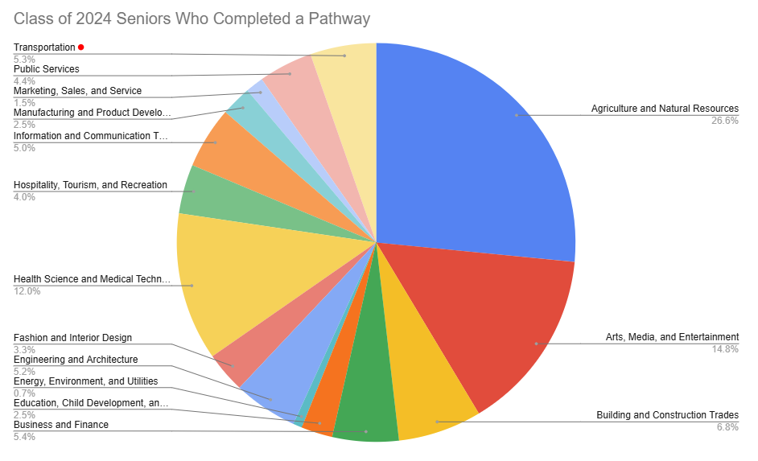
Notes:
Total numbers: 5942

Slide 17
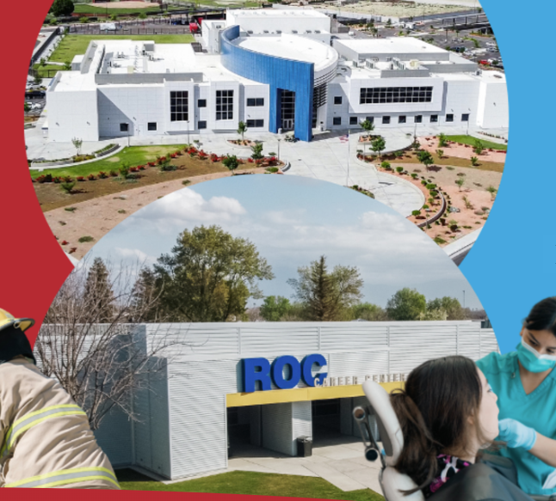
ROP PROGRAMS
Career Education at ROC & CTEC
Programs are designed as elective pathways for 11th & 12 grade students
ROC 1700+ & CTEC 1500+ students
Daytime concurrent programs are either 3 periods in the morning or periods in the afternoon
Evening programs operate Tues-Thur from 5:30-8:30

Slide 18
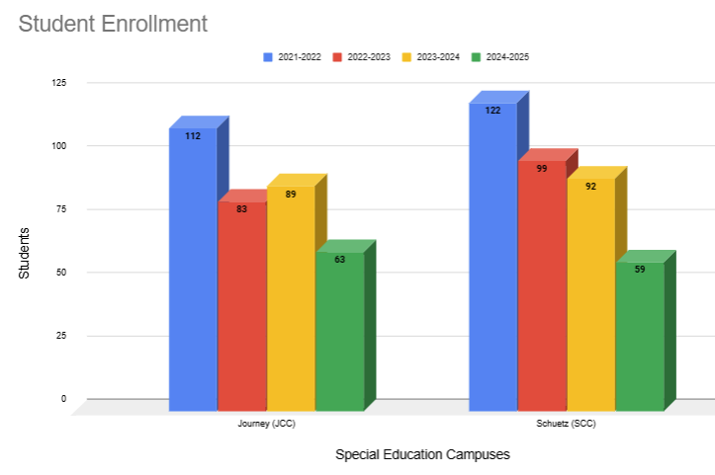
SPECIAL EDUCATION CTE PROGRAMS
PROGRAMS OFFERED
Jack Schuetz Career Center | Journey Career Center
Auto/Detailing | Auto Tech
Construction | Culinary Arts
Culinary Arts | Computer Tech
Facility Maintenance | Maintenance & Operations–Intro to Construction & Welding
Graphic Arts/Retail | Retail Manufacturing
Maintenance & Operations | Business & Finance: Hospitality
Welding

Slide 19
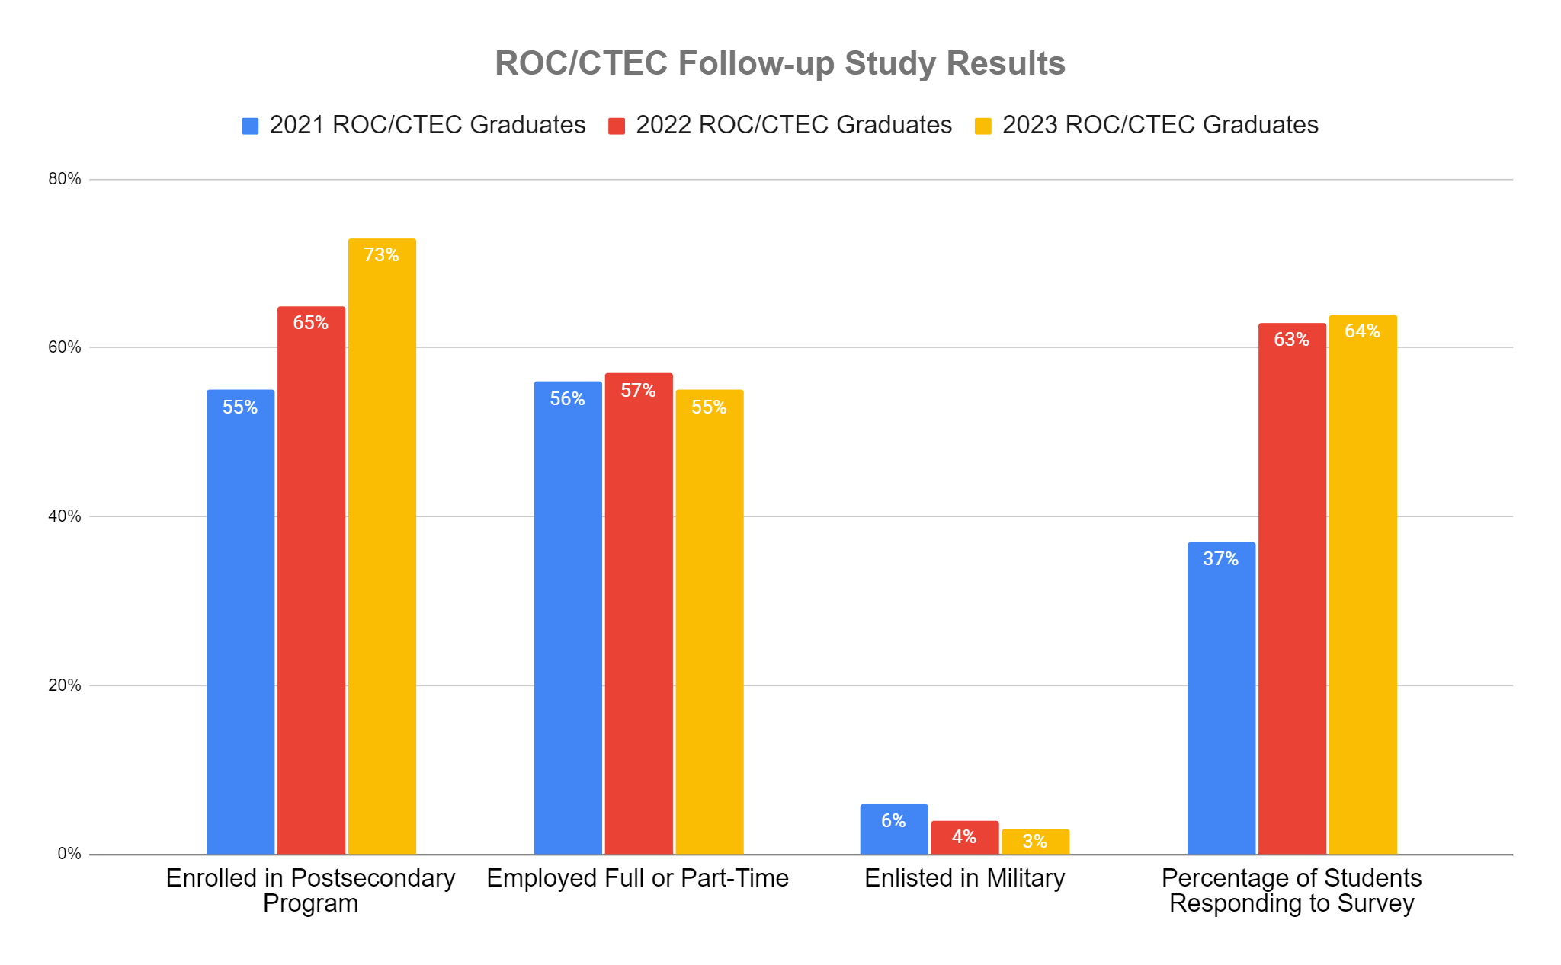
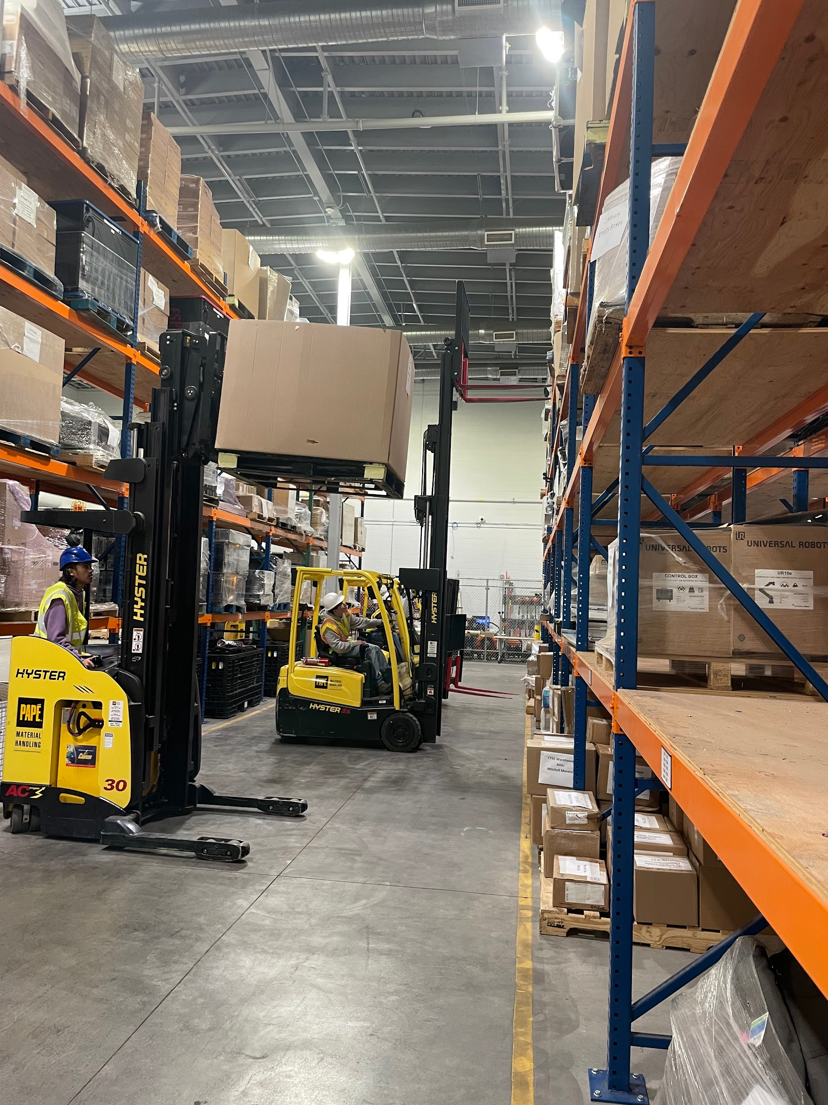
FOLLOW-UP STUDY FOR ROC/CTEC STUDENTS
*Students surveyed 6 months after graduation via phone call, text, email, or social media

Slide 20
PARTNERSHIPS THROUGH CAREER TECHNICAL EDUCATION
Working with our community, education, and business industry partners to identify and develop appropriate career and technical preparation programs

Slide 21
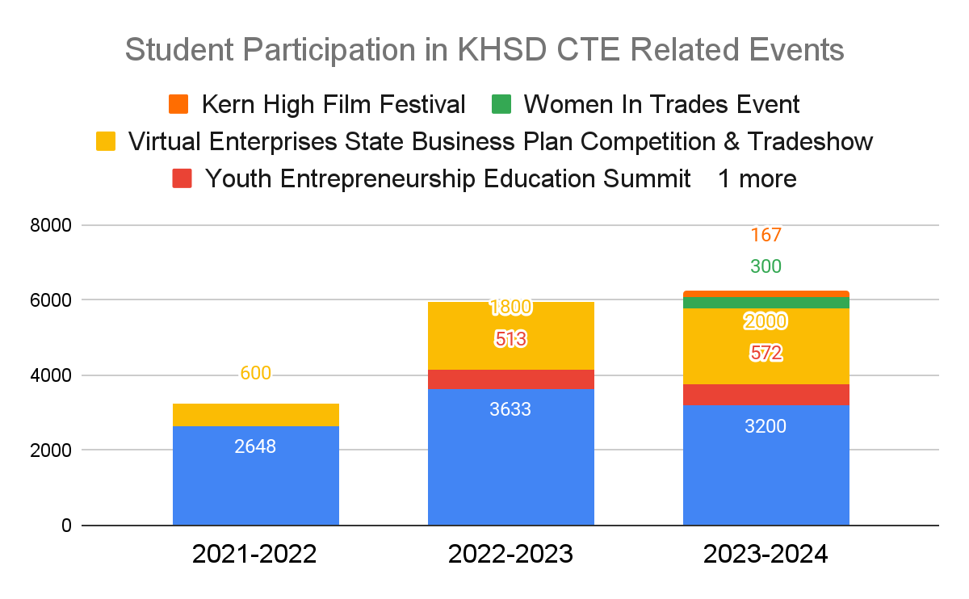
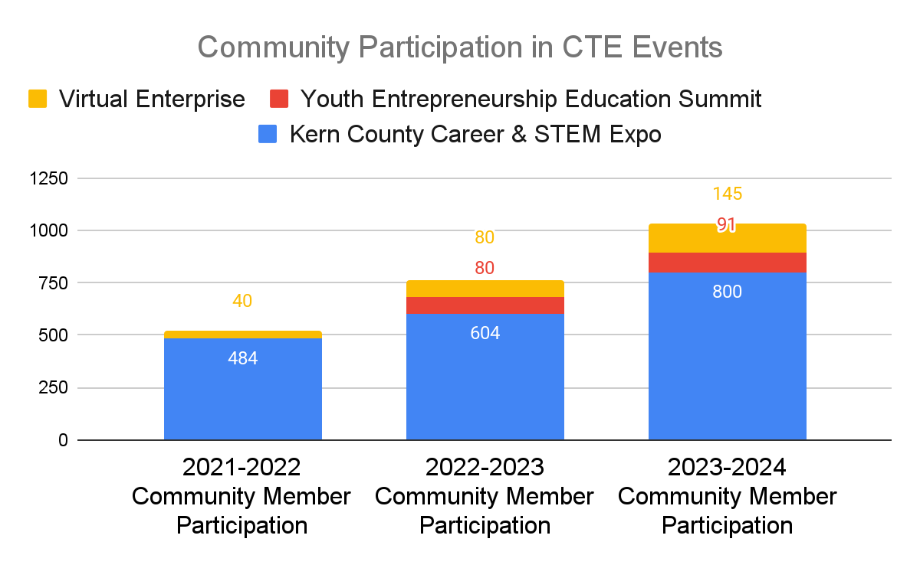
DISTRICT-WIDE CTE EVENTS PARTICIPATION

Slide 22
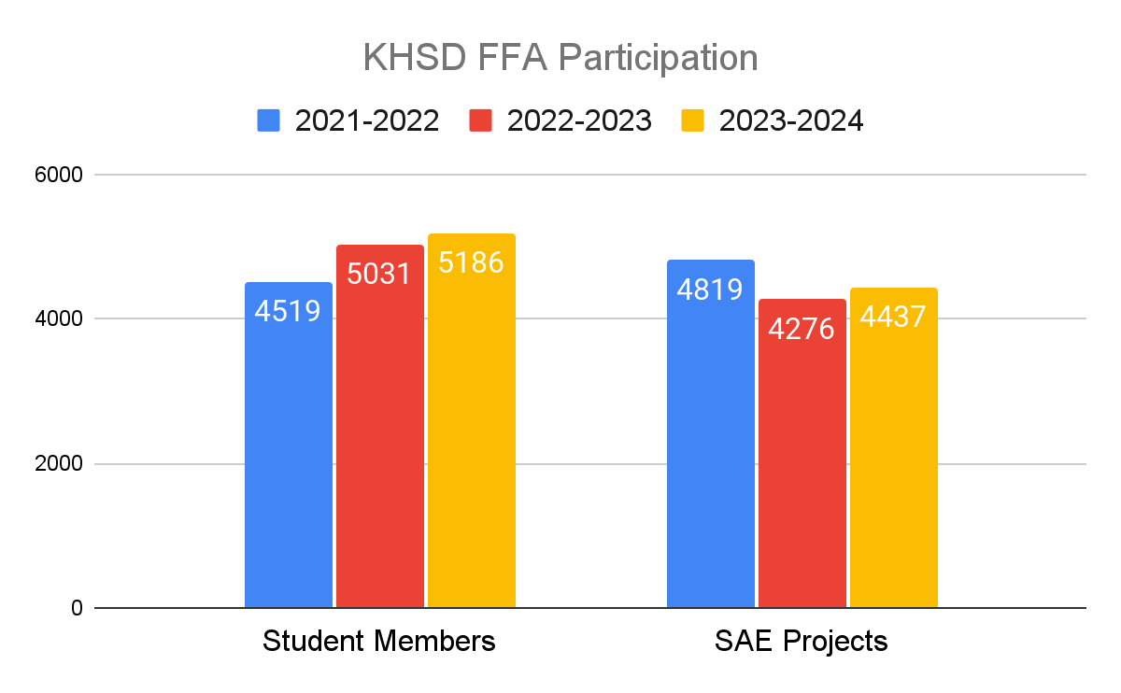
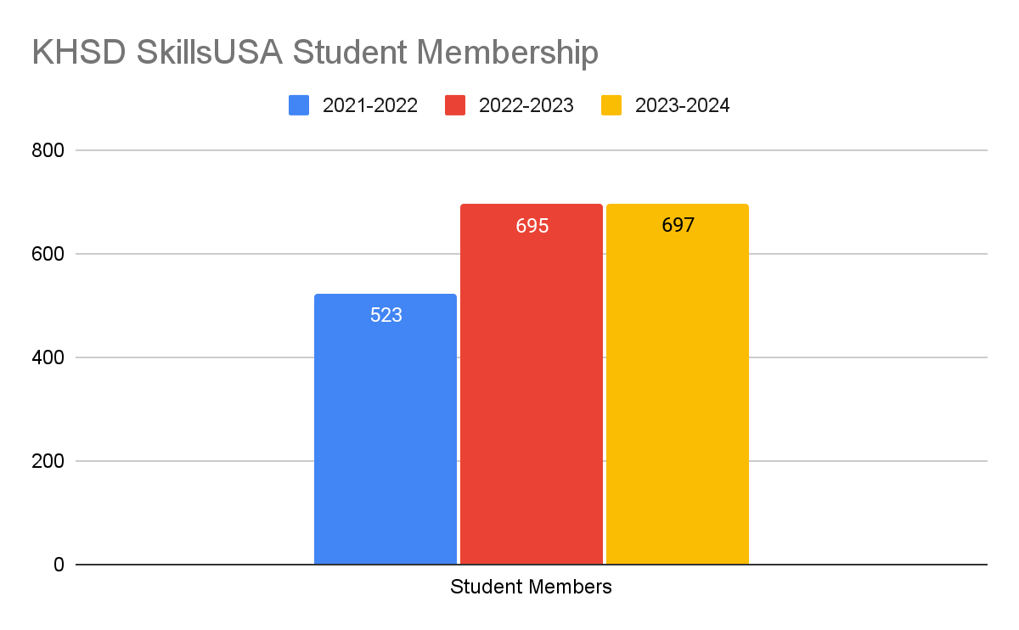
Career Technical Student Organization (CTSO) Participation

Slide 23
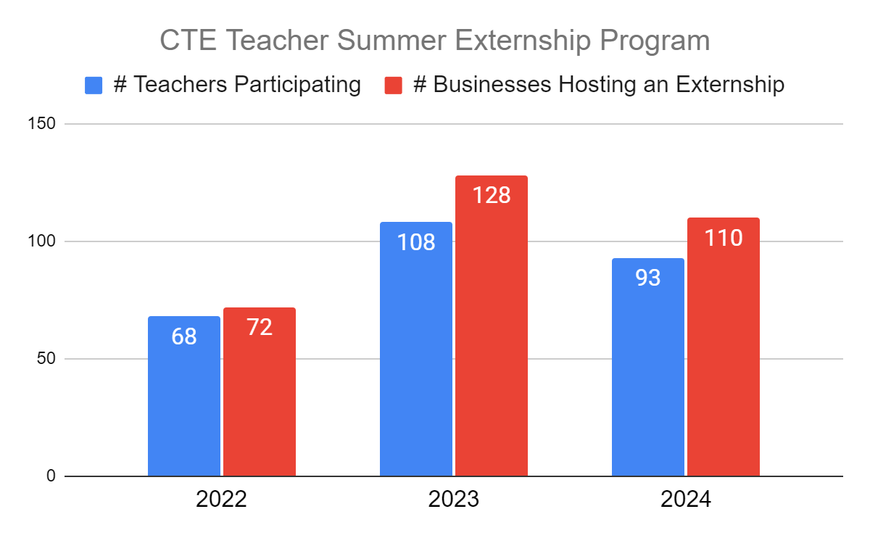
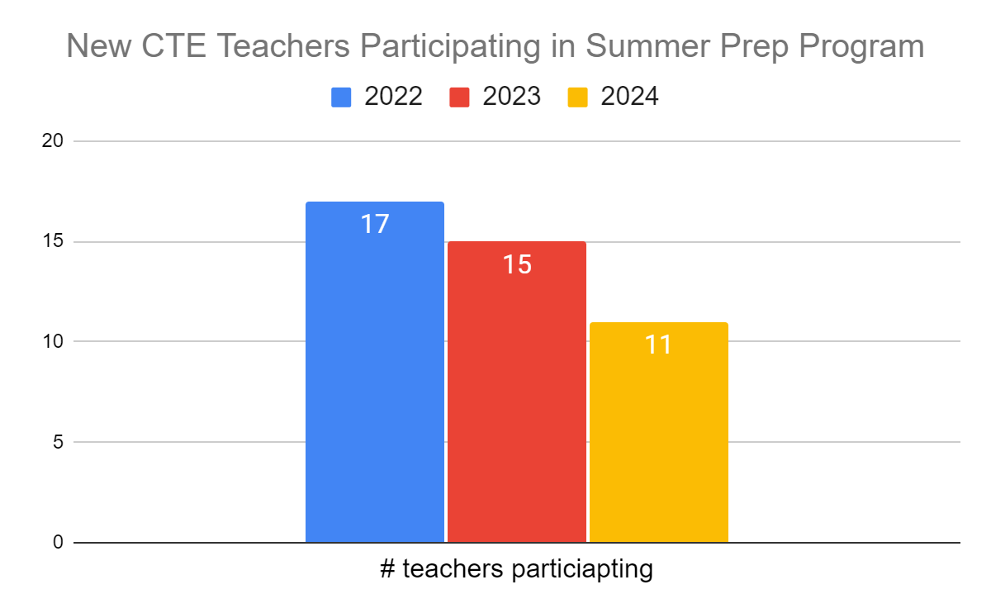
CTE TEACHER PREPAREDNESS

Slide 24
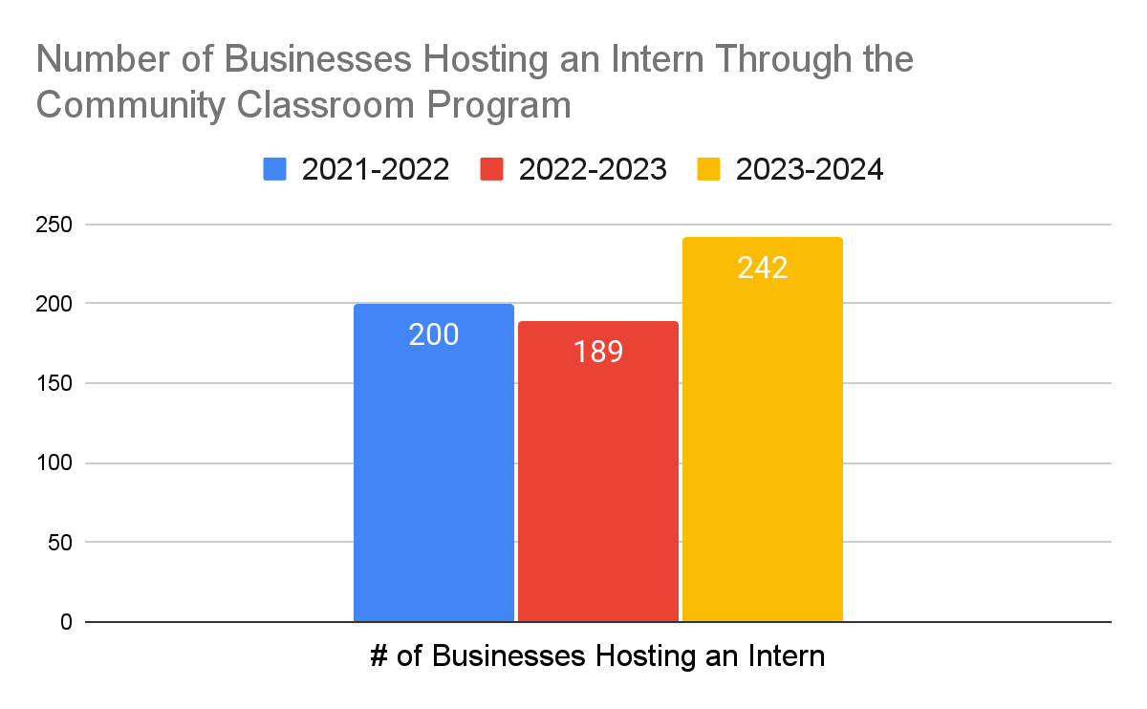
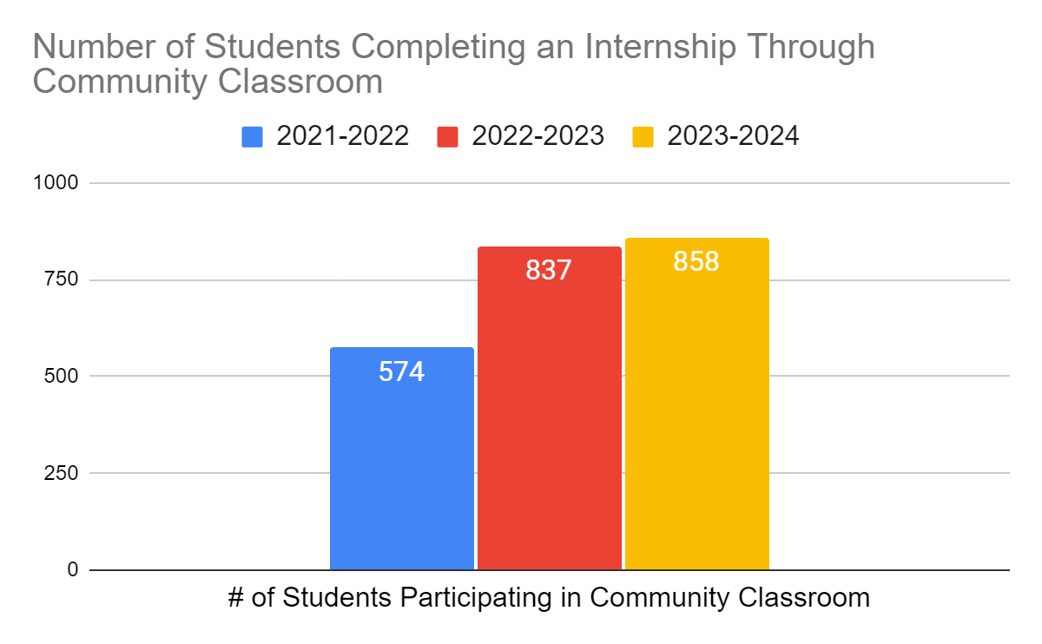
COMMUNITY CLASSROOM (INTERNSHIPS)
Community Classroom is a 12-week or longer internship that is available through many of the ROC/CTEC programs during the spring semester.

Slide 25
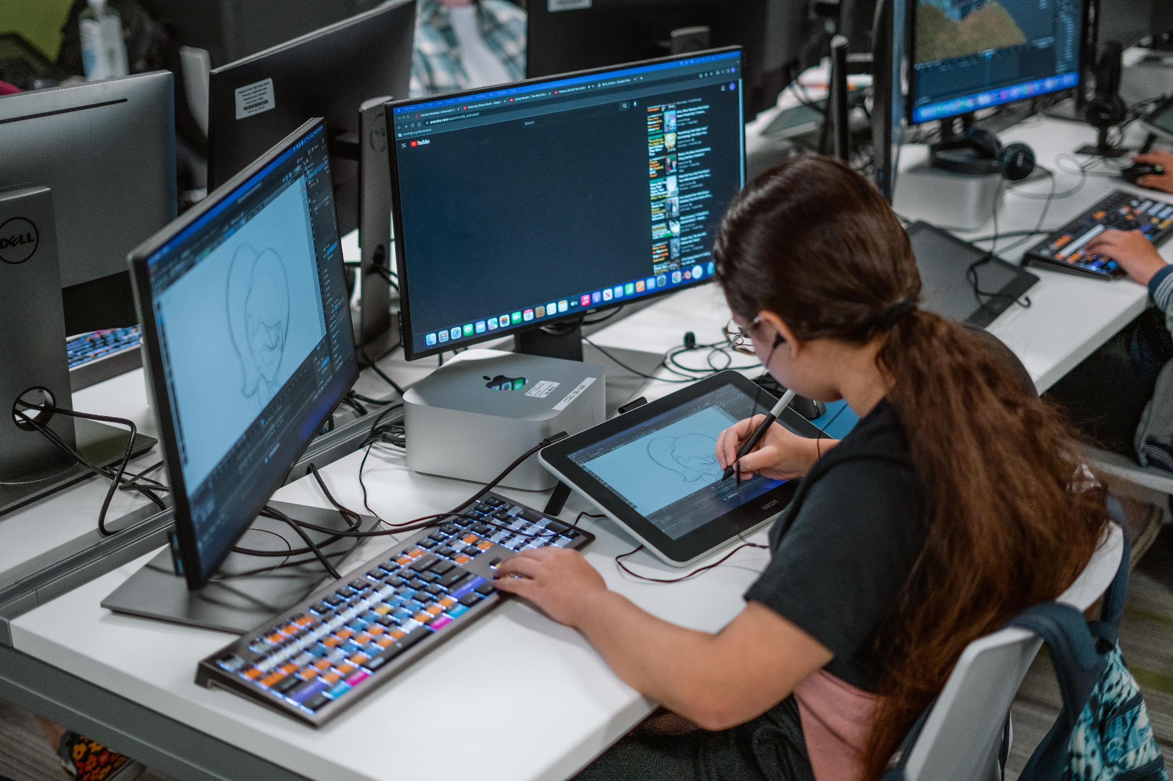
SUMMARY
Keys to Success
Work closely with your county office of education office
Develop and maintain strong relationships with local colleges and universities
Provide information and training to site administrators and teachers to enhance and extend CTE offerings and dual enrollment opportunities

Slide 26
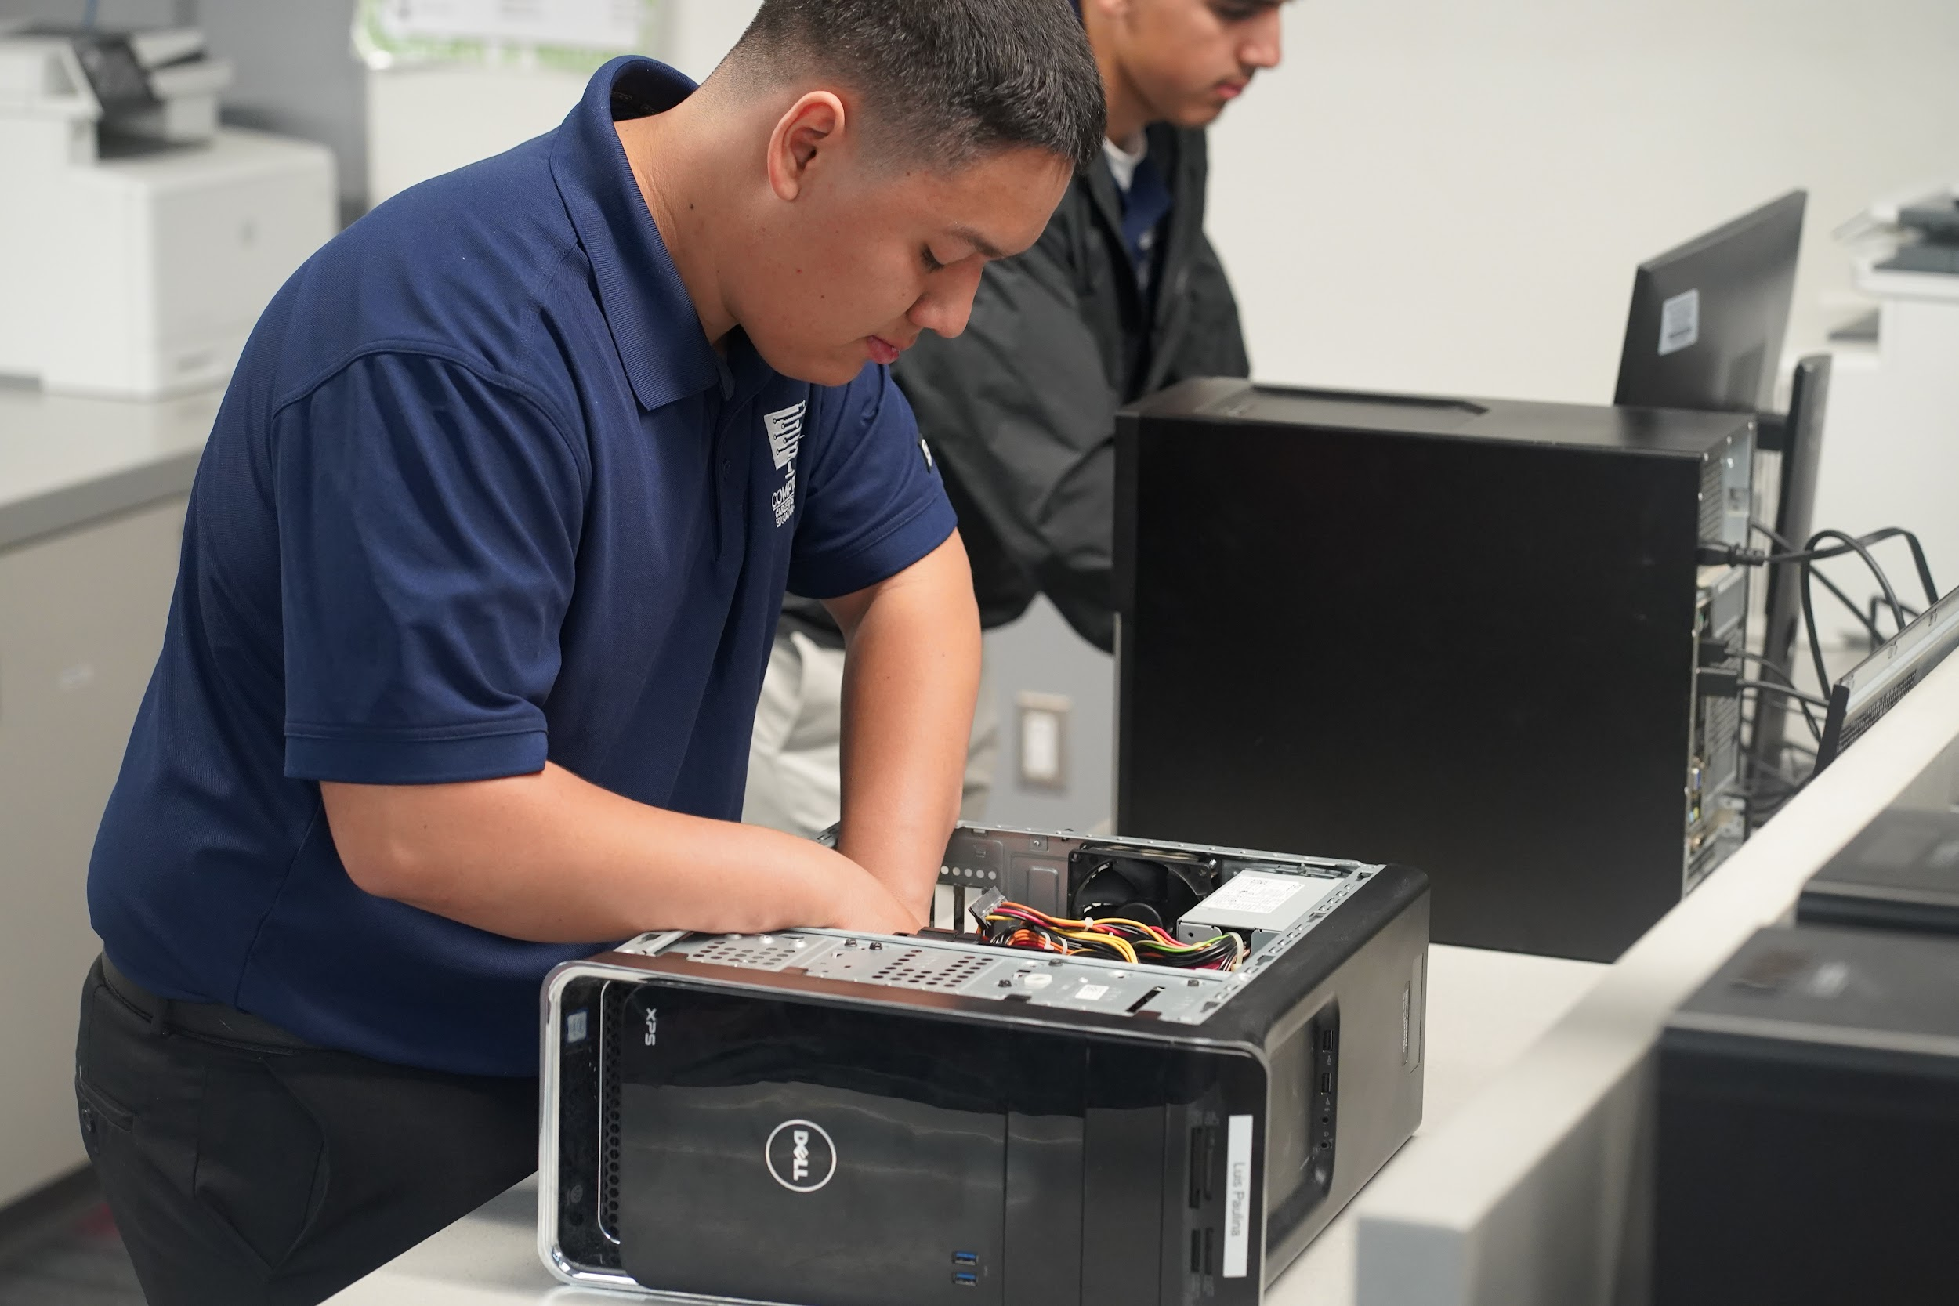
QUESTIONS

