Slide 1
CVHEC Dual Enrollment
Convening
Sonya Christian
February 3, 2025
Notes:
Good morning, everyone. It’s an honor to join you today to discuss the remarkable progress we’ve made in dual enrollment and the opportunities that lie ahead.
I want to thank the Central Valley Higher Education Consortium for organizing this convening and for your commitment to fostering equity and opportunity in our region.
Dual enrollment is a game changer, a bridge that connects high school students to the transformative power of higher education. It not only allows students to earn college credits while still in high school but also saves them time and money, accelerates degree completion, and helps them see themselves as college scholars. This is especially critical in the Central Valley, where, according to the California Community Colleges data resource, DataVista, we have the highest share of community college students dually enrolled in K-12 schools across the state.
The Central Valley’s momentum in dual enrollment is setting a gold standard for California. This region’s work exemplifies what is possible when we commit to expanding access and equity in education, paving the way for students to thrive in college and beyond.
Through Vision 2030, we’ve identified the “critical eight years”—from 9th grade through baccalaureate degree attainment—as pivotal for a student’s future success. We are working toward a future where all high school students graduate with at least 12 college credits, providing a solid foundation for lifelong learning and career readiness.
Recent legislative changes have been instrumental in shaping dual enrollment. Key policies, such as the College and Career Access Pathways (CCAP) agreements, have reduced barriers for students, streamlined partnerships, and expanded program opportunities. However, we know that with change comes both opportunity and challenge.

Slide 2
"Education is the most powerful weapon which you can use to change the world."
— Nelson Mandela

Slide 3
Vision 2030 –
9th Grade to Baccalaureate Strategy
Work toward a future in which all California high school students enroll in community college transfer, career or apprenticeship pathways and complete high school with at least 12 units of college credit.
Notes:
Before we look at the dual enrollment numbers and projects, let’s go over the bold vision to bring college to learners early, ensuring all high school students can enroll in transfer, career, or apprenticeship pathways.
Vision 2030’s “9th Grade to Baccalaureate Strategy” is the strategy which informs those strategic efforts. This strategy is informed by the success of colleges and their K12 partners throughout the state who were bold and ambitious in bringing college to learners as early as the 9th grade. This strategy builds upon those efforts, envisioning a future in which all California high school students can enroll in community college transfer, career or apprenticeship pathways and complete high school with at least 12 units of college credit.
Moreover, this strategy is focused on ensuring that those students who have been left behind and/or locked out of dual enrollment opportunities are centered in the planning and implementation of expansion efforts.
We believe this bold vision can be undertaken in partnership with key stakeholders, college districts and K12 partners like our esteemed colleagues from the Inland Empire, parents, guardians and loved ones, community-based organizations and credible equity messengers.
The 9th grade strategy ensures that every California student has the opportunity to access college pathways, with special attention to those who have been historically excluded. This includes tailored programs that address the unique needs of first-generation students, Black and Latino students, and rural communities, as well as bringing college directly to students through partnerships like the one between Bakersfield College and McFarland High School.
At McFarland High School, all ninth graders begin their journey with a student development course focused on college navigation skills and goal setting. This partnership has enabled students to graduate with associate degrees, career pathway certificates, or significant college credits—all before high school graduation.
This vision supports California's broader goals for improving educational attainment, addressing equity gaps and preparing students for a competitive workforce. It emphasizes starting early in high school to set students on a clear and achievable trajectory toward earning a bachelor's degree.
Now let’s look at current dual enrollment, projections and the untapped opportunity….
The Vision 2030: "9th Grade to Baccalaureate Strategy" is focused on creating a seamless and accelerated pathway for students starting in the 9th grade and culminating in the attainment of a bachelor's degree. This strategy aims to:
Enhance Early College Readiness: Provide high school students, beginning in the 9th grade, with access to dual enrollment opportunities and preparatory programs that align with college-level expectations.
Streamline Pathways: Map out clear, efficient academic pathways that minimize excess coursework and time spent transitioning between high school, community college, and university systems.
Focus on Equity and Access: Ensure that underrepresented and underserved students have equitable access to resources, guidance, and support to achieve their educational goals.
Promote Collaboration: Foster partnerships among high schools, community colleges, and universities to align curriculum and ensure transferability of credits.
Achieve Workforce Alignment: Align educational programs with workforce needs to prepare students for careers in high-demand fields by the time they graduate with their baccalaureate degree.
This vision supports California's broader goals for improving educational attainment, addressing equity gaps and preparing students for a competitive workforce. It emphasizes starting early in high school to set students on a clear and achievable trajectory toward earning a bachelor's degree.
Now let’s look at current dual enrollment, projections and the untapped opportunity….
About the 9th Grade to Baccalaureate Strategy Project
The Vision 2030 9th Grade Strategy to BA Completion strategy works toward a future in which all California high school students enroll in community college transfer, career or apprenticeship pathways and complete high school with at least 12 units of college credit.
Note on the CO implementation efforts:
Since the launch of Vision 2030, the Chancellor's Office has sponsored nearly two dozen equitable expansions of dual enrollment workshops, highlighting the 9th Grade to Baccalaureate Strategy. This effort is apart of a multi-pronged strategy, along with guided pathways, equitable placement and other system reforms to 1) bring college to new learners, 2) shift responsibility for college and career access, preparedness and success from the learners and their families to institutions and systems and 3) doing so while eliminating gaps in access, supports and success to accelerate progress toward not just completion of degrees and credentials but socio-economic mobility, economic empowerment and the elimination of racial inequities in higher education. The CO has also presented on our equity based dual enrollment strategy at the Umoja and A2MEND conferences, California Latino School Board Association conference and a number of statewide dual enrollment conferences.

Slide 4
California Community College Data on Dual Enrollment
Notes:
Now let’s look at current dual enrollment, projections and the untapped opportunity….

Slide 5
Dual enrollment students attending a
CA Community College
Historical data is in blue with baseline year in 2021-2022 in bold. 2023-24 data is using Fall 2023 increase (in parentheses). Annual Vision 2030 targets are in yellow with target outcome in 2029-2030 in bold
Notes:
Now let’s look at current dual enrollment, projections and the untapped opportunity….
Total enrollment in California Community Colleges has grown to over 2.1 million students as of 2023-24—a 9.6% increase from the previous year.
Dual enrollment has been a key driver of this growth, accounting for significant gains in access and equity.
Dual Enrollment has seen a significant increase of 24%. That represents 56,218 more high school students who can now see college in their future… remember, you cannot be what you cannot see) and this is over a 13.7%, (28,148 students) increase over the previous year.
This is the good news.
Even with 289,906 high students attending a California community college, disparities persist. Black and Latino high school students continue to be underrepresented in dual enrollment courses throughout California. We have much work to do!

Slide 6
Dual Enrollment Opportunity Is Strong
Last academic year, there were more than 1.9 million high school students in California.
For the 2023-24 academic year, there were 289,906 high school students dually enrolled at California’s community colleges.
Data shows that from the universe of high school students, the untapped opportunity is more than 80%.
Notes:
The state of dual enrollment is strong .... the state of the untapped opportunities is even stronger.
We must double down on our dual enrollment efforts with equity. The goal is for all high school students to graduate with at least 12 college credits by the time they complete high school. This number comes from the Governor’s Roadmap.
Now
the students could start in the 9th grade and do 12 credits in four years. This is the ninth grade strategy.
Or in the 10th grade and do 12 credits in three years
Or in 11th grade, they can do 12 credits in two years.
Data shows that from the universe of high school students, the untapped opportunity is more than 80%.
Data sources:
2023-24 with this HS data:
https://www.cde.ca.gov/ds/ad/cefenrollmentcomp.asp.
DE: 289,906
9-12th graders in CA: 1,913,982
Breakdown CDE data by grade available (NOT by age); need CCCCO corresponding enrollment data to map a chart:
https://dq.cde.ca.gov/dataquest/dqcensus/EnrEthGrd.aspx?cds=00&agglevel=state&year=2023-24
https://dq.cde.ca.gov/dataquest/dqcensus/EnrEthGrd.aspx?cds=00&agglevel=state&year=2022-23
For the percentage slide:
The percentage increase from 233,688 to 283,844 is 21.46%. ​​
The percentage increase from 233,688 to 289,906 is 24.06%. ​

Slide 7
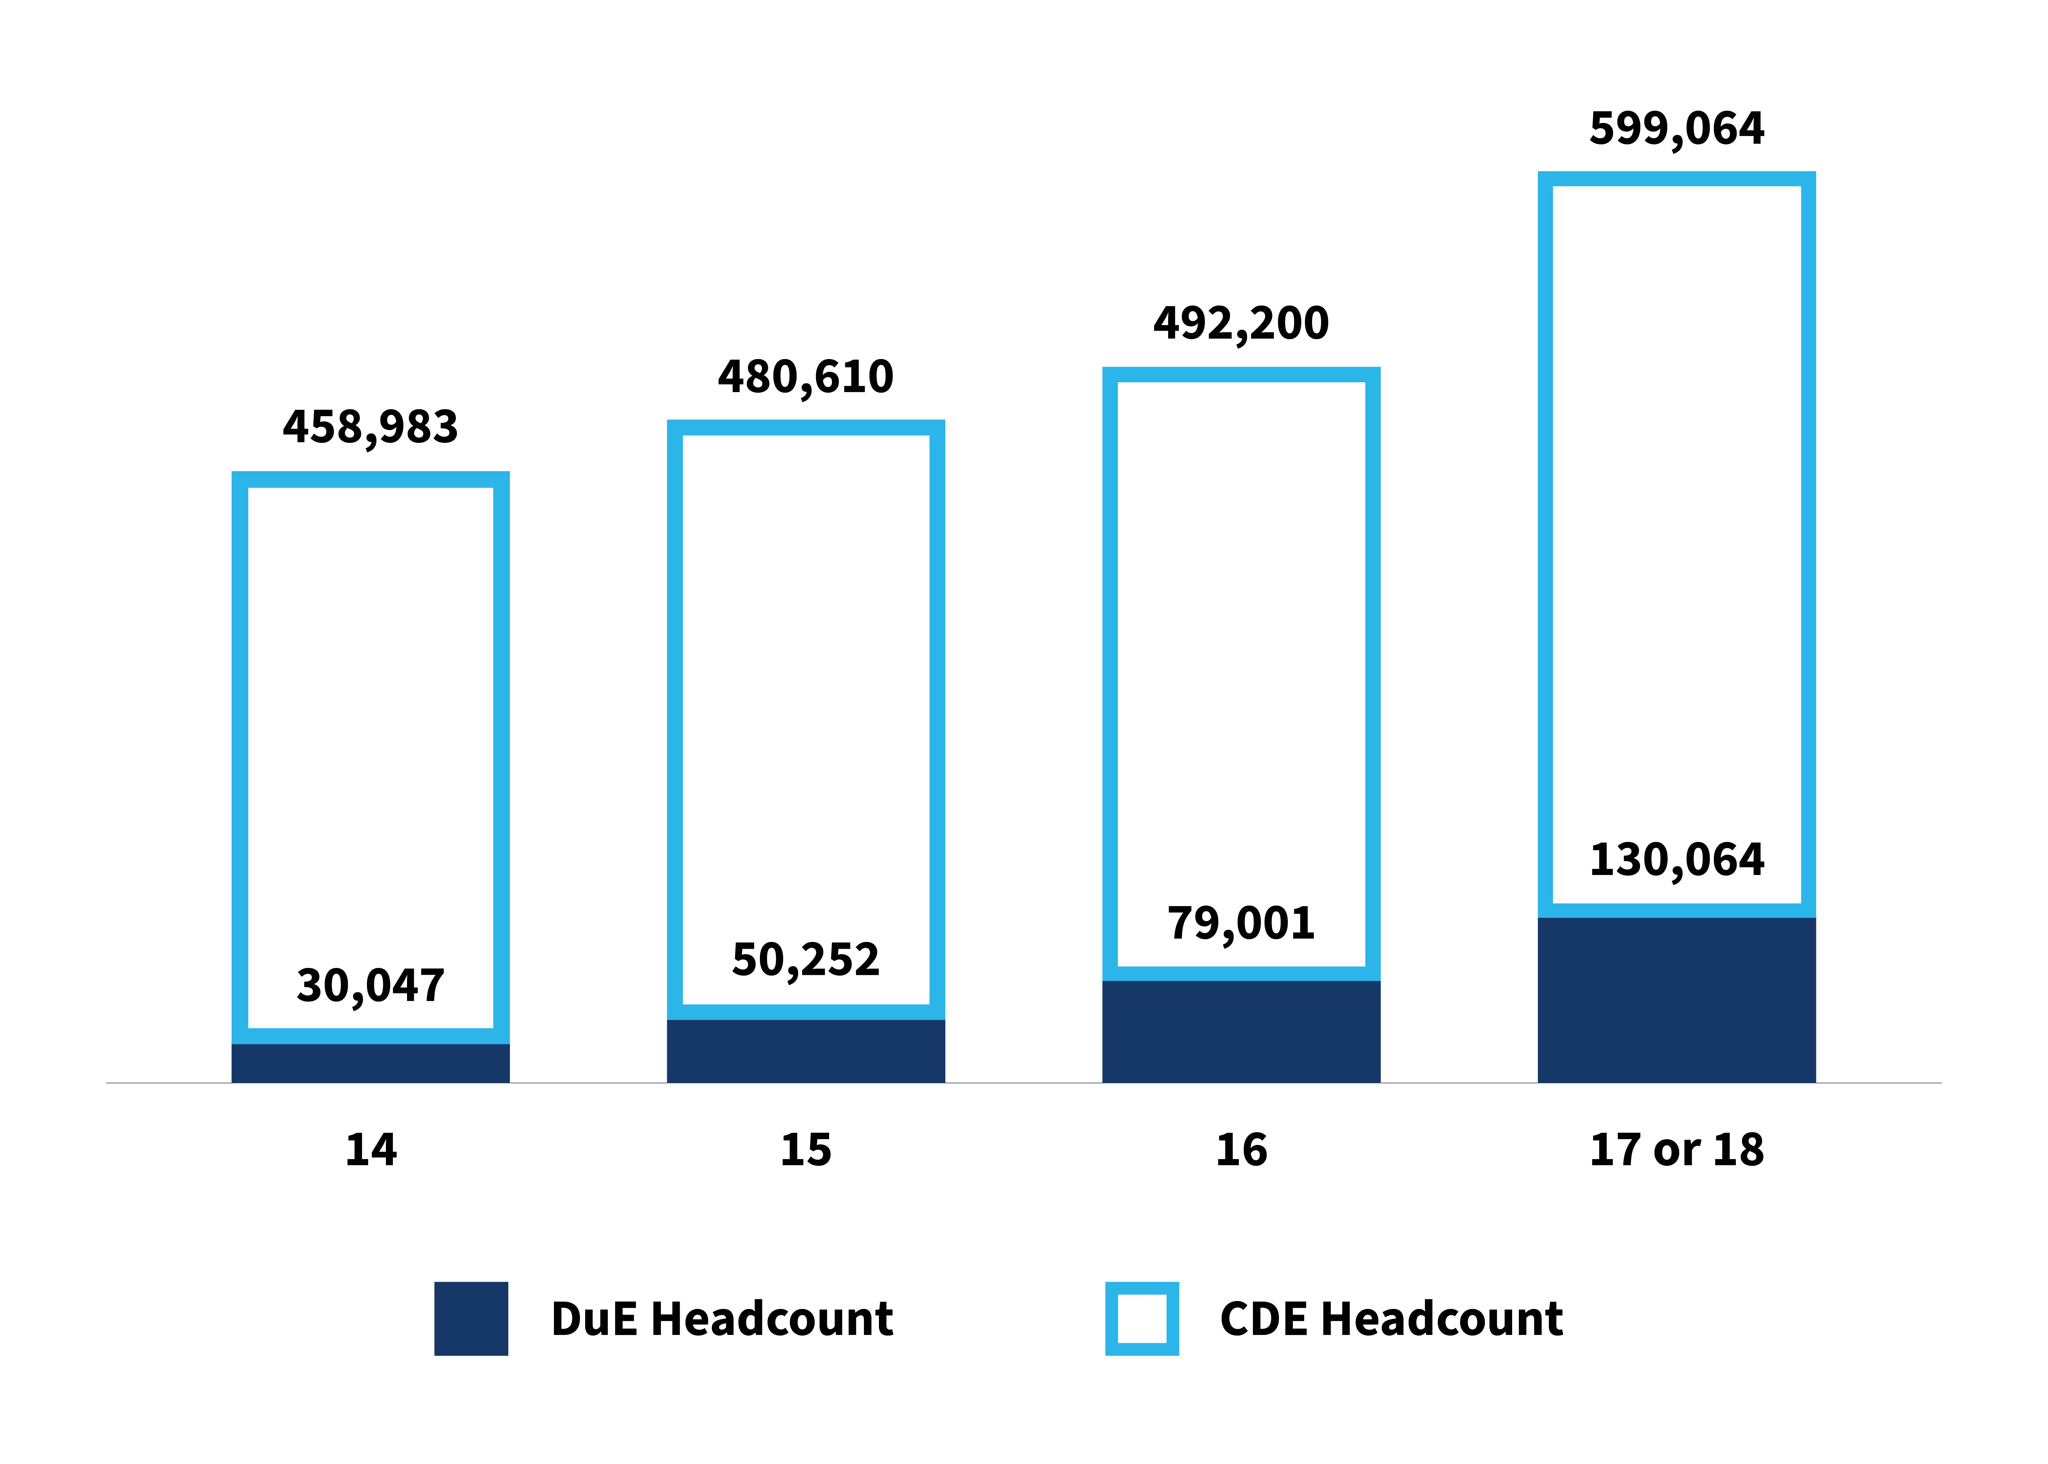
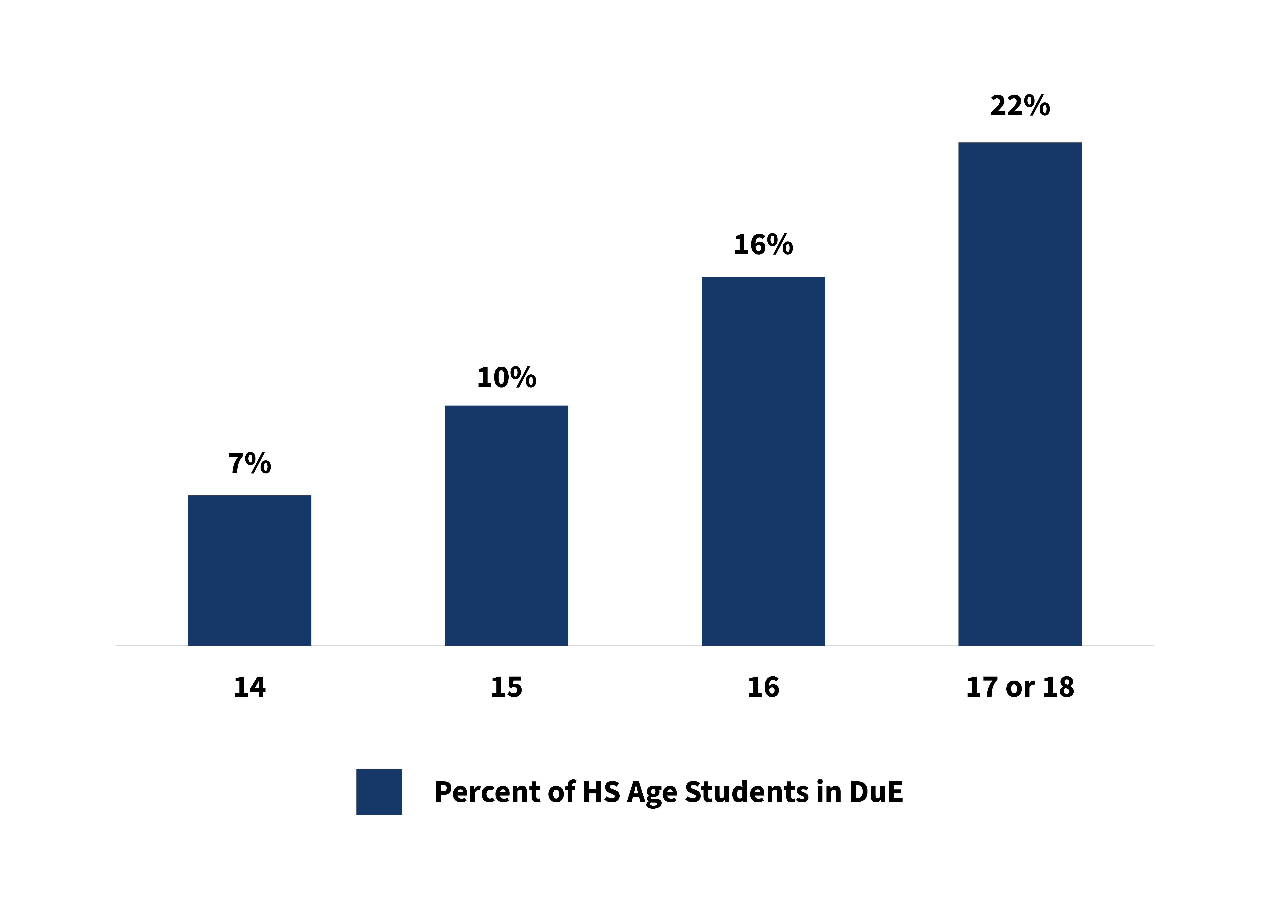
Dual Enrollment Opportunity Is Strong
California Dual Enrollment Participation
by Student Age | 2023-2024
Percent of High School Students Participating in Dual Enrollment by Age | 2023-2024
Notes:
This is one of my favorite bar graphs because the white space shows our high school students who have not enrolled in college classes.
And our job is to decrease that white space by getting all high school students to have this opportunity to both career education pathways and transfer pathways, particularly for underserved students.

Slide 8
Dual Enrollment as Share of CA High School Enrollment
Sources: COMIS, pulled 11/20/2024.
CDE DataQuest: https://dq.cde.ca.gov/dataquest/dqcensus/EnrAgeGrd.aspx?cds=00&agglevel=state pulled 12/06/2024
Age from COMIS is being used as a proxy for high school grade level.
Dual enrollment counts (numerator) are using the student’s age at the first term they appear in that academic year.
CDE counts (denominator) are from CDE’s publicly reported enrollment counts by grade level.
Notes:
When we look at “Dual Enrollment as Share of CA High School Enrollment,” we see that ages 16 and 17 are the most represented in dual enrollment, exceeding the percentage overall of dual enrollment students.
The opportunity here is to expand outreach to ages 14 and 15 in order to increase those age groups’ access to dual enrollment.

Slide 9
Dual Enrollment in the Central Valley is growing faster than other regions.
In 2017/18, the Central Valley made up 13% of the system’s
DuE population, in 2023/24 it was 21%
Notes:
Looking at Dual Enrollment headcount in Central Valley as share of state, Dual Enrollment in the Central Valley is growing faster than other regions.
In 2017/18, the Central Valley made up 13% of the system’s DuE population, in 2023/24 it was 21%
Bar graph is deduplicated at the system level.

Slide 10
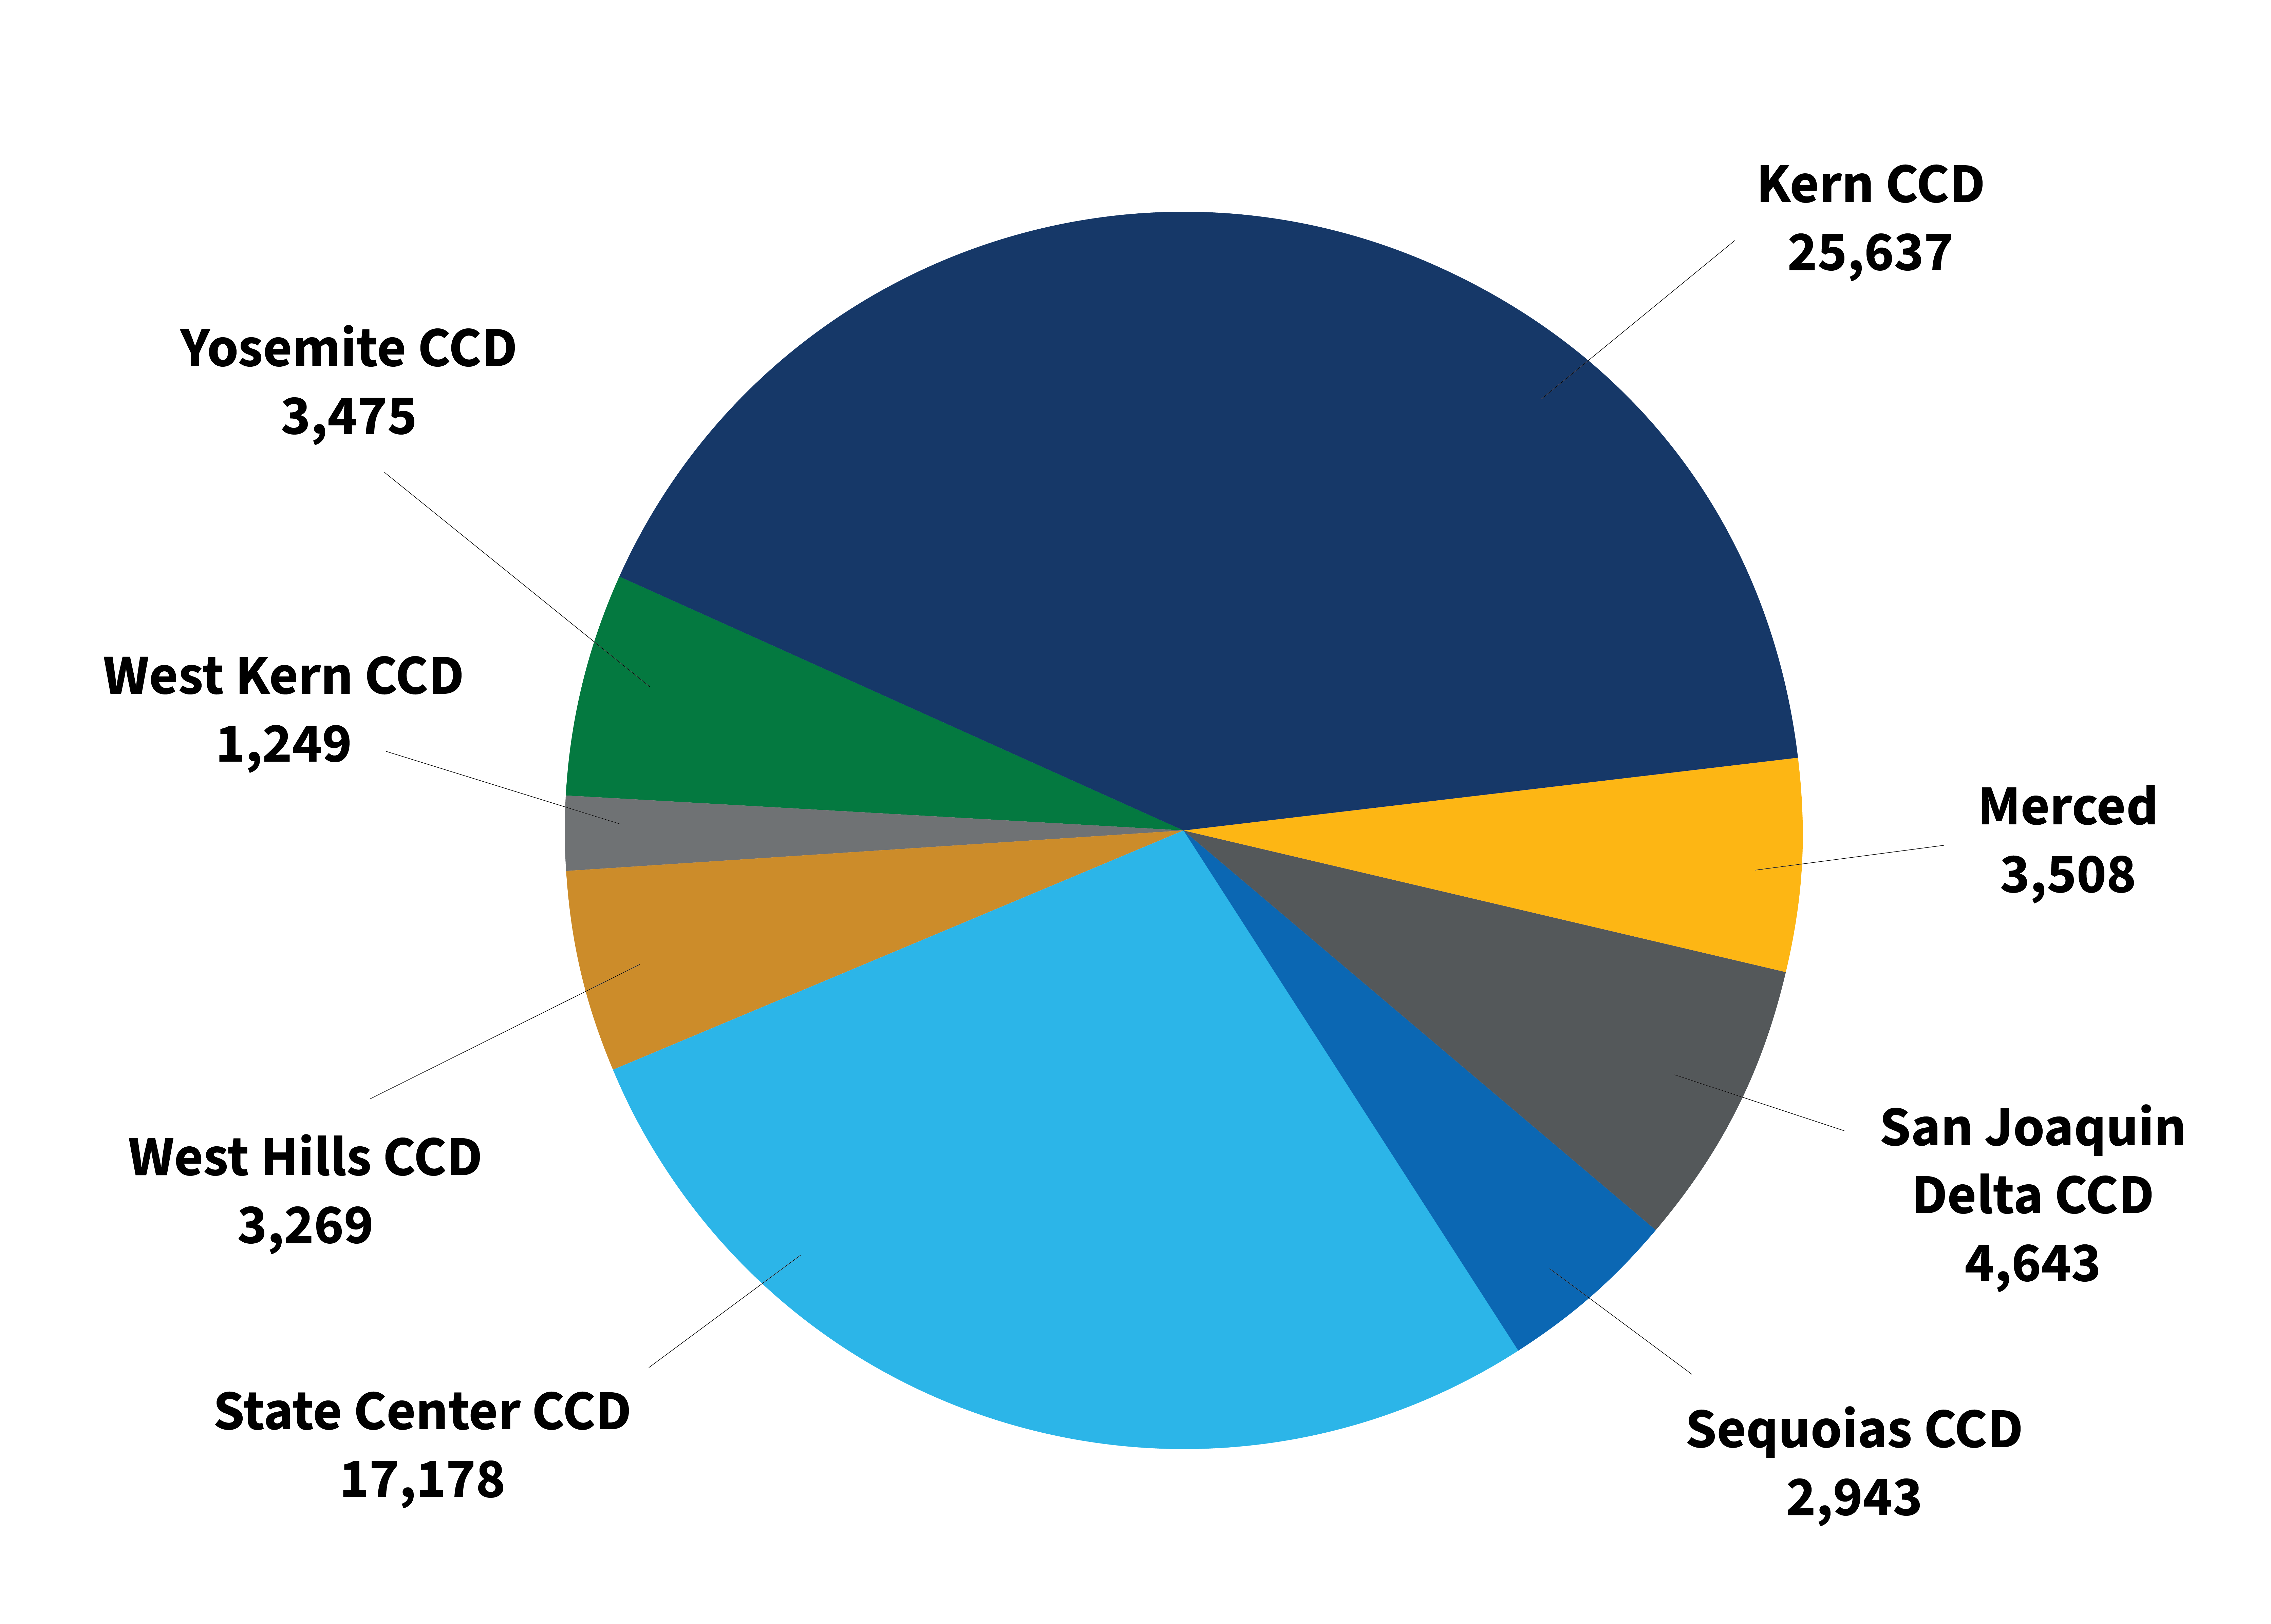
Dual Enrollment in Central Valley Districts in 2023-24
Kern CCD makes up 41% of the DuE headcount for the region in 2023/24.
Notes:
This is a snapshot of 2023/24 dual enrollment headcounts for the districts in the Central Valley region.
While Dual Enrollment is growing in all Central Valley districts, there is a wide range in the size of each district’s programs.
Kern CCD makes up 41% of the DuE headcount for the region in 2023/24.
Counts are deduplicated at the district level.

Slide 11
Dual Enrollment works –
This is not a disputed fact
So, what is the work?
Doing dual enrollment at scale and with equity

Slide 12
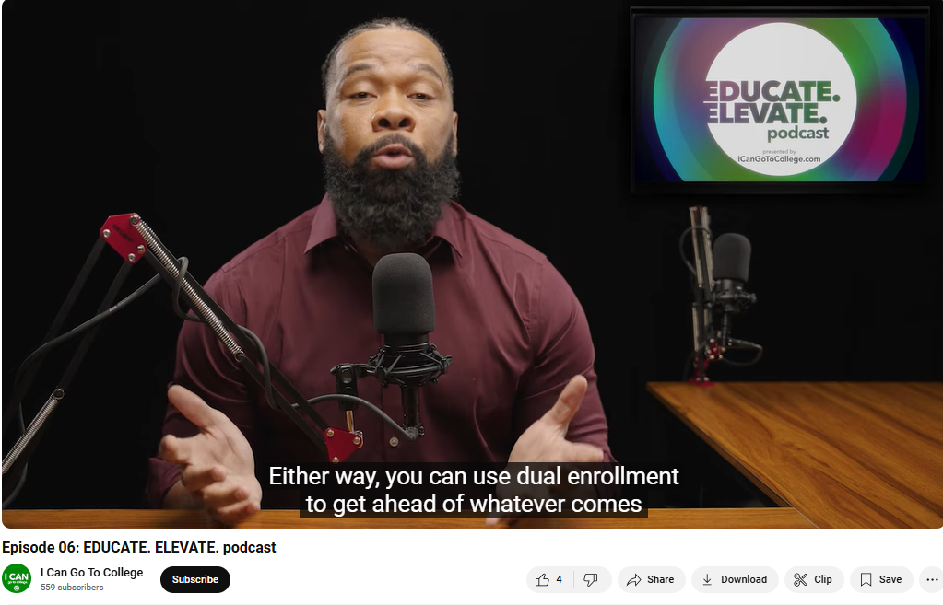
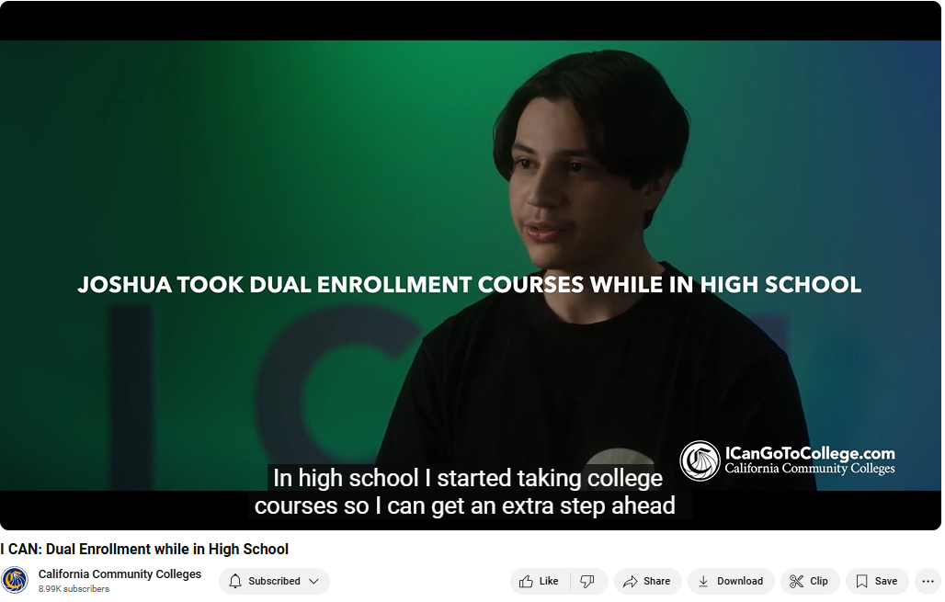

I Can Go To College Campaign –
Dual Enrollment Video Promotions
Educate. Elevate. Podcast
Video on Dual Enrollment
Notes:
The I can Campaign is addressing the equity gaps in specific advertising and outreach/messaging in some of our harder to reach communities such as Black/African American students.
The campaign produces an ongoing podcast series and released a video specific to Dual Enrollment.
Video Promo Full-Length; used for short Video Promotions as well on Social Media: (click image above to watch) – Let us know if you want to play the video
This video tells potential student that they can ”get a head start on your future at a California Community college.” It goes on to share that with dual enrollment courses, you can earn college credit while still pursuing your high school diploma. Learn more and enroll today at ICanGoToCollege.com.
The Elevate. Educate. Podcast Series – Episode 6 of Season 1 with Host Danny Morrison
This podcast is available online at the I Can website, on social media and wherever else you get podcasts.
This episode promo starts with “Unlock your potential with dual enrollment! If you are still in high school or earning your GED, dual enrollment offers a golden opportunity to earn college credits while still in high school or at an adult education school.”
MORE: In this episode, you'll hear from one of California's leading dual enrollment experts about how dual enrollment programs are creating new opportunities for Black students statewide. You'll also hear from another guest, a junior in high school who is already making waves in both academics and athletics thanks to dual enrollment. Her advice to others? Believe in yourself and pursue your dreams fearlessly. You CAN accomplish your dreams - it's never too late - you just need to know where to start. Learn more at ICanGoToCollege.com.

Slide 13
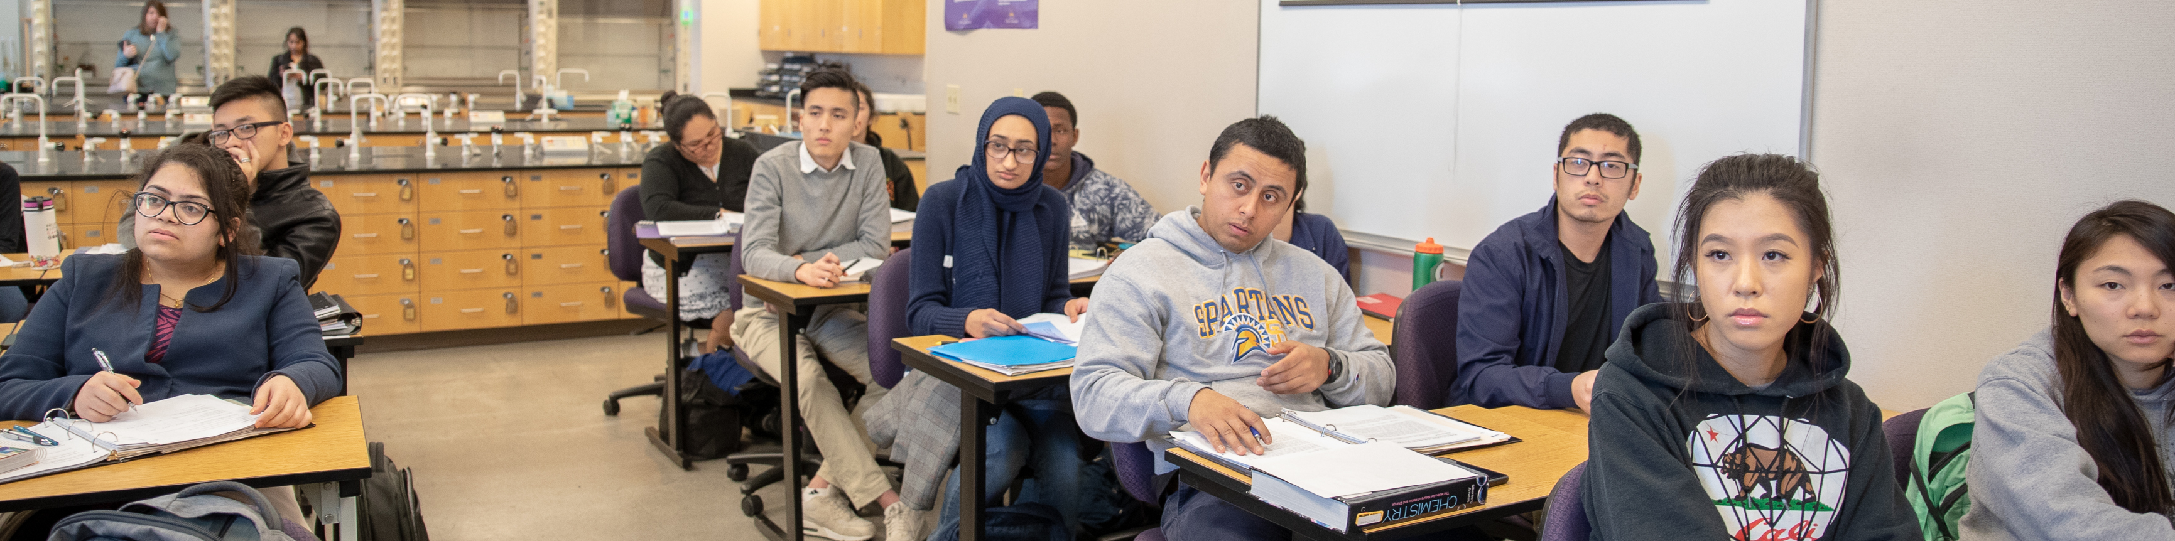
Program Pathways Mapper and Dual Enrollment
Notes:
The Program Pathways Mapper offers dual enrollment students a structured and supportive environment to plan their educational journey efficiently and effectively, reducing barriers to success and promoting timely graduation.
The Program Pathways Mapper benefits dual enrollment students in several key ways:
Clear Pathways Visualization: Dual enrollment students can use the Mapper to see a mapped-out view of their educational pathway, including how courses taken in high school align with their goals in higher education, whether in a community college, California State University, or University of California system.
Streamlined Transfer Process: The Mapper reduces complexity in transferring between different educational systems, ensuring that dual enrollment credits are appropriately applied to degree requirements, thereby reducing the risk of excess units.
Equitable Access to Planning Information: Dual enrollment students, especially those from underserved communities, gain equitable access to career and educational planning tools, helping them make informed decisions about their educational and career paths.
Higher College-Going Rates: By offering a clear, actionable plan for achieving their goals, the Mapper encourages more dual enrollment students to continue their education beyond high school.
Faster Entry into the Workforce: Dual enrollment students can efficiently progress through their educational pathways, accelerating their transition into the workforce.
Counselor Support: High school counselors can use the Mapper to provide targeted, strategic guidance to dual enrollment students, focusing on their specific educational and career goals.

Slide 14
"Live as if you were to die tomorrow.
Learn as if you were to live forever."
— Mahatma Gandhi

Slide 15
Our Time is Now!
Notes:
“Each day, millions of Californians trust us with their dreams for a brighter future. It is our responsibility to expand dual enrollment, create equitable opportunities, and help all students achieve success.”
Our time is now!

