Slide 1
NATIONAL AND STATE POSTSECONDARY ATTAINMENT RATES
56.1%
70%
California Postsecondary Attainment (2023)
California Postsecondary Attainment Goal 2030
54.9%
National Postsecondary Attainment (2023)
Lumina Foundation’s Stronger Nation: Educational Attainment in the United States

Slide 2
The Completion Imperative
Georgetown University Center on Education and the Workforce, The Cost of Economic and Racial Injustice in Postsecondary Education

Slide 3
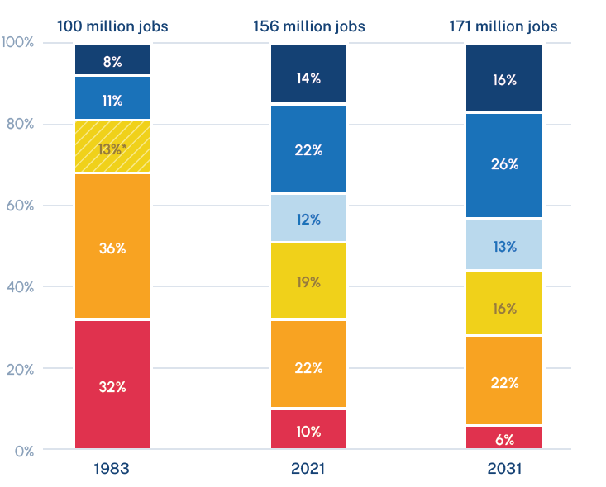
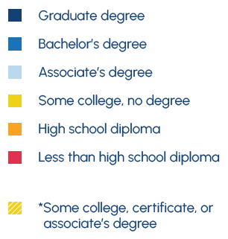
Education and Jobs
72%
California
12%
20%
22%
8%
24%
13%
Georgetown University Center on Education and the Workforce, After Everything: Projections of Jobs, Education, and Training Requirements through 2031

Slide 4
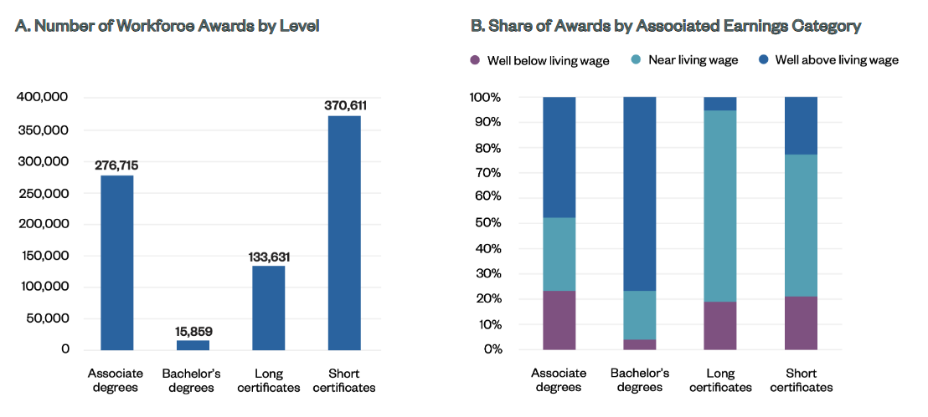
Community College Workforce Credentials
https://ccrc.tc.columbia.edu/publications/community-college-awards-for-post-completion-success.html

Slide 5
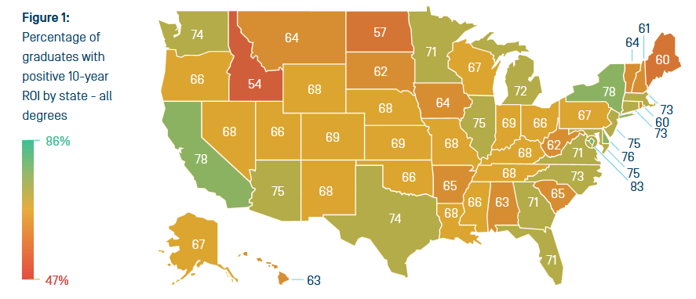
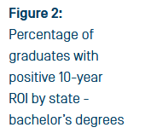
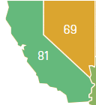
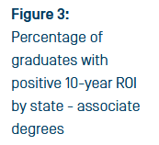
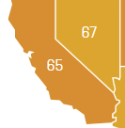
Return on Investment and Higher Ed
https://www.strada.org/state-opportunity-index

Slide 6
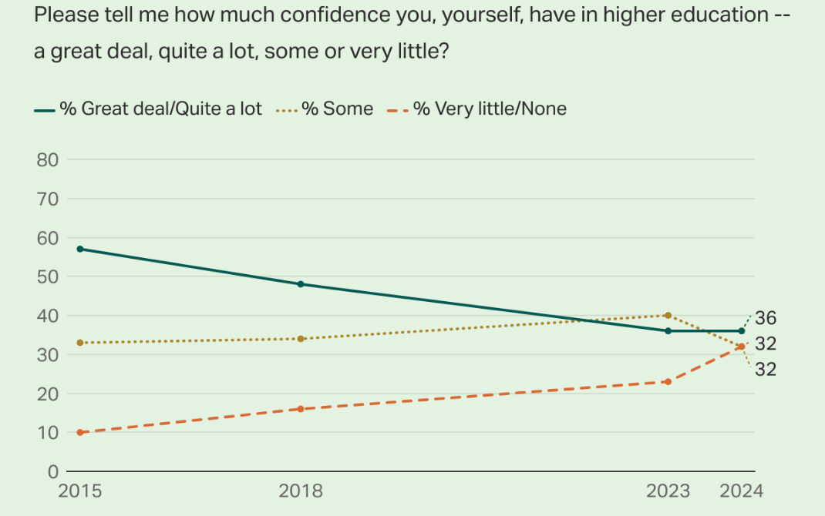
American’s Confidence in Higher Education Continues to Fall
https://news.gallup.com/poll/646880/confidence-higher-education-closely-divided.aspx

Slide 7
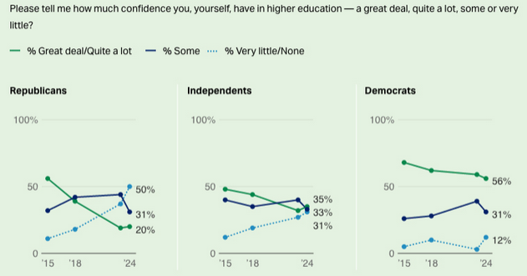
Trends in Confidence in Higher Education, by Political Party
https://news.gallup.com/poll/646880/confidence-higher-education-closely-divided.aspx

Slide 8
Americans still think that the investment in postsecondary education is worth it.
New America, Varying Degrees 2023: New America’s Seventh Annual Survey on Higher Education

Slide 9
What higher education can deliver for students and society
Student Social Justice Agency
Equitable Wealth
Student Learning Outcomes & Skills
Equitable Earnings
Value for Students
Value for Students and Society
Student Wellbeing
Equitable Completion
Public Revenues & Gross Domestic Product
Value for Society
Equitable Support
Workforce Diversity & Pay Equity
Equitable Afford-ability
Economic & Cultural Vitality in Communities
Equitable Access
Civic Engagement, Empower-ment, & Pluralism
Public Health
Postsecondary Value Commission, Equitable Value: Promoting Economic Mobility and Social Justice Through Postsecondary Education

Slide 10
Relationship Between Outcomes & Additional Postsecondary Education
Out of 52 economic and noneconomic outcomes tested in a recent Lumina-Gallup study — such as higher income, greater job satisfaction, higher voting rates and greater volunteerism — educational attainment has a meaningful statistical relationship with 50 of them.
Gallup / Lumina: Education for What?

Slide 11
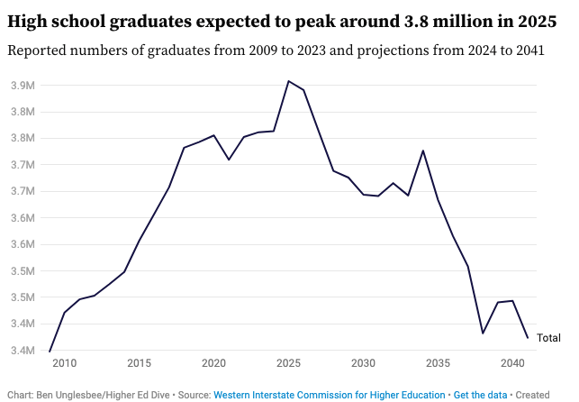
The Demographic Cliff
for traditional-aged students
https://www.highereddive.com/news/decline-high-school-graduates-demographic-cliff-wiche-charts/738281/

Slide 12
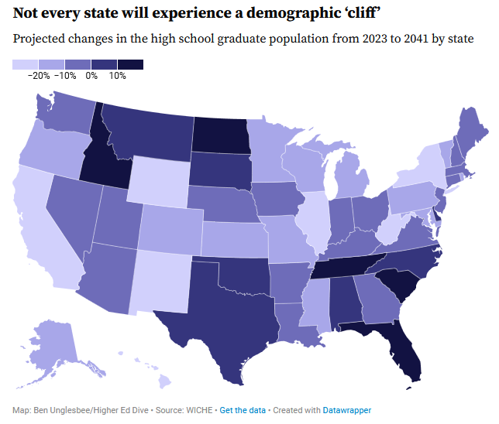
…and the impact in California
https://www.highereddive.com/news/decline-high-school-graduates-demographic-cliff-wiche-charts/738281/

Slide 13
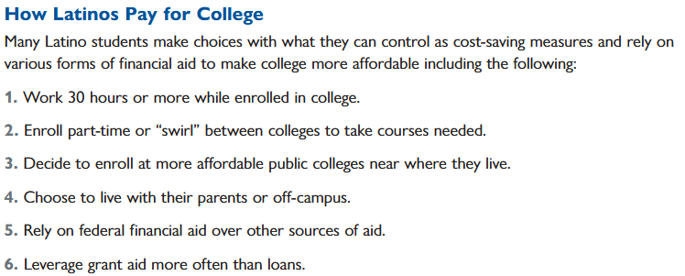
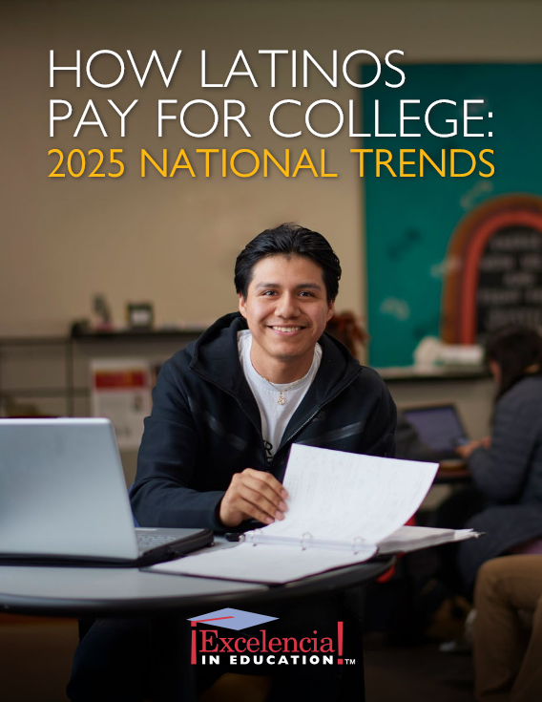
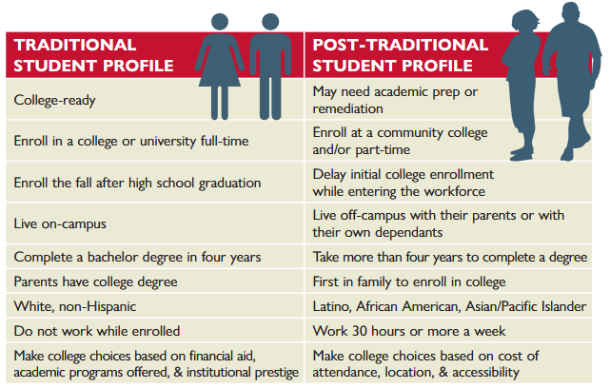

Slide 14
2025
AI
Workforce / ROI Outcome Measures
Mental Health
Skills Based Hiring
Short-term & Stackable Credentials
Student Basic Needs
TRENDS
Anti-DEI
Funding Restrictions
Ideological Changes
Undocumented Student Support
Student Voice
Financial Aid
The Confusion in Higher Ed Right Now ‘Knows No Bounds’ Higher education attorney Jim Newberry tells Inside Higher Ed his firm is struggling to find answers amid the federal policy uncertainty.

