Slide 1

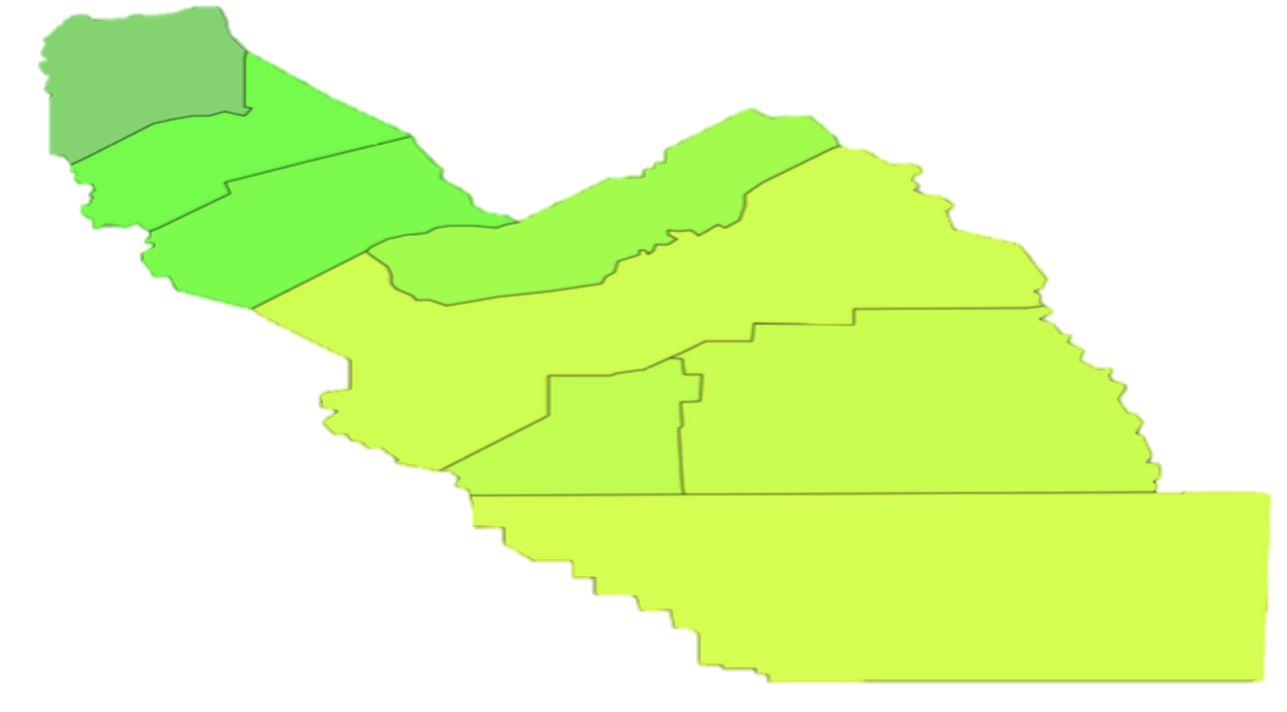

POLICY, PLACE, & POSSIBILITY: COLLEGE ACCELERATED PROGRAM Growth and Challenges in THE Central Valley
PRESENTED BY Zenaida Aguirre-muñoz
UC Merced, Cognitive & Information Science
Central Valley Higher Education Consortium MAY 9, 2025
Fresno, CA
Notes:
Bill & Melinda gates Foundation
Policy, Place, and Possibility: Dual Enrollment Access Growth and Equity Challenges in California’s Central Valley

Slide 2


Background
Widely used college credit pathways in US high schools, 71% of US high schools offer AP; 69% offer DE by 2015–16 (GAO, 2018)
Access and participation in AP and DE remain stratified by race, geography, and socioeconomic status
Gaps exist in research assessing college readiness for CV students, specifically focusing on underrepresented minorities (URM)
CV reflects national disparities in AP/DE access, with historically fewer opportunities compared to other regions
Increases in CV, partially due to targeted state and regional policies
Dual Enrollment
(DE)
Advanced Placement (AP)
(Fink et al., 2017; Taylor, 2015; Britton et al., 2019)
Notes:
College Acceleration Programs
Two most widely used college credit pathways in U.S. high schools
Access and participation in AP and DE remain stratified by race, geography, and socioeconomic status
CV reflects national disparities in AP/DE access, with historically fewer opportunities compared to other regions
Increased in CV, partially due to targeted state and regional policies
Gaps exist in research assessing college readiness for CV students, specifically focusing on underrepresented minorities (URM)

Slide 3

Study Context: Understanding Access in California’s Central Valley
Growth and equity challenges of AP and DE access in the Central Valley (CV).
CV is a large agricultural region with high poverty, high proportions of multilingual learners, and many under-resourced schools.
Analyzes school-level data across three years: 2015–2016, 2017–2018, and 2020–2021.
Using HLM, the study evaluates how CV policies and demographics have influenced access and participation in AP and DE.
Notes:
This study examines the growth and equity challenges of AP and DE access in California’s Central Valley (CV).

Slide 4
Opportunity Framework
Domains
Pre-high-school Preparation
SES Status
Racial Composition
Between-school Segregation
Resources & Tracking Practices
Policy Context
Xu, Solanki, and Fink (2021)

Slide 5
What are the access and participation rates of college readiness programs (DE & AP) in the Central Valley compared to other regions in California? Do the rates vary by school or student characteristics (poverty, ethnicity)
RESEARCH QUESTIONS
What school characteristics predict DE & AP access and participation in the Central Valley compared to other parts of California? Do predictors vary by contextual factors (Ethnicity, % EL, % poverty, % SWD)?

Slide 6
Data sources & inclusion criteria
CRDC and CDE datasets
Traditional & Alternative Schools
Access in 1+ DE or AP course
Participation within schools offering
2015-2016
2017-2018
2021-2022
1,927 high schools
Notes:
AP and DE data from CRDC and CDE Datasets from 2015-16, 2017-18, 2020-21
Traditional and alternative high schools were included; continuation schools were not.
Analyzed access of the programs across all traditional and alternative schools
Analyzed participation of the programs within the schools that offer them

Slide 7
Hierarchical linear Model analyses
outcomes
Predictors
Access – is 1+ course offered to students?
Participation rate – what proportion of students participate in at least 1 course within the schools offering program?
Level 1(school) – Year, CV status, Urban status, CC distance, Status of student demographic proportions (High Latinx, Black, URM, EL, SWD, EL, & Poverty)
  Covariates – Prior ELA & Math performance, Opposite indicator rates
Level 2 – District (random slopes) + School & demographic interactions (2-way & 3-way)
Level 3 – County (random slopes)
R, Glmer for access (binary) models and Lmer for participation (continuous) models

Slide 8
College readiness Opportunity landscape
Question 1: state & central valley landscape

Slide 9
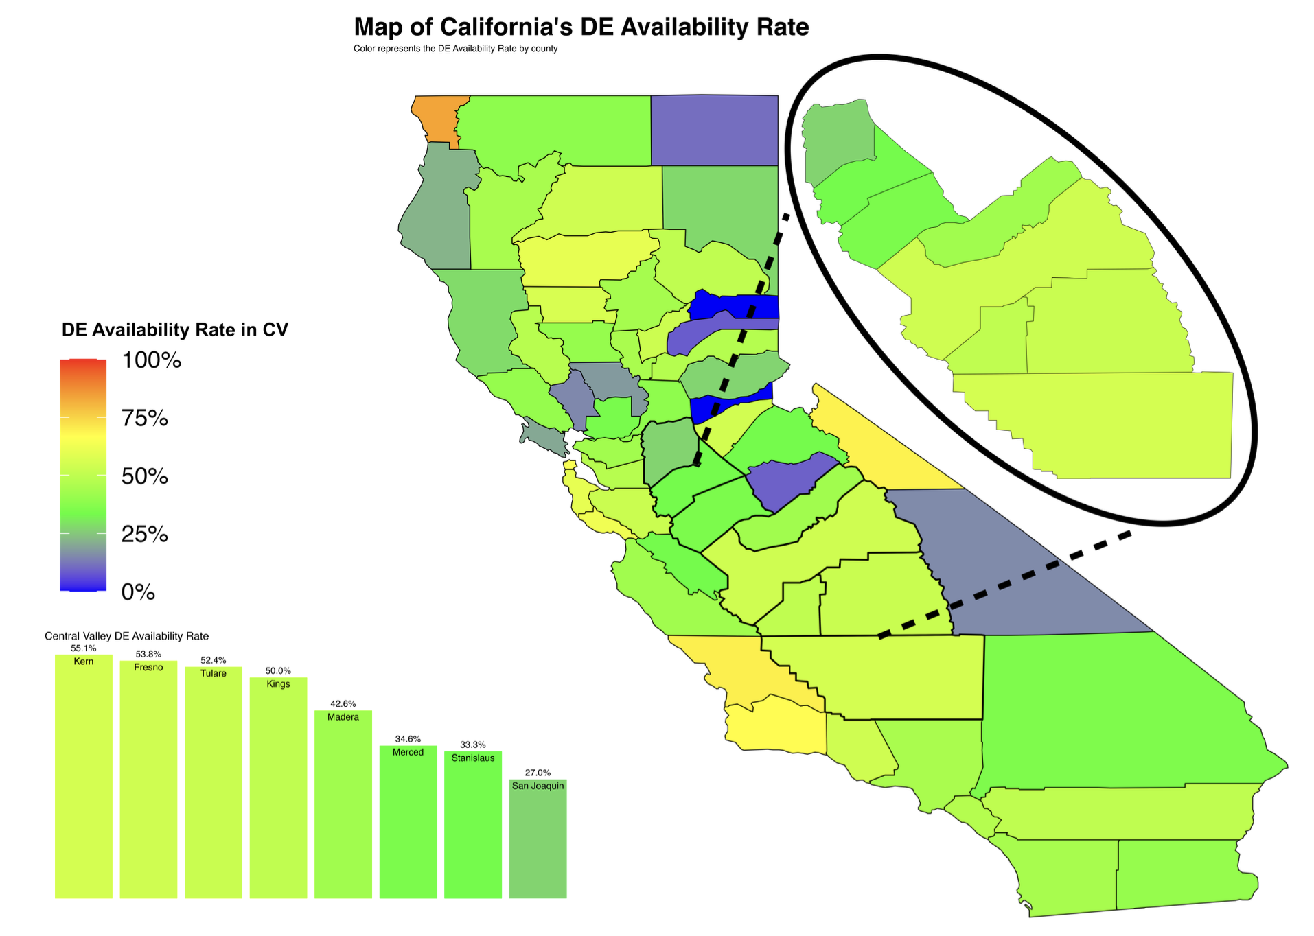
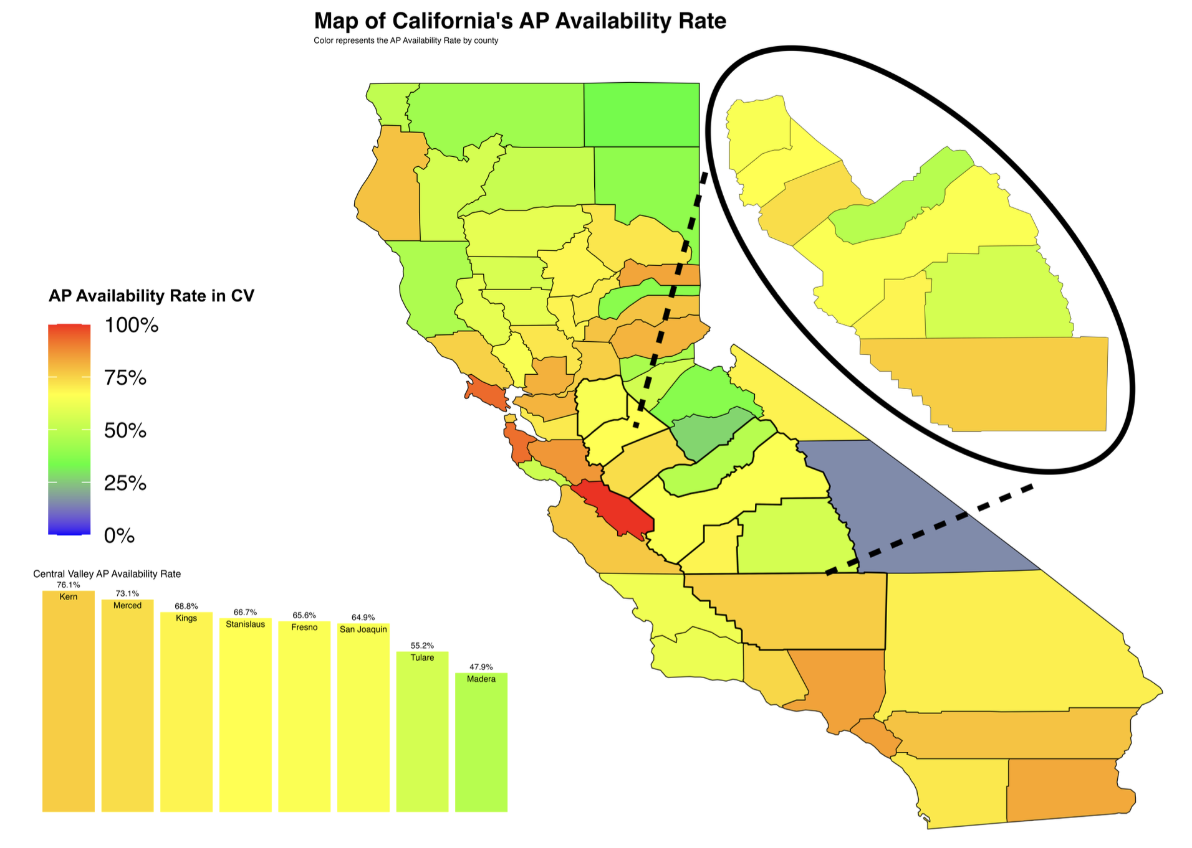
DE & AP Access rates
Dual Enrollment
27% – 55% in CV
Advanced Placement
50% – 75% in CV
50% – 60 % Across CA
75% – 100 % Across CA
Notes:
50-60% DE access: AP 75-100%, in CA

Slide 10
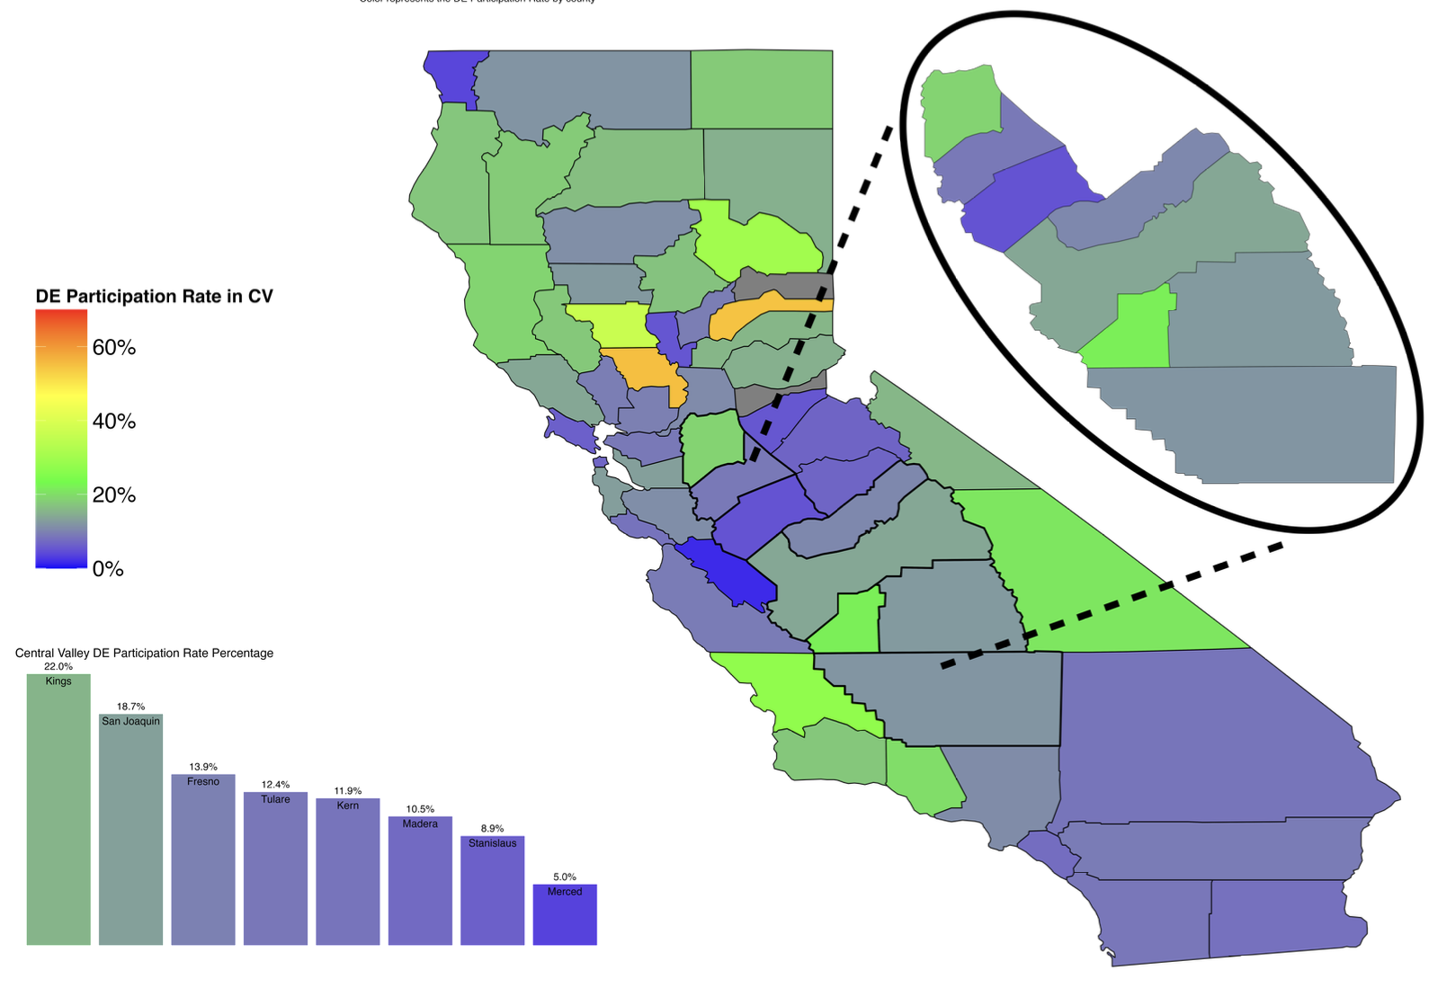
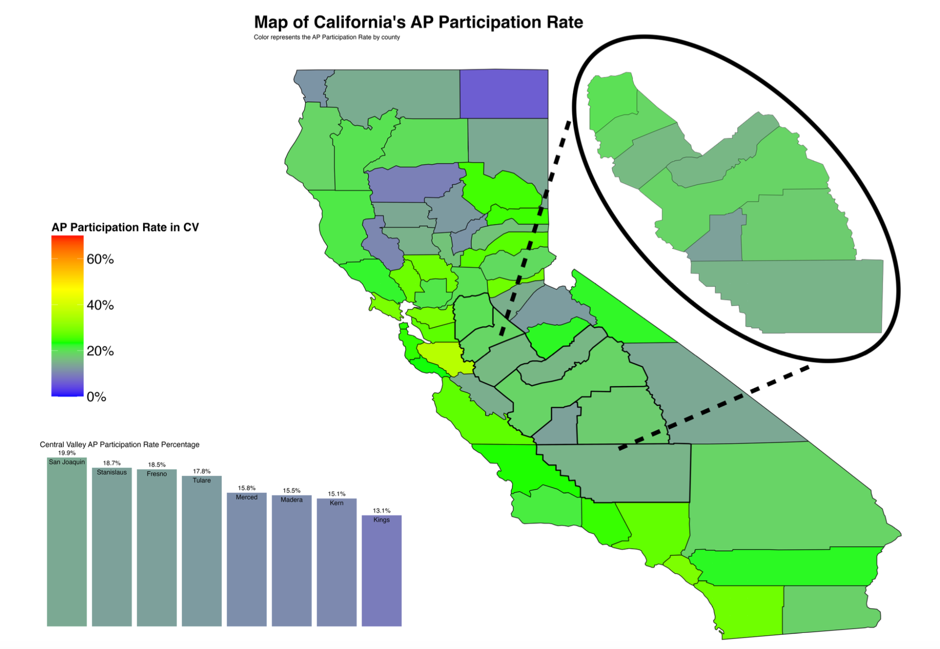
DE & AP PARTICIPATION RATES
Dual Enrollment
5% – 20% in CV
Advanced Placement
15% – 20% in CV
5% – 15% Across CA
30% – 50% Across CA
Notes:
DE 5-15% in CA; 50% participation.

Slide 11

CV DE Access & Participation rates lower initially, slightly higher in 2020-2021 (Grades 9-12)
Compared to other parts of the state, CV had higher increases in DE access & participation rates
CV had higher proportion of the school population participating in DE starting in 2017-2018

Slide 12
AP Access rates in CV consistently lower, CV Participation dips in 2020-2021 (Grades 9-12)
Compared to other parts of the state, CV had consistently lower AP access & participation rates
AP Participation rate mostly consistent in other parts of the state, CV participation rate declined in 2021

Slide 13
By 2021, high poverty schools have higher DE participation in CV (Grades 9-12)
Compared to other parts of the state, High Poverty Schools in the CV had lower DE access & participation rates but surpassed other regions by 2021-2022

Slide 14
Most Ethnic groups in CV had lower DE Participation rates initially, Slightly higher rates by 2020-2021
Most ethnic groups in CV had lower DE rates initially, most groups slightly higher rates by 2020-2021
(Grades 9-12)
Notes:
Slightly

Slide 15
DE Participation Differences by Race/Ethnicity
- Lower Rates in CV
+ Higher Rates in CV
(Grades 9-12)

Slide 16
Predictors of access & participation
Question 2: state & Central valley opportunity growth & challenges

Slide 17
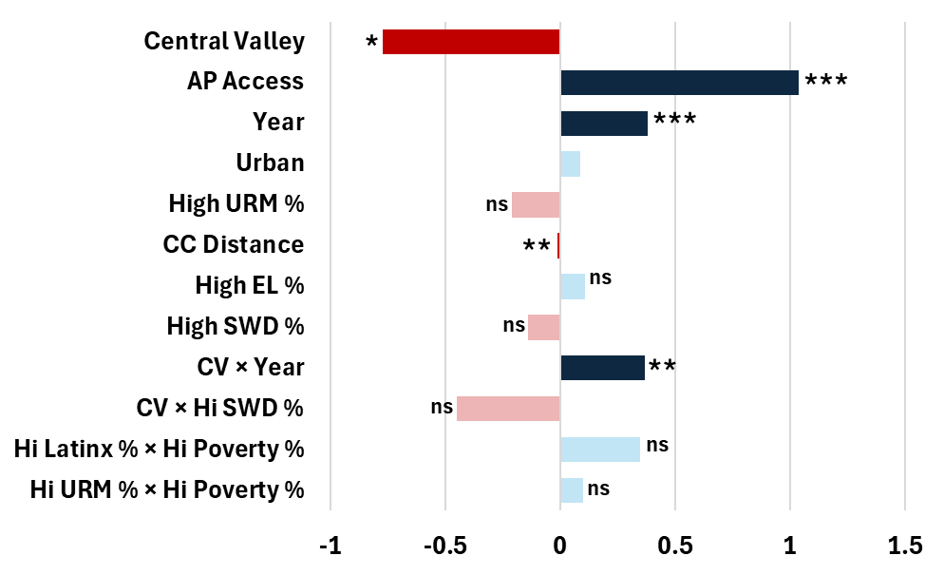
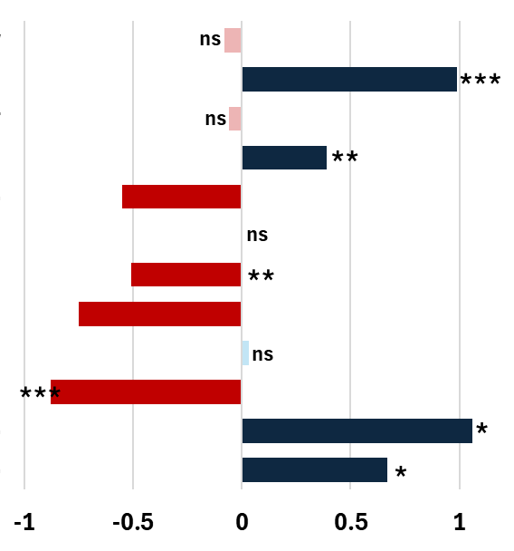
ACCESS PREDICTORS
Dual Enrollment
Advanced Placement
Log Odds
Notes:
Central Valley: Schools in the Central Valley were significantly less likely to offer DE courses compared to schools outside the region, even after controlling for other factors.--54% decrease in the odds of DE access compared to schools outside the region. BUT- the CV x Year interaction

Slide 18
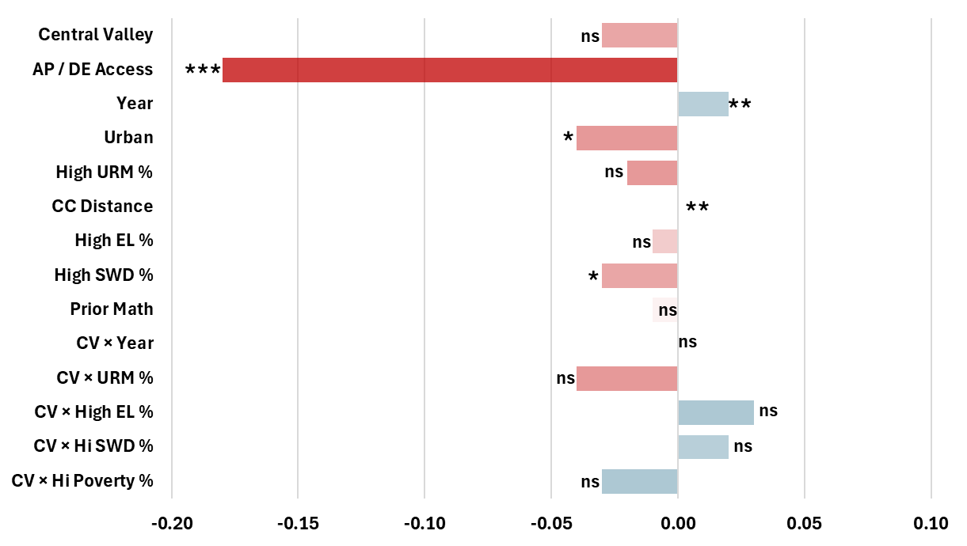
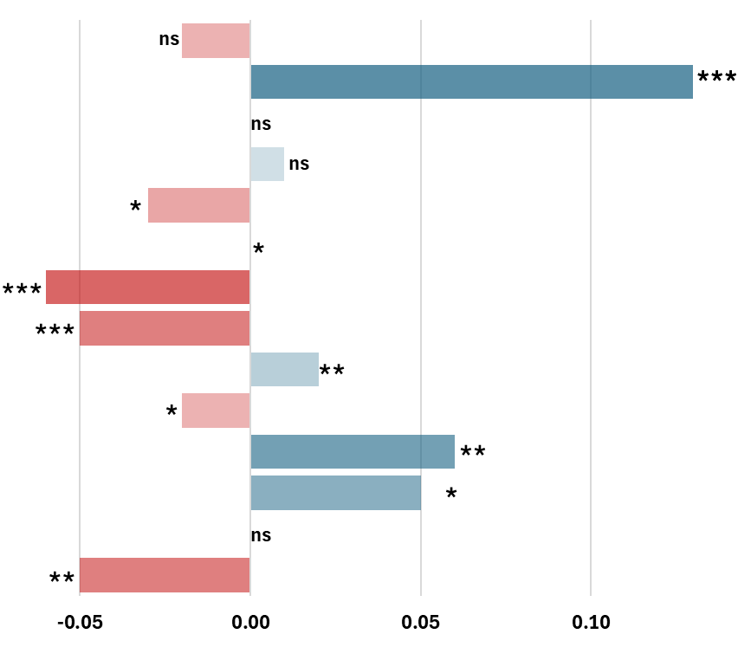
PARTICIPATION PREDICTORS
Dual Enrollment
Advanced Placement
β Estimates

Slide 19
Summar of key Findings
DE availability improved in the Central Valley, helping reduce regional disparities in college acceleration access.
AP offerings remained relatively flat during the same period.
DE growth may have complemented AP stagnation, broadening overall college-credit opportunities.
A slight increase in the AP participation gap suggests diverging access to college acceleration programs across regions.
DE participation rates were similar across regions, indicating comparable student engagement once access is established.
DE access remains influenced by school-level contextual factors such as demographics, disability status, EL population, and proximity to community colleges.

Slide 20
Implications for Higher Education
Expanding DE holds promise for promoting educational equity but must be coupled with efforts to dismantle persistent structural barriers.
Colleges should:
  Align credit transfer policies to ensure DE coursework contributes to degree completion.
  Provide academic and advising support for DE students after matriculation.
  Partner with K–12 districts to remove systemic barriers to accelerated learning programs.
Without targeted equity measures, DE and AP programs risk perpetuating existing racial and geographic disparities in college readiness.

Slide 21






THANK YOU!
GET IN TOUCH
Zenaida Aguirre-Muñoz, Ph.D.
UC Merced
zaguirre-munoz@ucmerced.edu

