Slide 1
UC Merced/CVHEC Transfer Project James Zimmerman Tom Burke Jennifer Johnson Ginni May Sr. Assoc VPDUE CVHEC Coordinator Chief Partnership Officer Academic Affairs UC Merced fccc CCCCO

Slide 2
Fast Facts
Number of maps developed to date: 14,969
75 campuses with published maps
59 California Community Colleges
8 CSU’s
2 UC’s
6 Out-of-state institutions (WA & OR)
PPM Implementation in progress:
21 California Community Colleges
2 CSU’s
1 UC (UCLA)
Program Pathway Mapper web site https://programmapper.org/about/
Frequently Asked Questions https://programmapper.org/faq/
Notes:
Tom/Stan

Slide 3
Central Valley Transfer Project Status

Slide 4
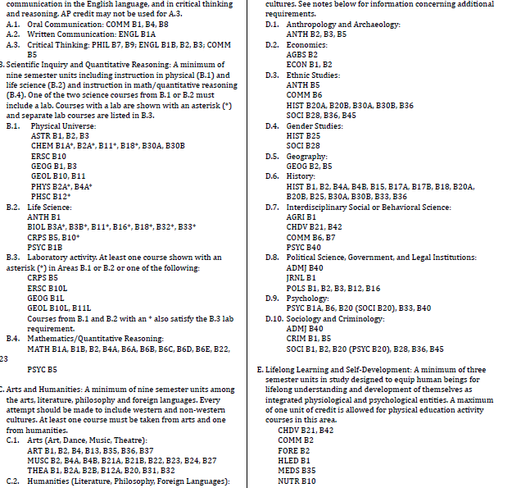
What Students See Now →
Cognitive Overload!
Notes:
Choice architecture – based on classic research study by Iyengar & Lepper (2000) in which students who had watched “Twelve Angry Men” as part of a class had the option to write a short essay about the film for extra credit. Some students were given 30 possible prompts to choose from, while other students were given 6 possible prompts. What do you think happened? 74% of the students who had six prompts to choose from completed the extra credit assignment while only 60% of those who had 30 prompts to choose from opted to participate. Moreover, students from the limited choice condition actually performed slightly but significantly better.
GP Conclusion: We need to provide default program maps that cuts through the catalog craziness, transforming the catalog into something that is easy to understand…

Slide 5
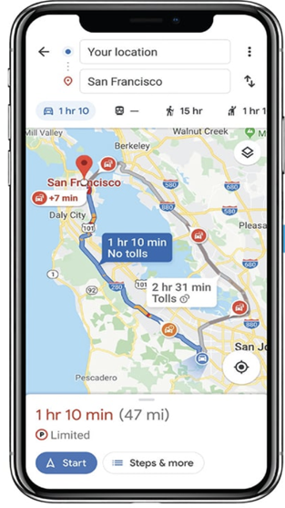
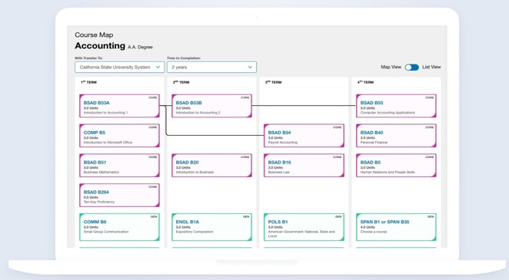
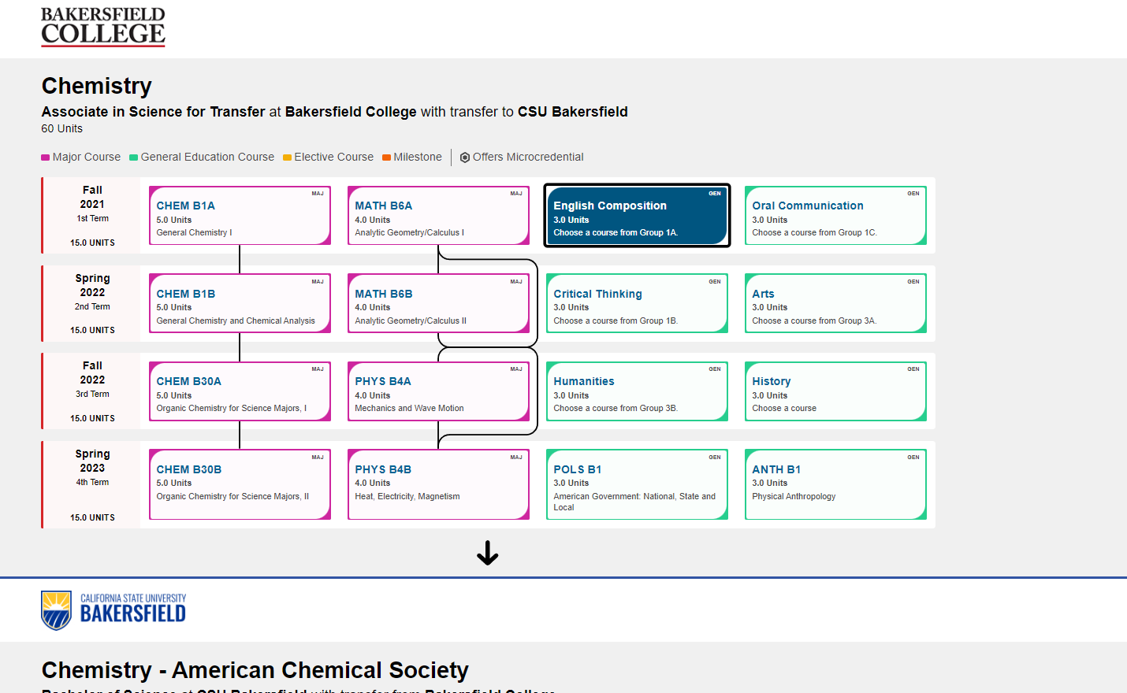
What Is Program Pathways Mapper?
PPM is a tool that creates interactive, pathway-based visualizations. Similar to a GPS mobile app, PPM displays a term-by-term course map that any student can follow to complete their desired program, either at the community college, at the university, or at both, as a transfer student.
Program Exploration:
Students are able to learn about academic programs in the context of expected employment outcomes or general desired areas of interest.
Academic Wayfinding:
Each academic map features a term-by-term plan that displays all general education and major requirements. Intersegmental maps clarifying the pathway to the Bachelors for transfer students have been developed with various partnerships.

Slide 6
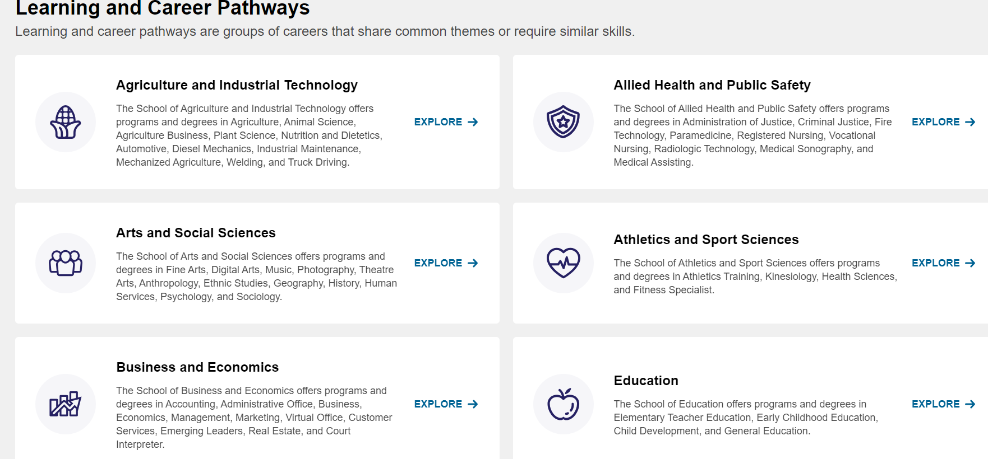
What students see in the PPM

Slide 7
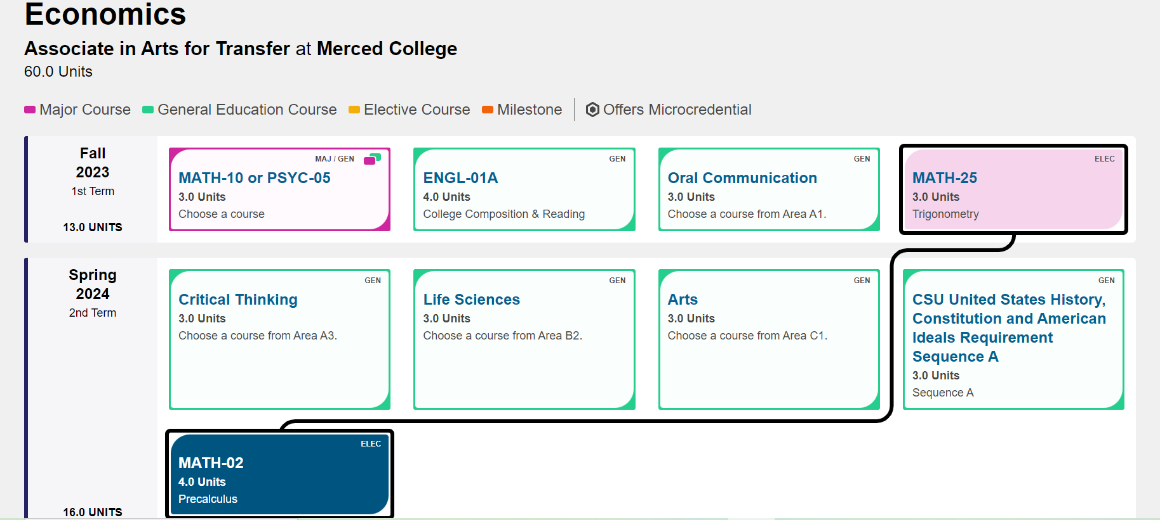
Key features of the Mapper
No log-in required
Mobile friendly
Course Sequencing
Unit load and course balance
GE Identified
Indicators where 2+2 maps exist
Notes:
Transition to JJ
PPM doesn’t cover every single thing the student needs to know; pathways are suggested, but each are nuanced
Acknowledge here that not everyone in the room has seen the mapper or will be using the mapper; we should stay brief here

Slide 8
Program Pathways Mapper – UC Merced Transfer applications
https://programmap.ucmerced.edu/

Slide 9
Program Pathways Mapper – UC Merced degree Programs Status
Completed | Near Completion | Near Completion | On-deck
Applied Mathematical Sciences | Material Sciences and Engineering | Computer Science and Engineering | Bioengineering
Biological Sciences | Anthropology | Management and Business Economics | Civil Engineering
Chemical Sciences | History | Political Science | Critical Race and Ethnic Studies
Physics | Economics | Cognitive Science | Global Arts Studies Program
Psychology | English | Environmental Systems Science
Sociology | Philosophy | Public Health
Environmental Engineering | Spanish

Slide 10
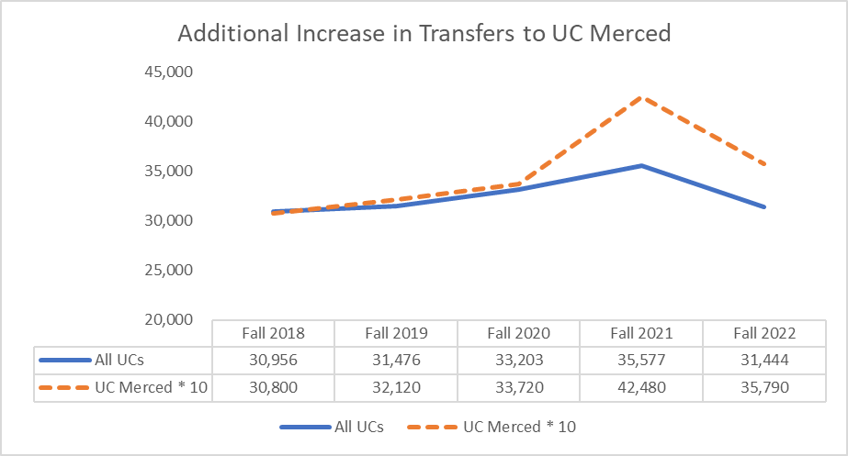
Program Pathways Mapper – UC Merced Transfer applications
Additional Increase in Transfer Applications to UC Merced

Slide 11
Evidence of PPM Effectiveness Student Course-Taking Becomes More Focused
Source: Bakersfield College
Notes:
Ultimately, increasing OPP will result in more students graduating and more students graduating more efficiently.

Slide 12
Evidence of PPM Impact on Equity The PPM has already advanced the equity agenda
Source: Bakersfield College
Notes:
Among students pursuing an ADT, White students increased their on-path percentage by 11 percentage points while Black students increased by 15 percentage points and Latinx students increase by 18 percentage points. PPM levels the playing field by elucidating the hidden curriculum in a radically transparent way. This promotes diversity, equity, and inclusion goals as well as completion goals

Slide 13
Reducing Units Earned at Degree Completion

Slide 14
Program Pathways Mapper – UC Merced Ready to respond
AB 928 – Berman Bill – Common Course Numbering in California CCs
California General Education Transfer Curriculum (CAL-GETC)
UCOP Transfer Recommendations (UCTP)

Slide 15
Program Pathways Mapper – Key New Developments
Analytics https://lookerstudio.google.com/u/0/reporting/ceee8b05-aff4-47a7-b3b6-bab220429e84/page/p_e7c87u62id
API Integration Capability
curriQunet
eLumen
Grant Funding Opportunity
Up to $60,000 in funding is available to support either the implementation of PPM or the sustainability of existing PPM maps.
This grant opportunity is designed to support CCC, UC, and CSU schools with two options
Option A: Implementing PPM (up to $60,000)
For schools new to PPM or those looking to fully implement and institutionalize it
Option B: Sustaining PPM Maps (up to $60,000)
For schools with existing PPM maps looking to ensure long-term sustainability

Slide 16
Program Pathways Mapper

Slide 17
Creating Clear Maps
Conversations with faculty
Student input
Visualize term by term sequenced courses
Notes:
JJ

Slide 18
Participants
For the curricular work of map creation
Academic Leadership (Proj. Manager)
Advisor/counselor
Faculty
Articulation officer
Curriculum chairs/expert
For the technical work of
map creation in the tool
Academic Leadership
(Proj. Manager)
Author of maps
in the Mapper
IT
Possible consults with
Registrar, Articulation
Officer
Notes:
During the onboarding process, an orientation to the tool is provided.

Slide 19
Q and A
We are happy to answer any questions you might have.
jzimmerman6@ucmerced.edu
tburke5@att.net
gmay@cccco.edu
jjohnson@programmapper.org

