Slide 1
Campaign for Transfer Excellence
UC/CCC
ONLINE PATHWAY
PILOT PROGRAM
03/28/2025

Slide 2
WHAT IS THE CAMPAIGN?
The Campaign is an intensive effort to impact thousands of high-achieving CCC students with high financial need so that they are aware of transfer opportunity. Our partnership links that awareness with action steps for course-taking, and receive accurate, consistent advising and operational tools that support their timely transfer.
Our focal areas are identification/alignment of students and a comprehensive virtual center pulling resources and opportunities into a one-stop ecosystem to engage with transfer mechanisms.

Slide 3
ONLINE COURSE
FOCUS
Familiarity with four-year institutions (such as the University of California campuses) allows students to use the skills learned in CC and build the confidence to succeed and thrive through the transfer process.
One key component of the Campaign is connecting CCC students with UC instruction. Because of the obstacles many students face throughout the transfer process, utilizing that connection in a way that can alleviate those obstacles would provide multiple benefits.
The opportunity for CCC and UC credit provides direct benefit for student success in their two-year and four-year goals.
The online format uses the affordances of digital environments to build pedagogical and support networks that connect the two- and four-year ecosystems.

Slide 4
Summer 2025
DETAILS
UC Merced will offer Math 22 and Math 24 during Summer Session (June 23 to August 15)
CC students will be able to register utilizing a discounted tuition code bringing the per-unit cost below $200 (details forthcoming)
UC Online will provide MESA directors with three email blasts to share with local students: one in early April, one in late April and one in mid-May.
Emails will provide details as well as links to a FAQ page (http://ctfe.uconline.edu) and the UC Merced summer session site.
Pilots such as the potential work between the UC System and the CCC through UC Merced and the CVHEC colleges can only work if the collaboration is genuine and reciprocal.
25-26 Academic Year
UC Merced will offer one online section of Math 22 and Math 24 during the academic year exclusively for CC students
Students will be able to register utilizing the intersegmental agreement portal (SB 1914).
Upon scheduling of courses (Fall or Spring), UC Online will provide marketing materials at intervals similar to the Summer plans.

Slide 5
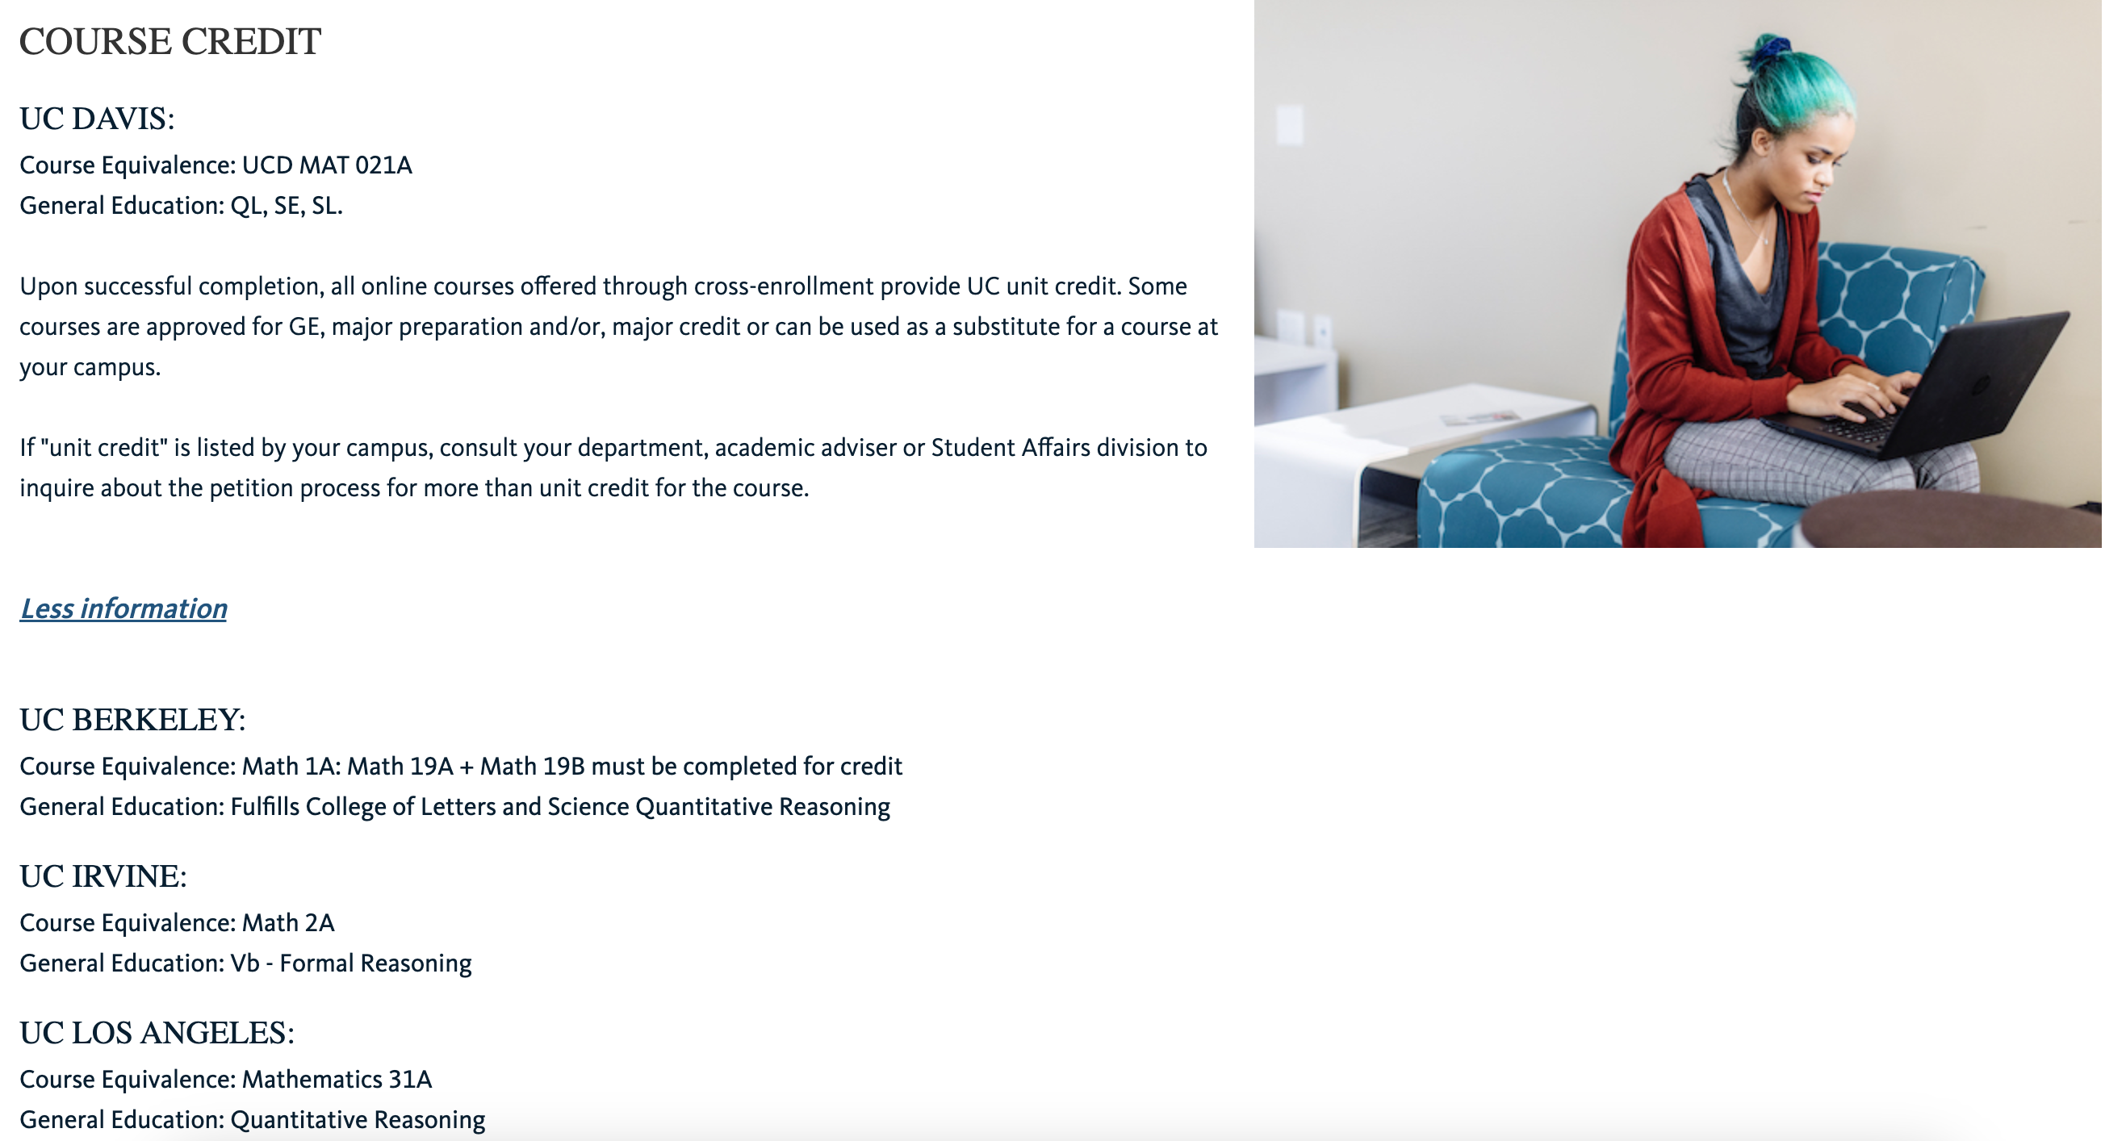
Credit
OBSTACLES
Ensuring the unique courses are accepted as major requirements throughout CA colleges
Messaging to academic advisors the unique elements of credit within the UC (no ‘set and forget’ articulation
Differences between Summer and Academic Year registration leave questions about unit availability and financial aid
There are always areas in which problems arise, and we are working together with partners on ensuring successful launch
Cost
Summer waiver will come closer to SB 1914 but not fill the gap; we can backfill for first year with grant funds and a second year with other discretionary funds
SB 1914 is a powerful tool but one that leaves the full cost of instruction left to others to fill
Course development is not factored into this conversation, so new courses are more difficult to imagine in development fees

