Slide 1

Central Valley Way to Math Success – Fresno, March 2025

Slide 2
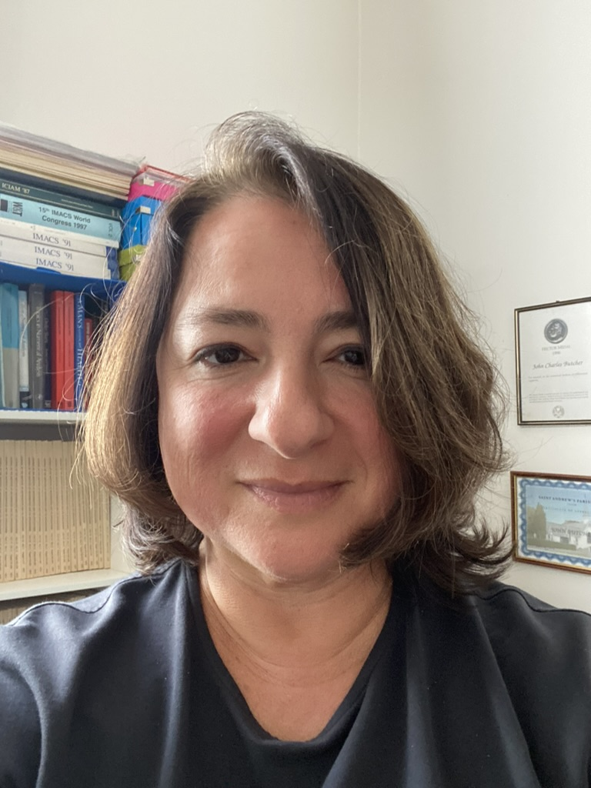
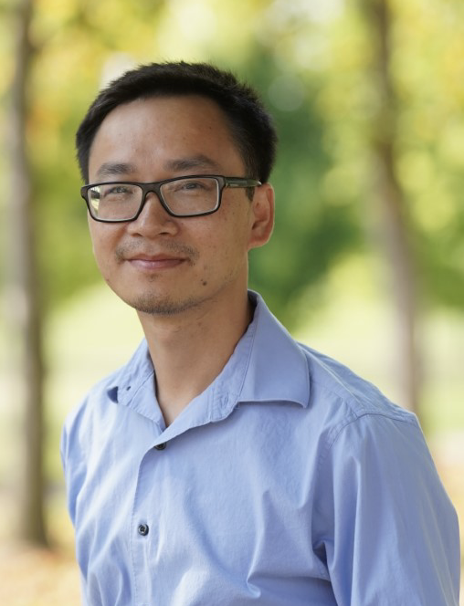
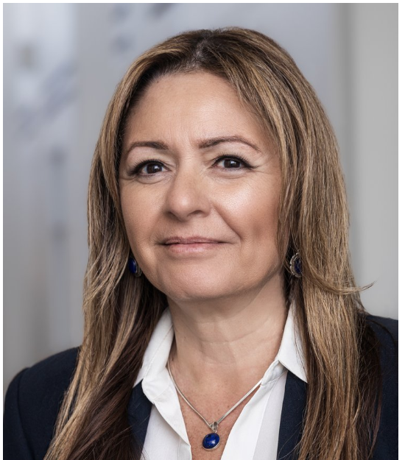
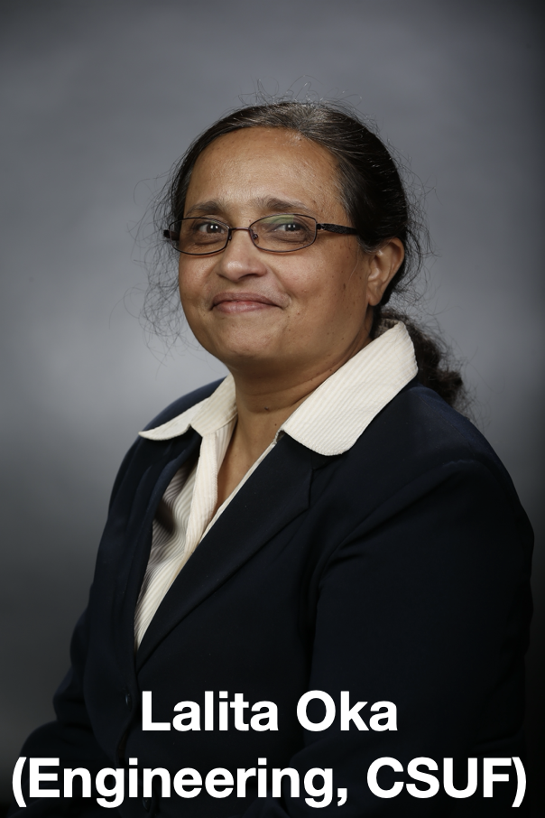
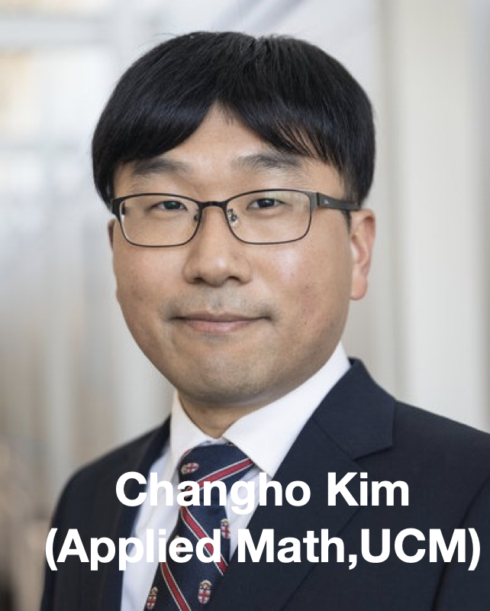
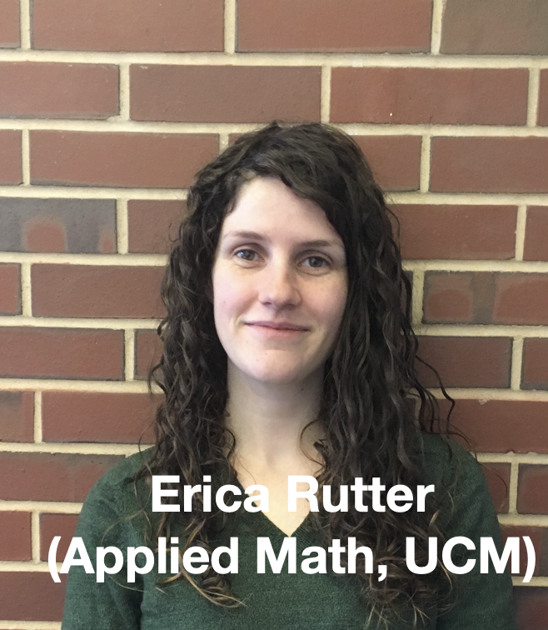
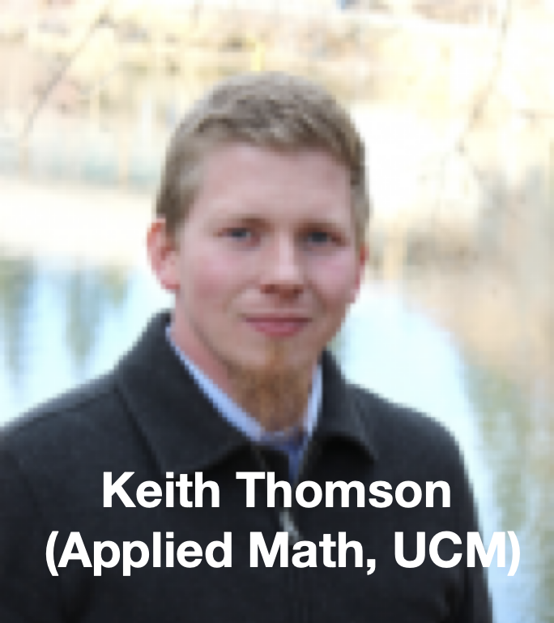
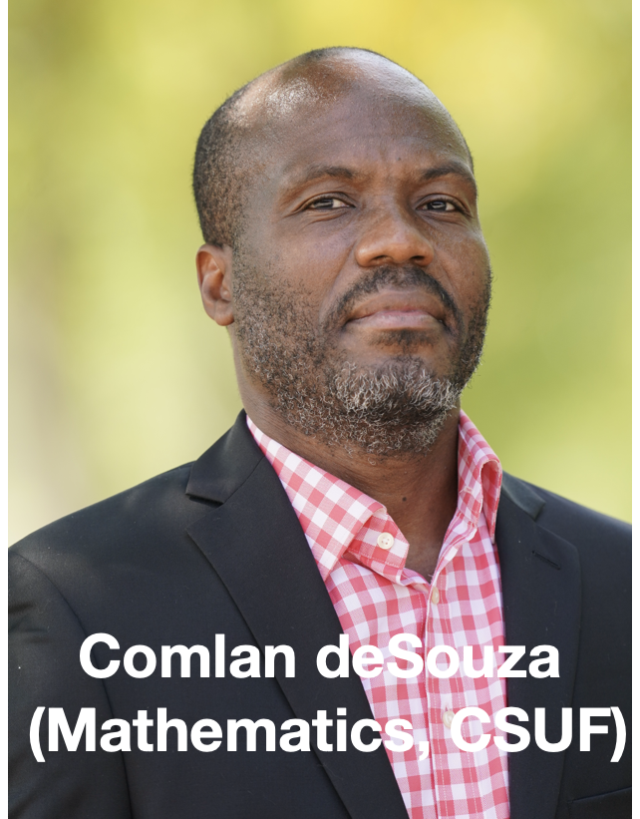
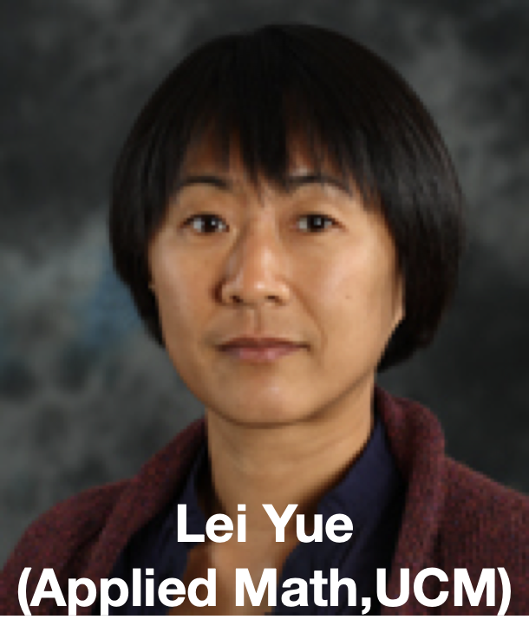
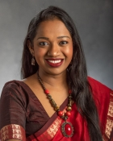


….and WHO….
Mayya Tokman
(Applied Math, UCM)
Khang Tran
(Math, CSUF)
Zenaida Aguirre-Muñoz
(Cognitive Sci., UCM)
Mayya Tokman
(Applied Math, UCM)
Reshman Menon
(Applied Math, UCM)

Slide 3
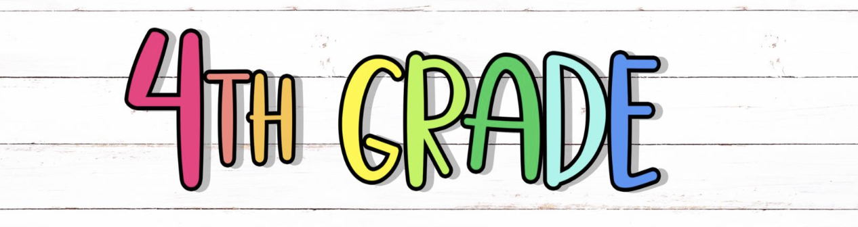
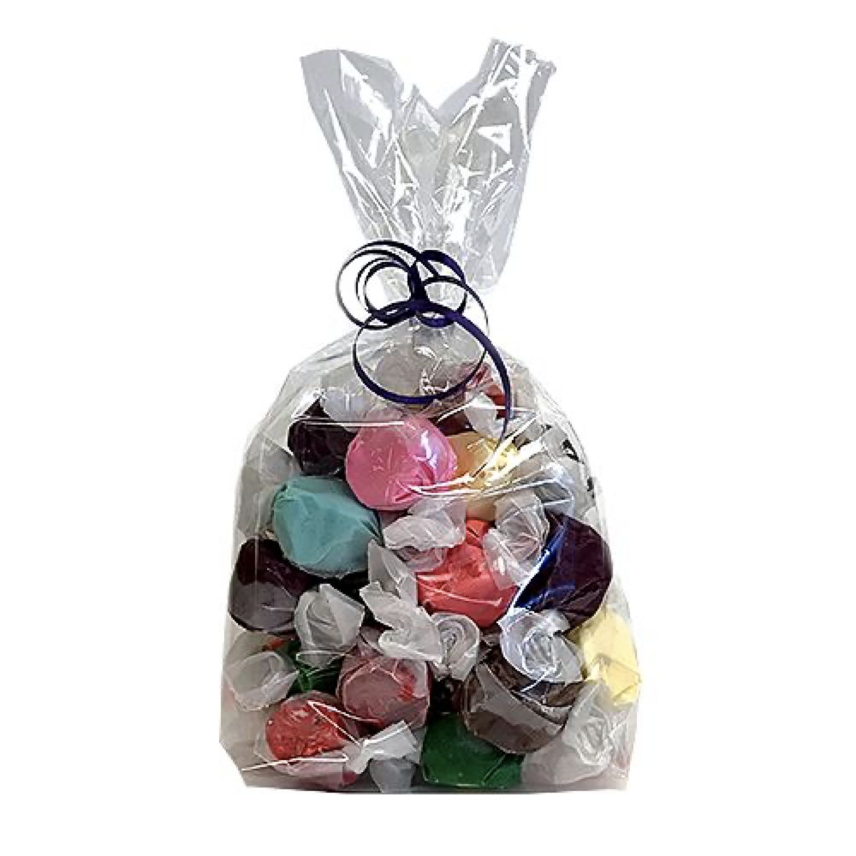
Why
Problem 1
Problem 2
You have 23 pieces of candy and want to distribute them among 5 friends.
How many candy will each friend get?

Slide 4

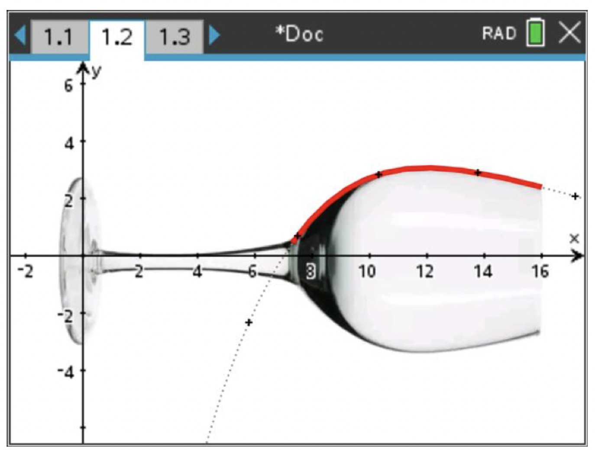
Why
Problem 1
Problem 2
What is the surface area of a wine glass?

Slide 5

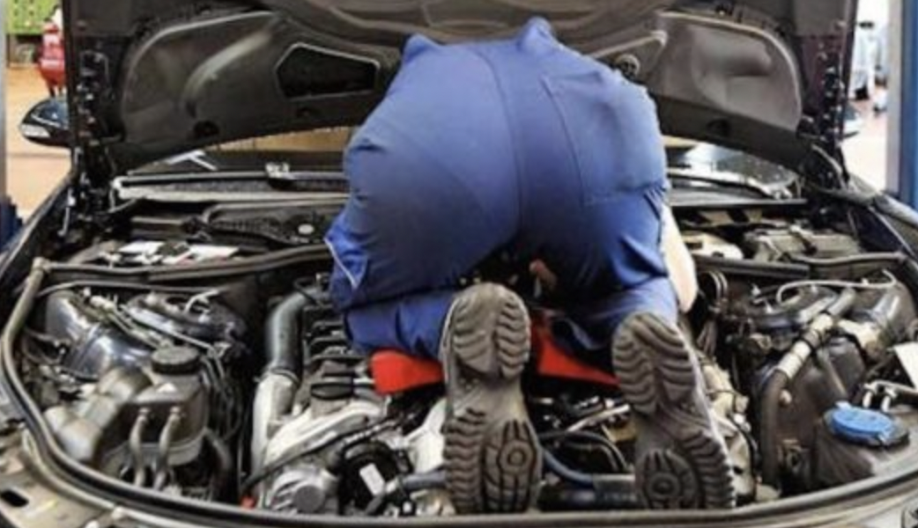
Why
What have you learned in Calculus?
Most common answer:
I learned about integration and differentiation
What it really is:
I learned how functions can be used and analyzed to solve real-world problems

Slide 6
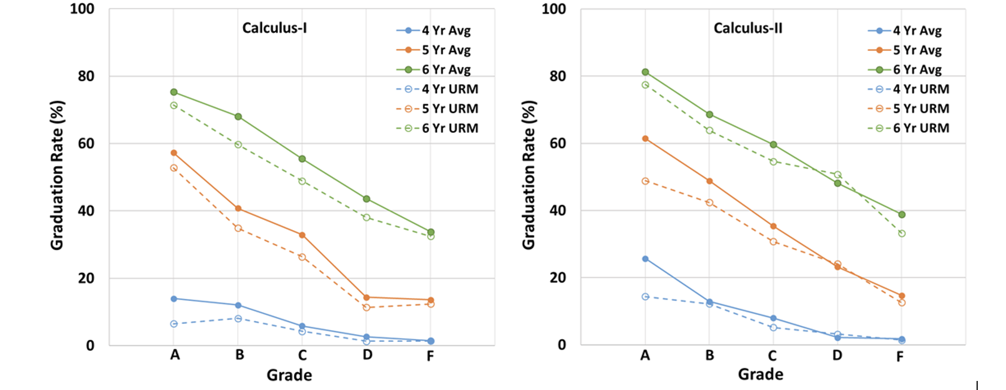
Why
Comparison of graduation rates based on URM status of engineering students at Fresno State

Slide 7

What $1.4M from
Reform calculus curriculum
  Conceptual understanding
  Problem solving and applications
Training and support for Culturally-responsive approach
instructors
Support systems and resources for students

Slide 8
How
Reform calculus curriculum
  Mini-lectures with activities, projects
  Learning assistants
Training and support for instructors
  Workshops and networking
  Online resources
Support systems and resources for students
  Collaboration with tutoring services

Slide 9
How
Reform calculus curriculum
  Mini-lectures with activities, projects
  Learning assistants
Training and support for instructors
  Workshops and networking
  Online resources
Support systems and resources for students
  Collaboration with tutoring services

Slide 10
How: Curriculum Development

Slide 11
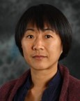
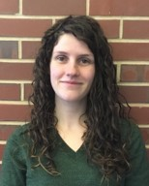
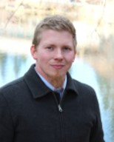
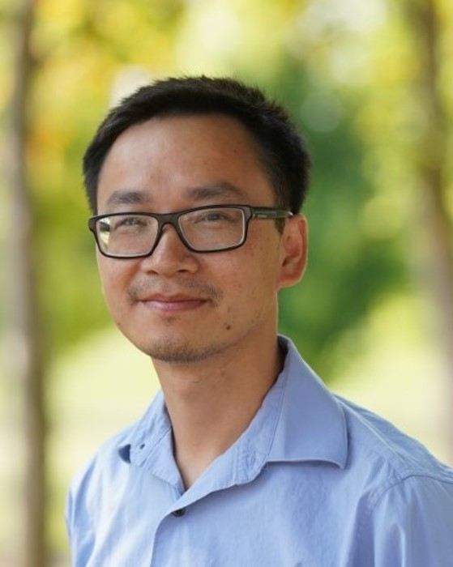
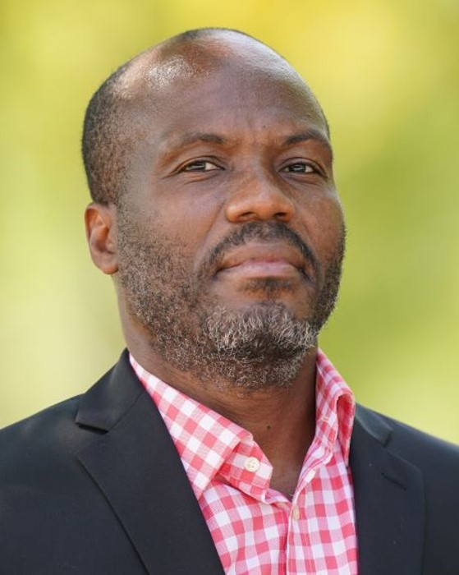
How: Curriculum Development
Fully and partially inverted classes
Lei, Yue
UC Merced
Calc I
Fully inverted
Erica Rutter
UC Merced
Calc II
Fully inverted
Keith Thompson
UC Merced
Calc I and Calc II
Partially inverted
Khang Tran
Fresno State
Calc I and Calc II
Partially inverted
Comlan de Souza
Fresno State
Calc II
Partially inverted
Teaching materials
  Lecture notes
  Pre-lecture notes
  Discussion worksheets
  In-class worksheets
  Projects, etc

Slide 12
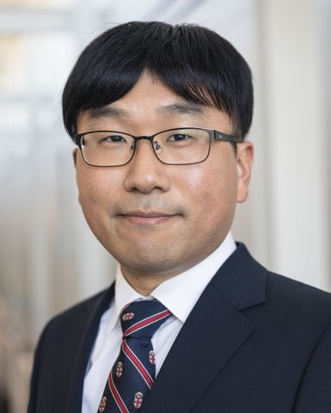
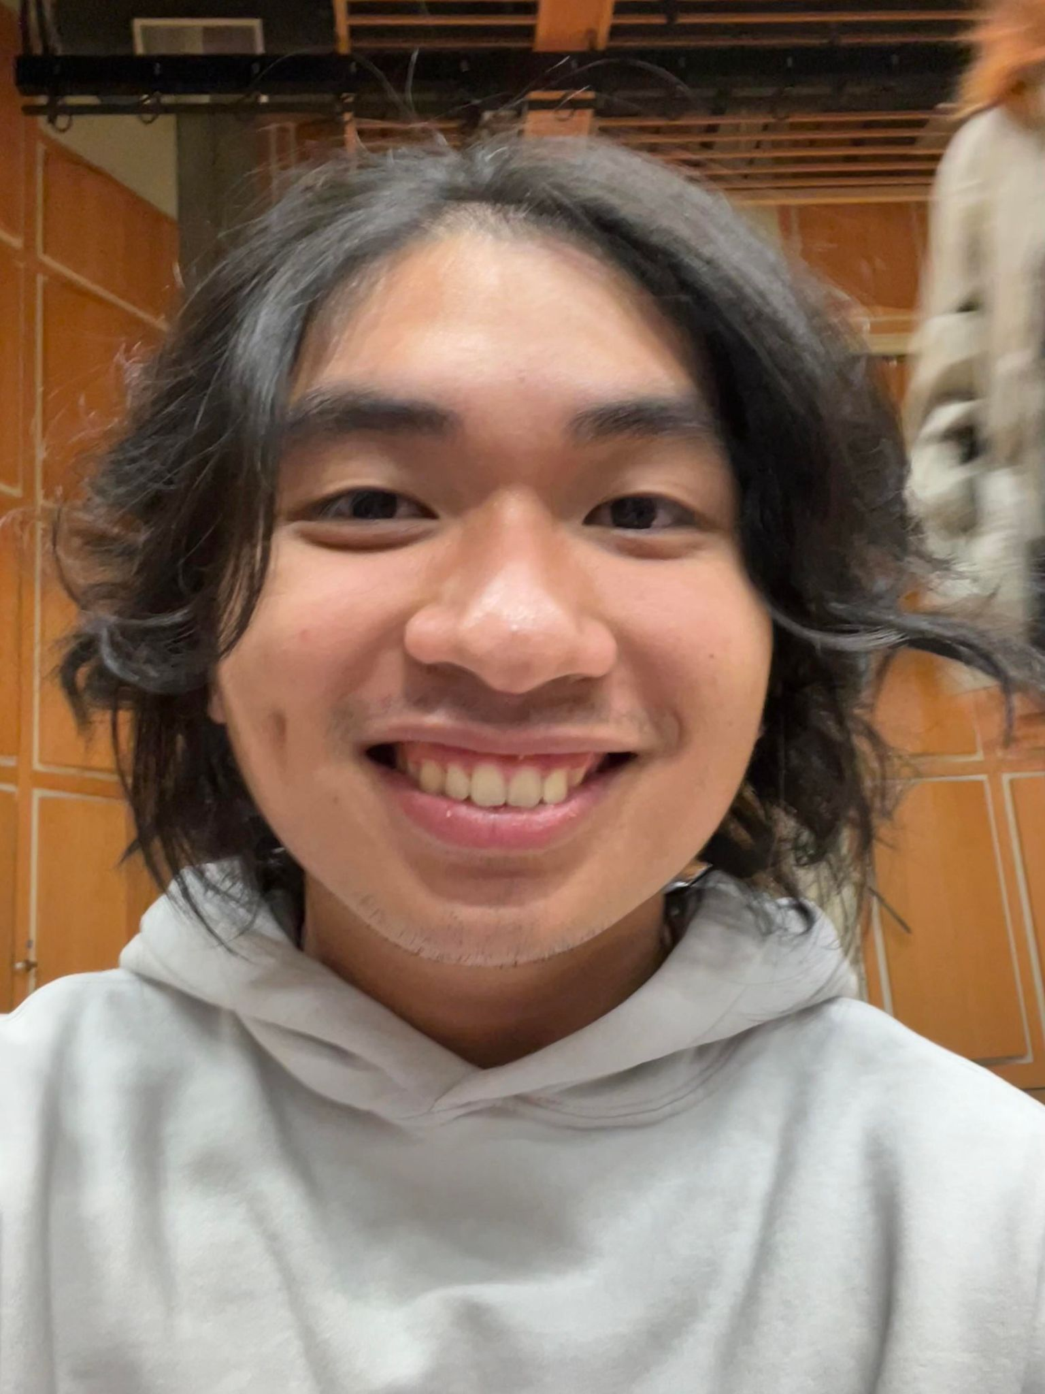
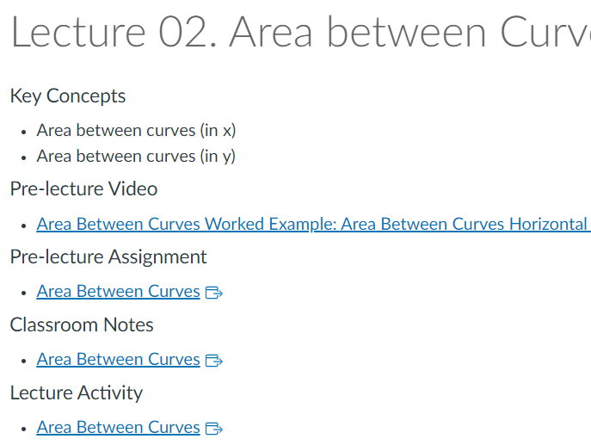
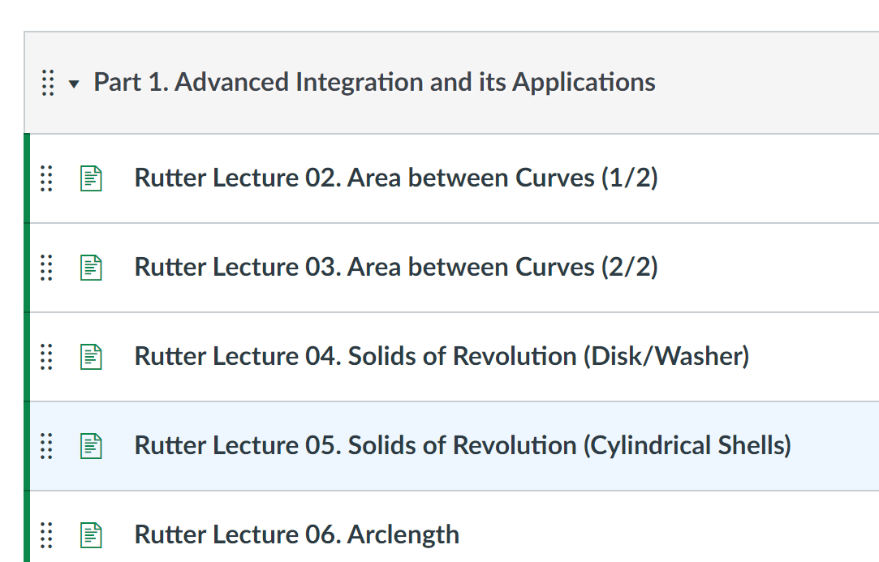
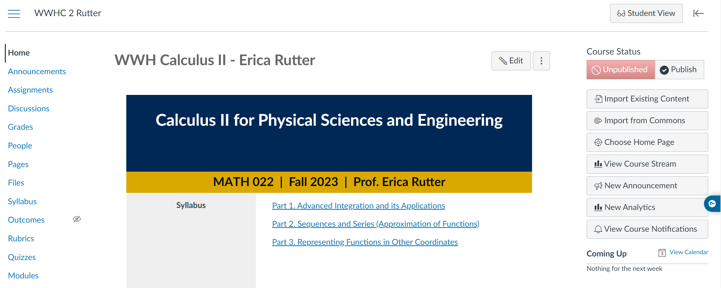
Online Resources
Michos Cristobal, UCM
Two repositories developed on Box (online cloud storage)
  Repository 1 sorted by developers
  Repository 2 sorted by topics and teaching material types
  For some courses Canvas template has been created

Slide 13
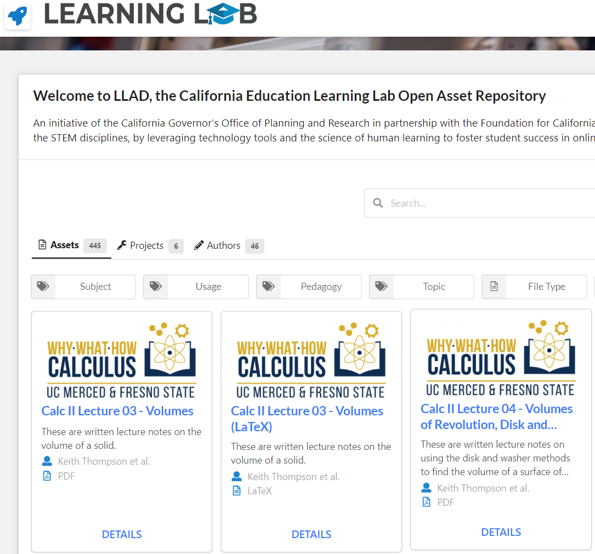
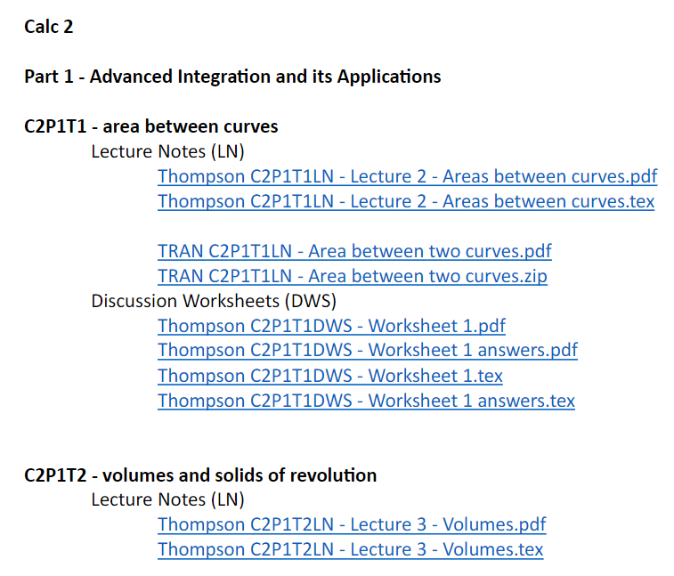
Open Educational Resources (OERs)
A portion of teaching materials has been published as OERs
  Each OER has a sharable public link
  OERs are included in the Learning Lab’s LLAD

Slide 14
Some stats
Student and instructor participation
  Calculus 1
Campus | Students (AY 21/22, 22/23, 23/24) | Instructors
UC Merced | 2422 | 6
Fresno State | 1762 | 12
  Calculus 2
Campus | Students (AY 21/22, 22/23, 23/24) | Instructors
UC Merced | 1693 | 5
Fresno State | 851 | 10

Slide 15
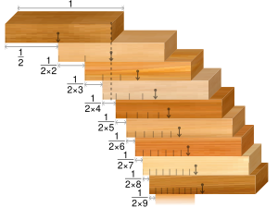

A sample topic: Absolute and
Conditional Convergence
The order of Why, What, and How matters
Convergence – Why do we care?
Absolute, conditional convergence:
  (1-1)+(1-1)+$…=$0
  1+(-1+1)+(-1+1) +$…$=1

Slide 16
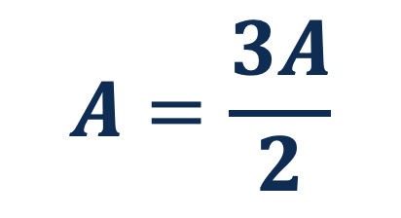
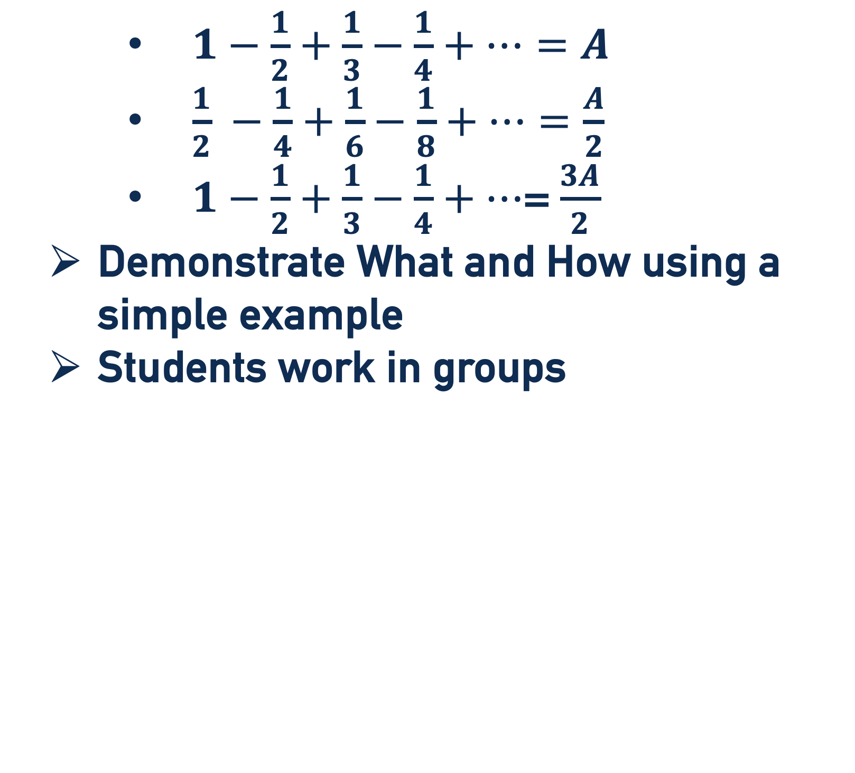
      $1−\frac{1}{2}+\frac{1}{3}−\frac{1}{4}+…=A$
      $\frac{1}{2} −\frac{1}{4}+\frac{1}{6}−\frac{1}{8}+…=\frac{A}{2}$
      $1−\frac{1}{2}+\frac{1}{3}−\frac{1}{4}+…$= $\frac{3A}{2}$
  Demonstrate What and How using a simple example
  Students work in groups
$$A=\frac{3A}{2}$$

Slide 17
Context Matters
Need to address the psychosocial factors that can bolster resilience, persistence, and positive self concepts.
These factors need to start with rethinking the design of the calculus experience.
Success includes impact on performance, psychosocial factors, and engagement.
Notes:
Today's presentation is centered on understanding and addressing the multifaceted challenges in calculus education, particularly as they relate to student success in STEM fields.
I'll begin by examining how calculus courses can act as substantial barrier to students' progress.
I'll also touch on the amplified challenges faced by underrepresented racially minoritized Students, URMS, in STEM education.
Next, my colleague, Maribel, will delve into Psychosocial Factors and Curricular Reform, and how these elements are critical in shaping student experiences and outcomes.
Then, Zenaida, a guiding force behind this project, will discuss the collaborative initiative between UC Merced and CSU Fresno. This initiative, rooted in evidence-based approaches to mathematics instruction reform, aims to provide inclusive and effective education strategies specifically for science, technology, and engineering students…Zenaida will also share some pivotal results from our ongoing efforts.

Slide 18

STEM
MATH
SELF-EFFICACY
SELF-CONCEPT
IDENTITY
ANXIETY
BELONGING
INTEREST
Notes:
STEM Self-Efficacy-Confidence in abilities to function as a STEM professional
STEM Identity-Thinking being STEM professional is part of who they are
STEM Sense of Belonging - Sense of belonging to the STEM community
Math Self-Concept-Views about mathematics abilities
Math Anxiety-Concerns about math content, tasks, and exams
Math Interest-Involves concentrated focus, cognitive participation, and emotional engagement in a particular activity
Key factor in motivating individuals to pursue STEM careers and engage in STEM learning

Slide 19



CLASSROOM COMPOSITION CAN MATTER
PROPORTION FIRST-GEN
INDICATORS
PROPORTION FEMALE
PROPORTION URM

Slide 20

Data sources
37 Discussion Sections
19 Class Sections, 2 HSIs
Survey Administered on Qualtrics to Calc 1 & 2 students
Final Calculus Grades
Background & Psychosocial Factors

Slide 21
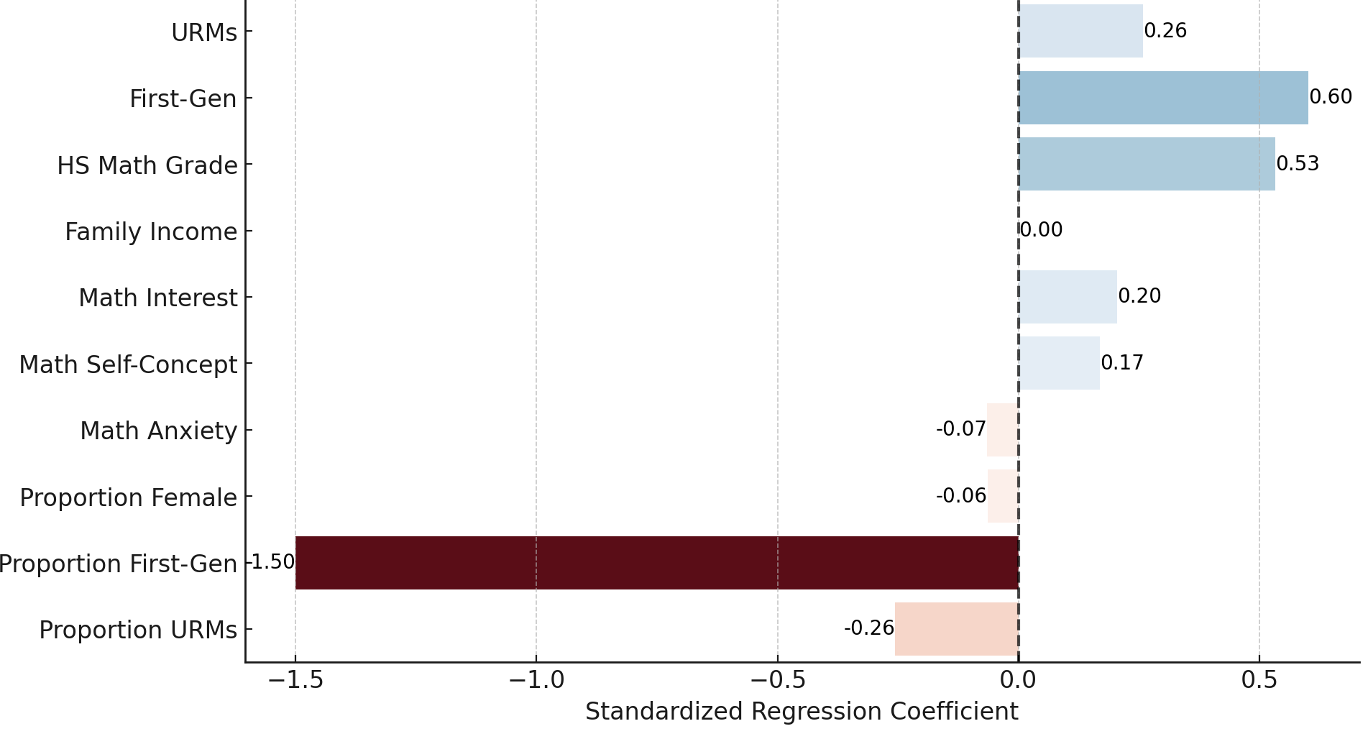
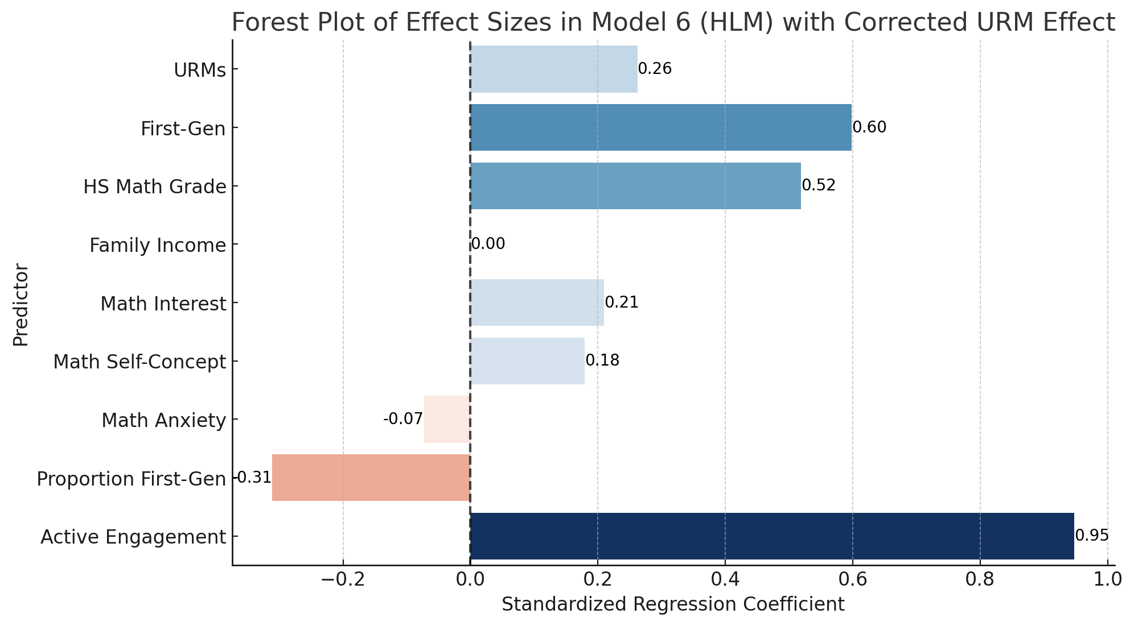
Active Engagement Matters
Model without Active Engagement
Model with Active Engagement
*
*
*
*
*
*
✓
✓
*
*
*
*
*
*
*
n.s.
n.s.
*
(n = 743)
*p <.05; ✓ = p <.05 but not meaningful in performance; *p< .07
Notes:
For ease of interpretation and direction this forest plot visually compares the magnitude and confidence intervals of each predictor’s effect,

Slide 22
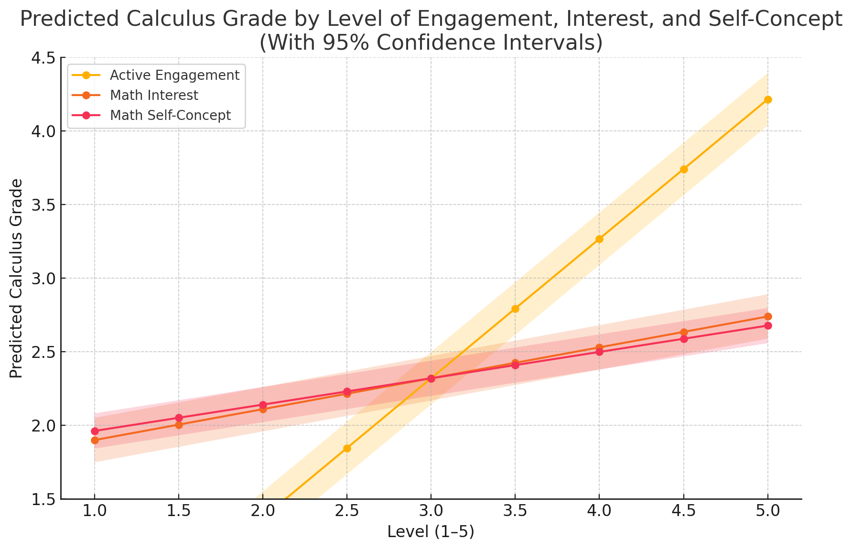
Performance Possibilities
Predicted Calculus Grade by Level of Active Engagement, Math Interest, & Math Self Concept
with 95% Confidence Intervals
Avg Engagement
Avg Grade

Slide 23
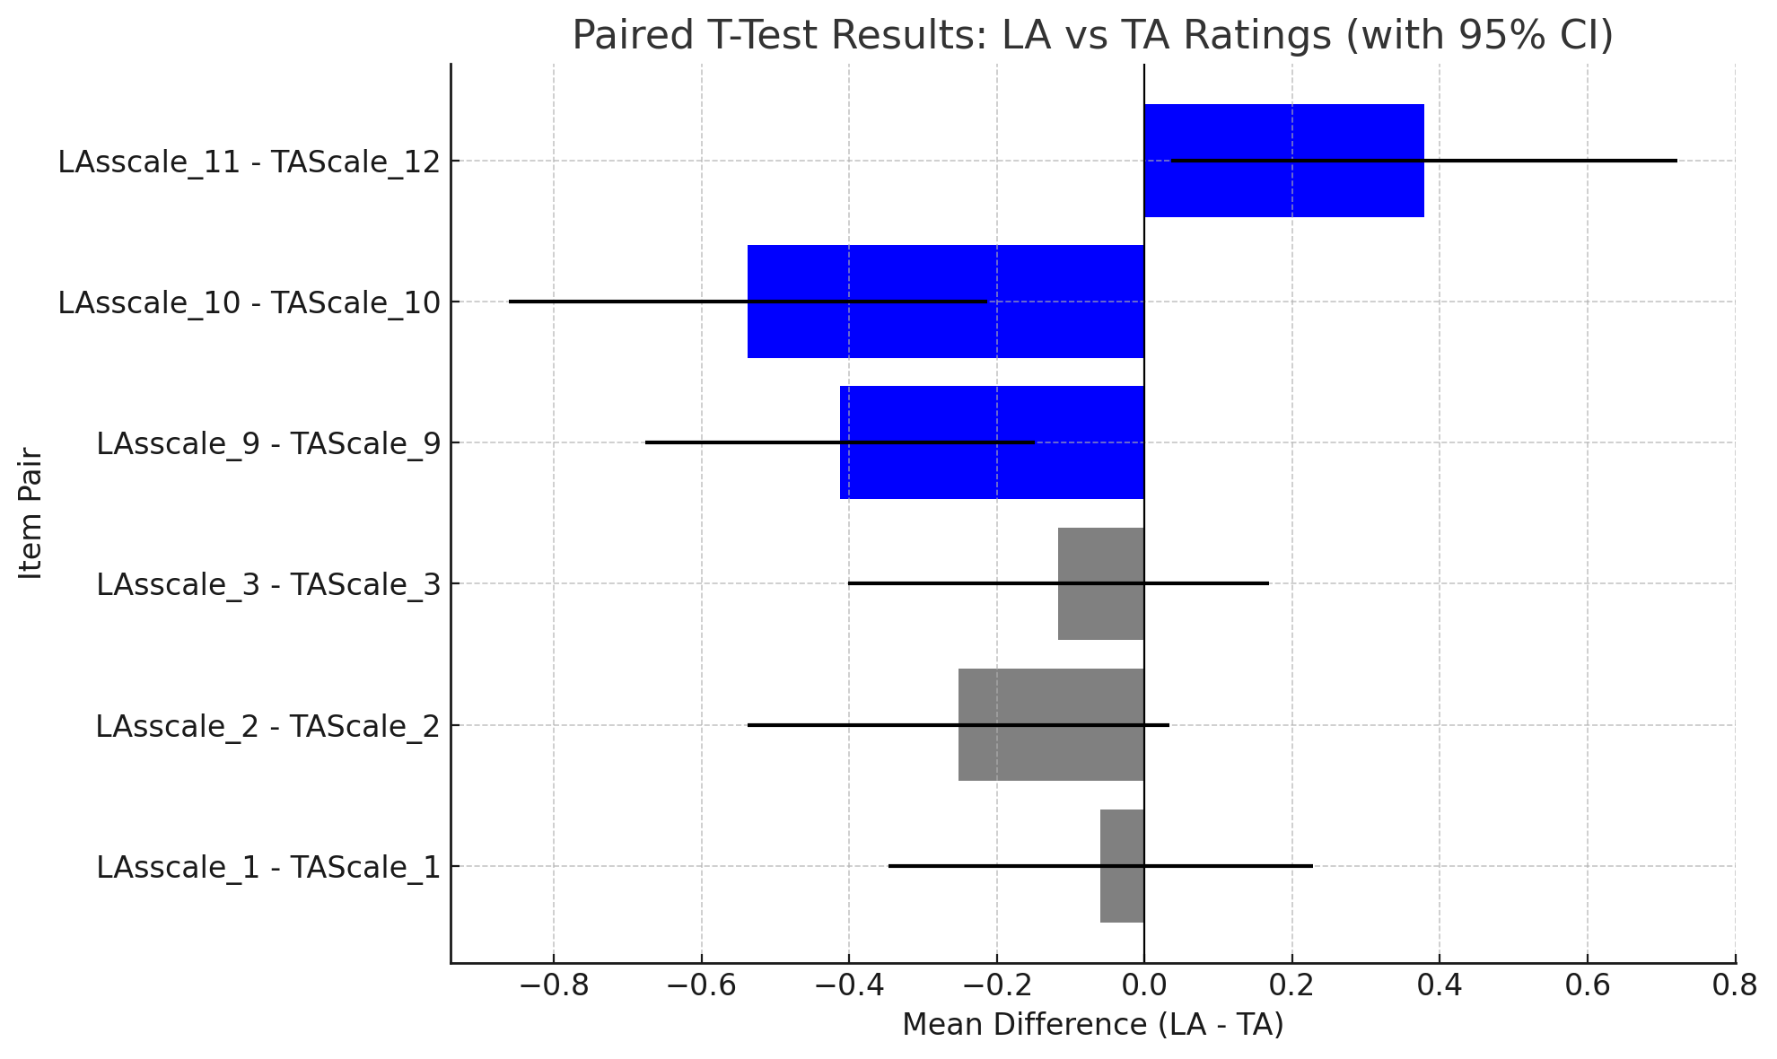
Learning Assistants v. Teaching Assistants Ratings
- higher ratings for TAs
+ higher ratings for LAs
I wish I had more time to meet with them
*I would not have been able to do as well as I did without their support
Understands the content well
p < .05
p > .05
Explained concepts/tasks in a way I can understand
helpful for understanding task expectations
helpful for understanding math concepts

Slide 24
Assessment Summary
High Satisfaction Levels: Course Elements
Mini Lectures, Projects
Learning Assistants: Recognized as valuable resources
Support systems within the course positively impact student learning experiences.

Slide 25


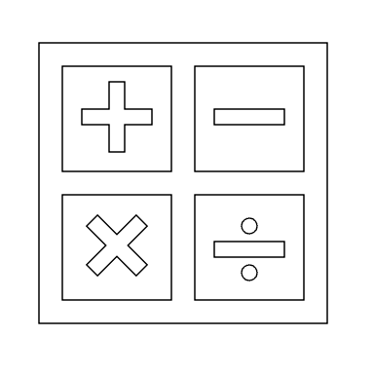


Summary
Background factors influenced calculus grade.
URMs outperformed non-URMs
Math interest and self concept influence course grade.
First Gen students outperformed non-First Gen
STEM Psychosocial factors did not influence course
Higher average class engagement
enhanced performance the most.
Grade above other factors.

Slide 26
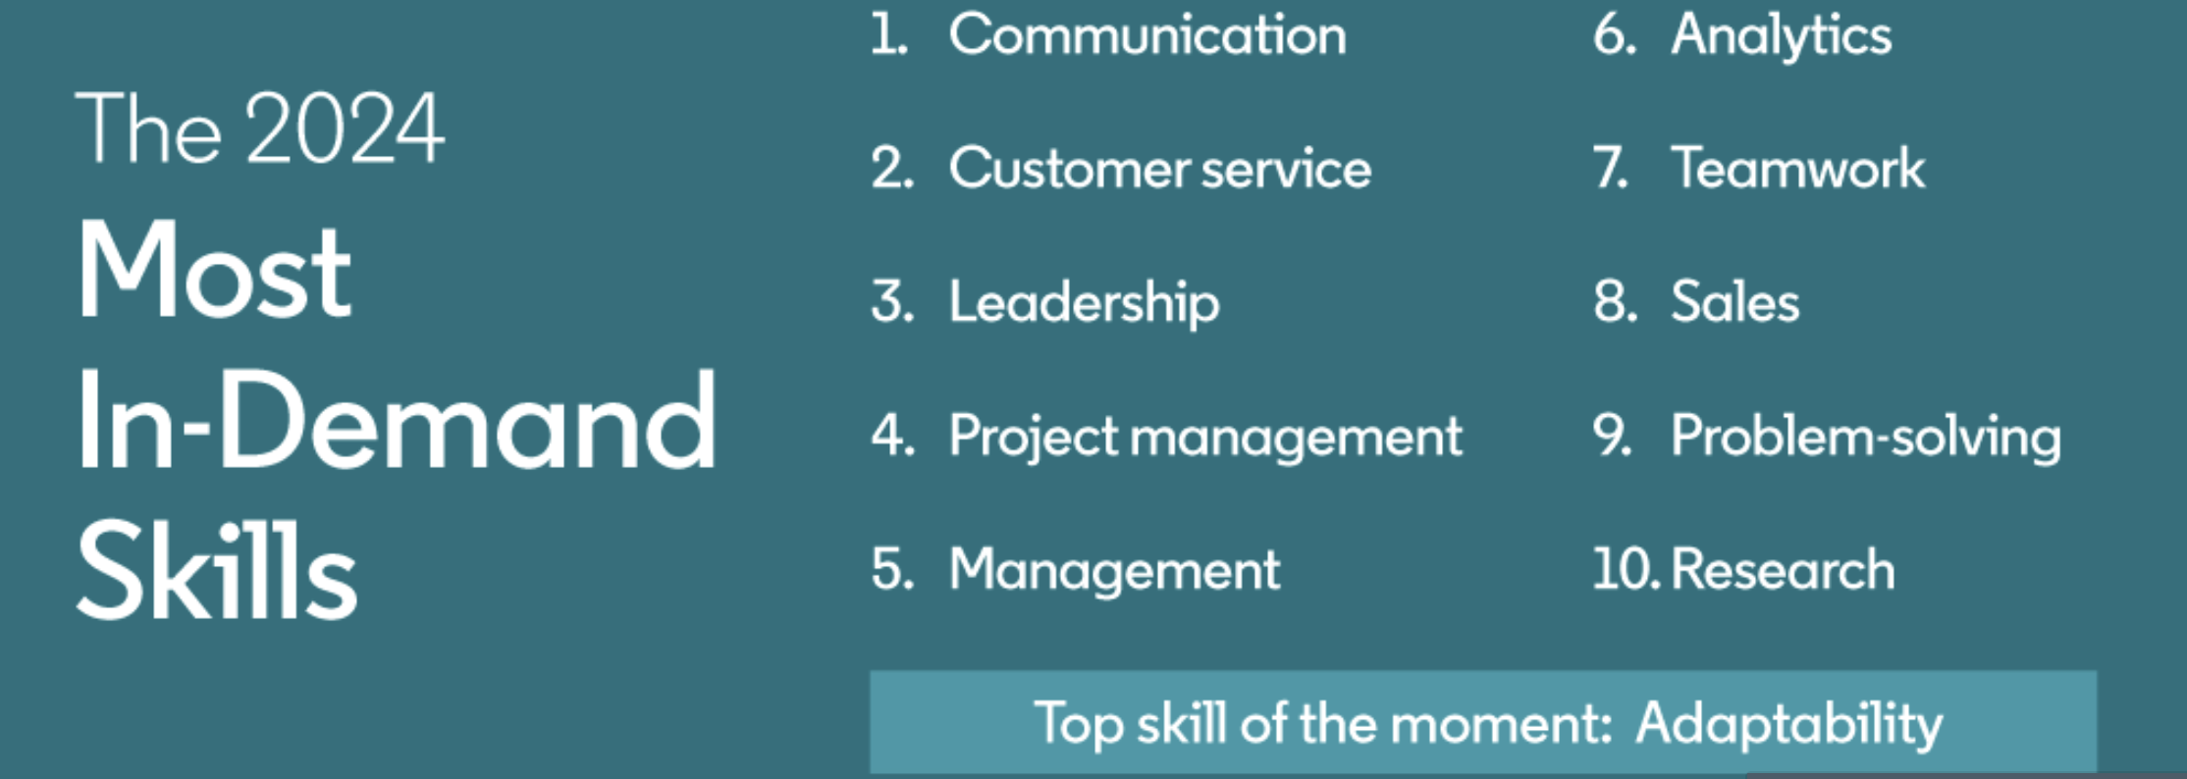
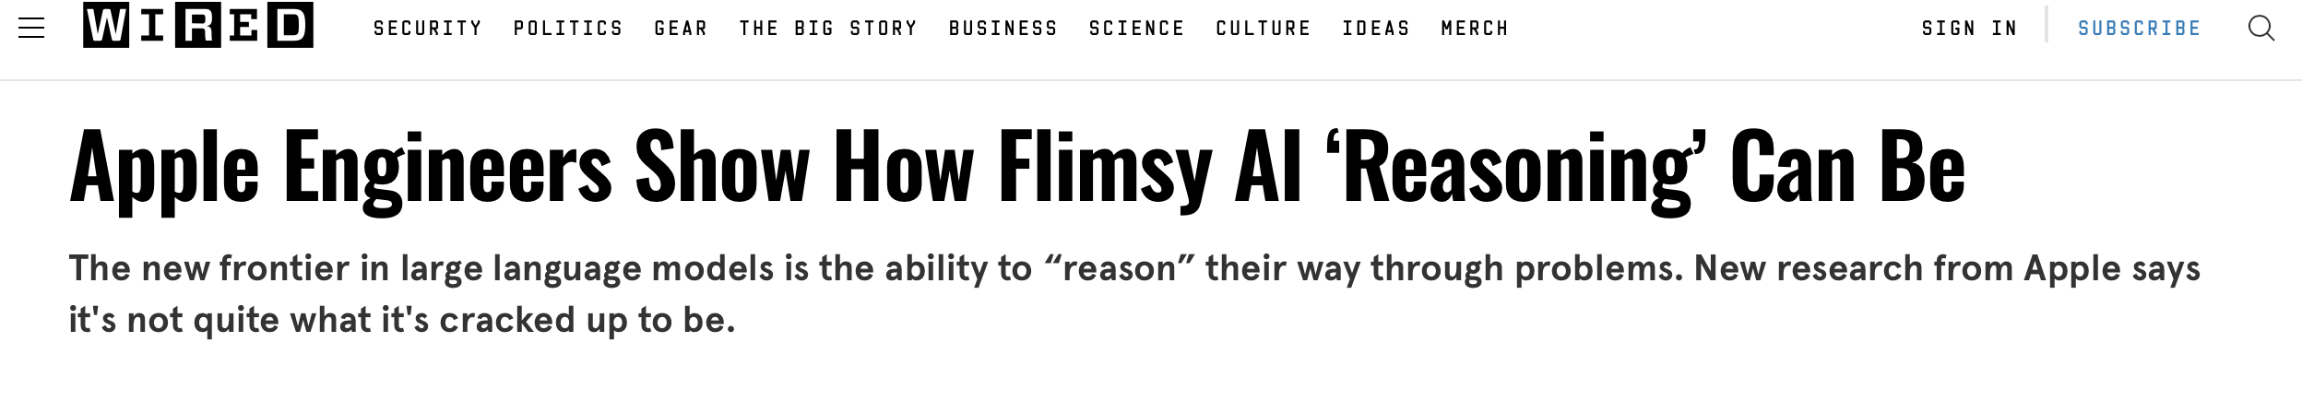
Epilogue: Questions to Ask Ourselves
What is needed in today’s workplace?
What do we need to and can teach?
Reasoning

Slide 27
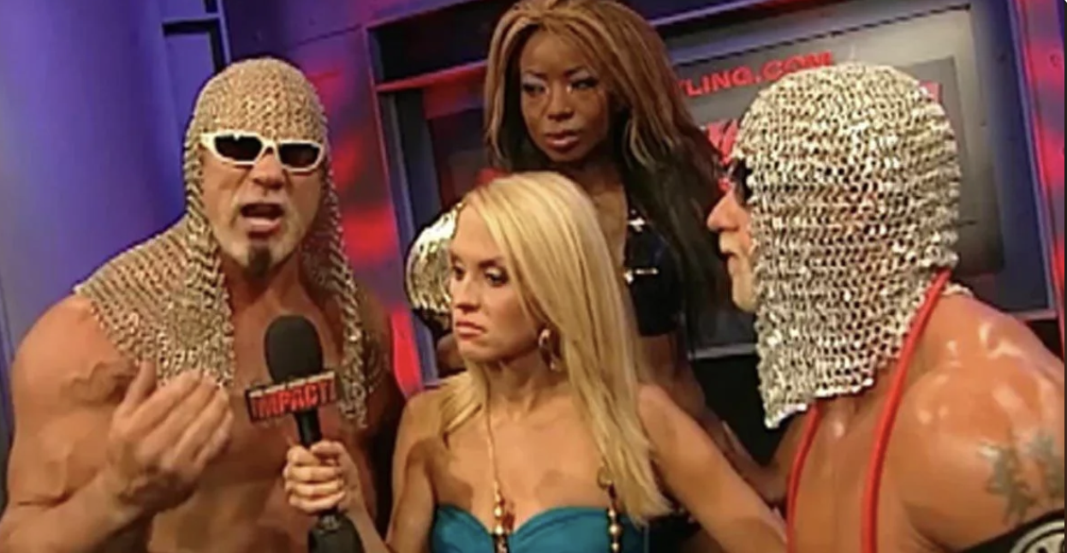
WWH Calculus
Not to be confused with
WWE Math!
Central Valley Way to Math Success – Fresno, March 2025

