Slide 1
Pre-Requisite Validation 2025-27 Nathan Cahoon Taft College

Slide 2
Thank you
John Spevak
Ben Duran
Angel Ramirez
All of CVHEC!

Slide 3
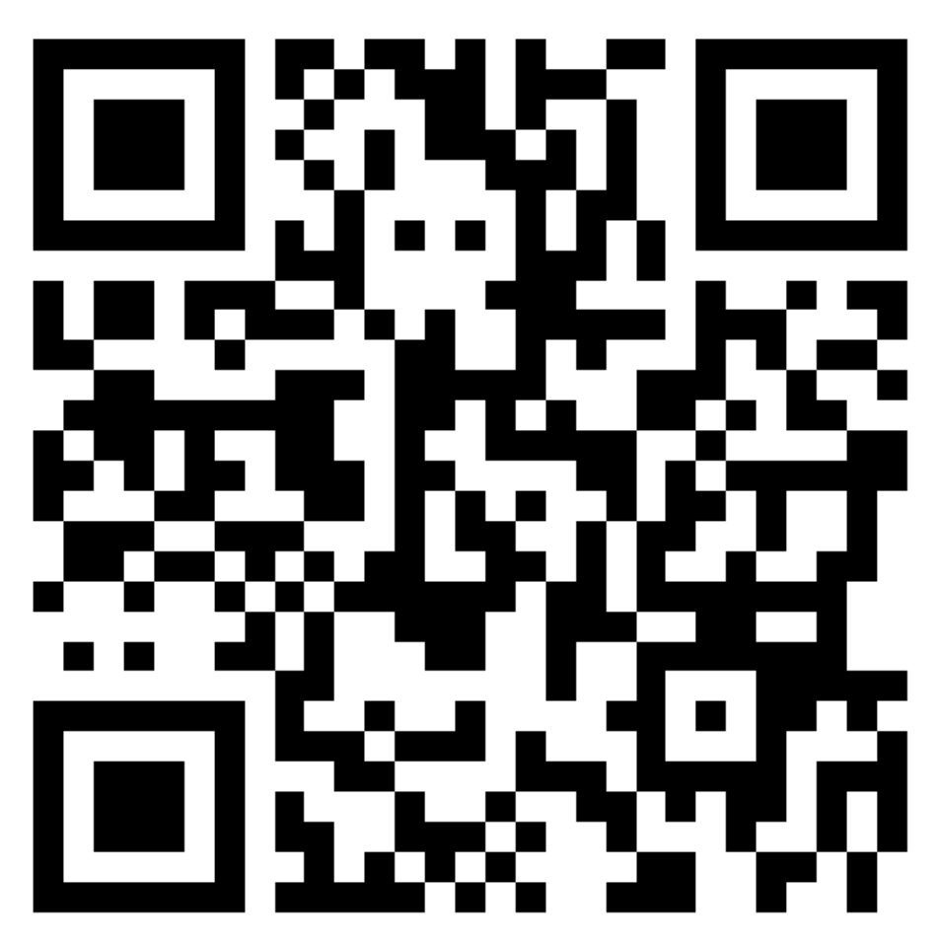
Questions for 2025-27 Validation
Please scan the QR code and log in with your name and college. Class code is 1. Select “Question/Response” in the upper right corner. Type your question in the “your question” field. You can then select “private” for a direct response with your name or “anonymous” if you prefer. Then hit send.

Slide 4
Items to review:
Did your college get a “compliance” email?👍👎🏻
CCCCO Communication (by email)
Data collection form: https://docs.google.com/spreadsheets/d/1htW5d5Ddrp5bVmtPAQflxGR3y_y4kOL_/edit?gid=210323975#gid=210323975
Webinar questions

Slide 5
CCCCO Communication by email AB1705@cccco.edu

Slide 6
Questions regarding the Dec. 10 AB 1705 Memo:
Does the new placement matrix completely replace the previous one from page 5 of the Feb 27, 2024 Memo?
Answer: Yes, the STEM calculus pathway placement rules specified in recently released Academic Affairs memo 24-69 replaces past memo ESLEI 24-15 (Feb 2024) on STEM calculus placement guidance.

Slide 7
Questions regarding the Dec. 10 AB 1705 Memo:
Is the GPA condition no longer in force?
Answer: Correct for students entering the STEM calculus pathway. The STEM calculus pathway placement rules specified in recently released Academic Affairs memo 24-69 replaces past memo ESLEI 24-15 (Feb 2024) on STEM calculus placement guidance. Previous AB 705 guidance still applies to students entering other quantitative reasoning pathways.

Slide 8
Questions regarding the Dec. 10 AB 1705 Memo:
What will the validation Fall ‘25-'27 consist of? –
Answer: Validation of STEM calculus pathway placement and initial math enrollment is described on page two of the recently released Academic Affairs memo 24-69, and states:
AB 1705 specifies that colleges must examine the impact of placing and enrolling students into transfer-level courses in order to verify the benefit of transfer-level math preparatory courses for STEM Calculus 1 by showing all of the following:
The student is highly unlikely to succeed in the first STEM calculus course without the additional transfer-level preparation.
The enrollment will improve the student’s probability of completing the first STEM calculus course
The enrollment will improve the student’s persistence to and completion of the second calculus course in the STEM program, if a second calculus course is required.

Slide 9
Questions regarding the Dec. 10 AB 1705 Memo:
Are we still held to the 15% Calc and 50% Pre-calc throughput, as noted previously?
Answer: Yes, the throughput rates remain the same as noted in previous guidance from the Chancellor’s Office (AB 1705 STEM FAQ).

Slide 10
Questions regarding the Dec. 10 AB 1705 Memo:
Are courses offered before calculus in sequence capped at 4 credits, as noted earlier?
Answer: Existing courses can be used. Colleges are encouraged to determine the effectiveness of these courses. The unit cap applies to newly developed innovative courses as noted in memo ESLEI 24-15.

Slide 11
Data collection form:
https://docs.google.com/spreadsheets/d/1htW5d5Ddrp5bVmtPAQflxGR3y_y4kOL_/edit?gid=210323975#gid=210323975

Slide 12
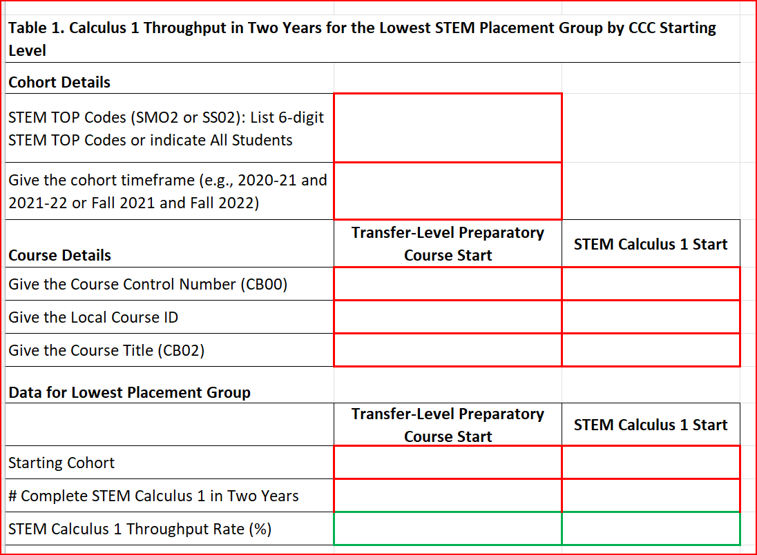
Data collection form:

Slide 13
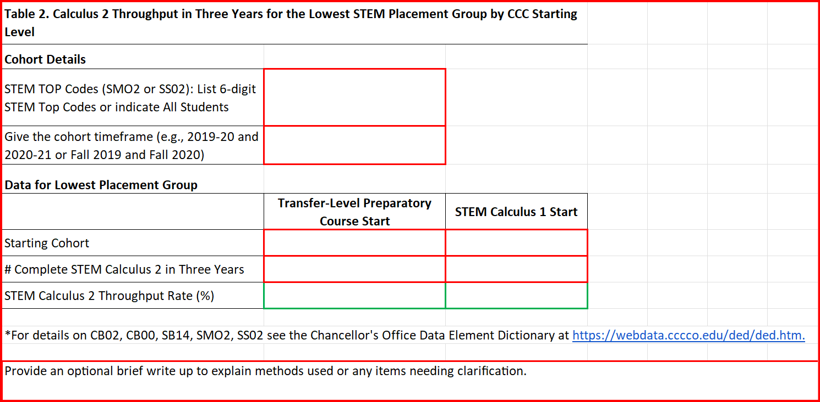
Data collection form:

Slide 14
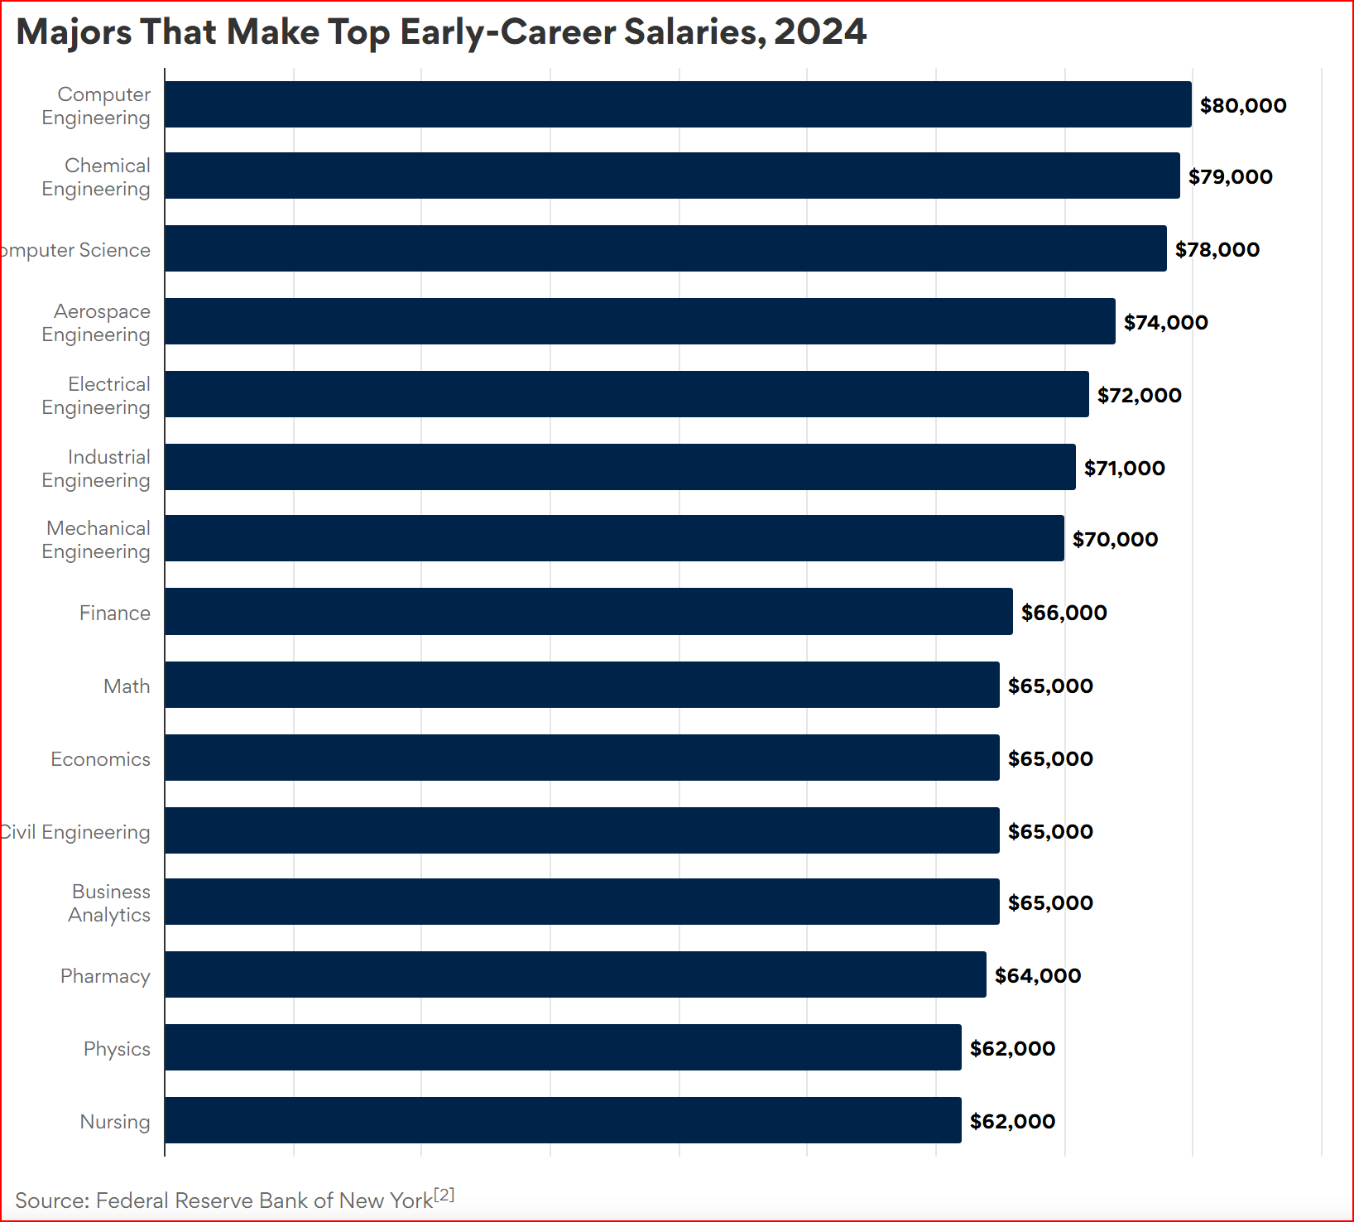
Ghosts
No data is collected or analyzed before census.

Slide 15
Ghosts
I am very concerned that we are not generally considering students who drop before census. We have had discussions with students who, when told that they cannot take any transfer-level preparatory classes before calc, decide to not enter STEM
Mallory Newell (The RP Group/De Anza College)
That is a very great question that should be explored locally. The CCCCO does not collect these data from colleges, so it is not possible to track at the system.

Slide 16
Options and voices
Are we collecting and listening to student voices?
At the Senate hearing, students asked for a choice!

Slide 17
Thank you
Nate Cahoon
661-293-0059
ncahoon@taftcollege.edu

Slide 18
Q & A
Q:
Can we require that low-level students take the corresponding co-requisite for each designated course?
2 levels below Calc?
1 level below Calc?
Calc?
A:
Corequisites can be required with local validation that they improve a student’s likelihood of success in the primary course. Note this is a lower standard than prerequisites that require showing a student is “highly unlikely to succeed” without the prerequisite.

Slide 19
Q & A
Q:
What is the specific quantitative threshold that we are required to meet to require co-requisites?
A:
At the local level, corequisite courses go through the process detailed in the Board policy developed by the district, which could be Content Review with Statistical Validation or Content Review alone. In most cases faculty create or suggest which course they believe should become a corequisite, a review is then done, and approval/non approval is by the curriculum committee.

